Slide 1
Linking Stack Overﬂow to Issue Tracker for Issue Resolution 2014 Tao Wang†, Gang Yin†, Huaimin Wang†, Cheng Yang†, Peng Zou

Slide 2
Abstract
Issue resolution is a central task for software development
Stack Overﬂow：knowledge for issue resolution
CrossLink, an analysis framework that automatically introduce related posts in Stack Overﬂow to issues in Android Issue Tracker.
CrossLink explores the semantic similarities as well as the temporal associations between the two types of repositories to recommend Stack Overﬂow posts to Android issues.
The internal links in Stack Overﬂow are also employed to improve the linking accuracy
The experiments prove the eﬀectiveness of CrossLink with precision of 62.51% for top-10 recommendations, which is signiﬁcantly higher than the state-of-art method.

Slide 3
Introduction&Motivation
It is estimated to take as much as 50% of the eﬀorts among all development tasks
bug reports in issue tracking systems often provide inadequate or even incorrect information
The rich and high-quality contents in Stack Overﬂow make it a valuable external source of knowledge for issue resolution

Slide 4
Introduction&Motivation
Firstly, the extensive participants in SO provide rich information for issue ﬁxing. 370,000 developers,Discuss covers about 87% of Android platform API classes.
Secondly, the high-quality contents in SO provide more precise information for issue ﬁxing. Voting and reputation mechanism which motivates users to provide high-quality questions and answers
Thirdly, the quick response in SO can motivate bug reporters to participate in and provide more additional information. Android Issue Tracker: 31 days; SO:13mins
Overall, linking related SO posts to issues will introduce the external crowds in SO to Issue Tracker for issue ﬁxing, and thus improve the eﬃciency of issue resolution

Slide 5
Overview of CrossLink
Data Extraction:
three types of information are extracted from the issues and SO posts.
1.the text contents including the titles and tags of issues/posts, issue/post contents and corresponding answers. For a given issue in Android Issue Tracker or a question post in SO, the issue/post and the corresponding answers are organized into issue thread or post thread. We treat the text contents of an issue/post thread as a whole to represent the issue/post.
2.the internal links in SO posts which are added by questioners or answerers to refer to other related posts.
3.the temporal attributes, including the reporting and responding time of issue and post threads.

Slide 6
Overview of CrossLink
Similarity Model Training
the internal links are employed to cluster posts in SO. The extracted thread texts are used to build the Semantic Similarity Model, and the temporal attributes are employed to build the Temporal Locality Model.
At building the semantic and temporal
models, the post clusters instead of each single post thread are used. Then these models are integrated as the Synthesized Similarity Model.

Slide 7
Overview of CrossLink
Links Recommendation
the thread texts and temporal attributes of a query issue are used as the input of the Synthesized Similarity Model. Based on the synthesized similarity between the issue and all the post clusters, a list of post clusters will be returned as potential associations

Slide 8
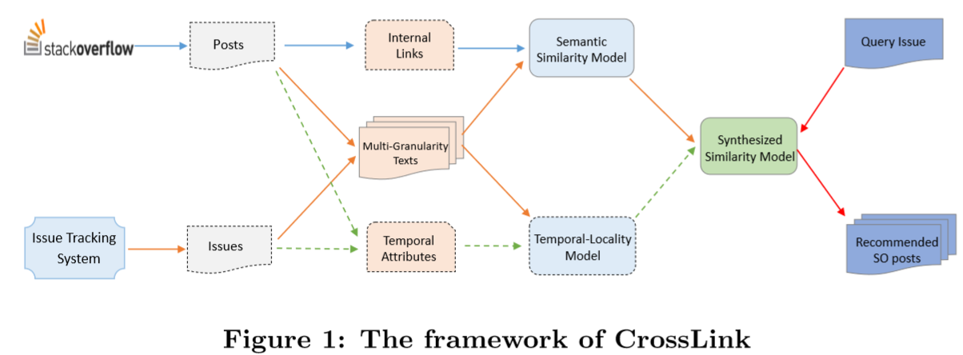
Overview of CrossLink

Slide 9
Internal Links and Semantic Similarity
The internal links in SO posts and the semantic similarities between them are leveraged to cluster the posts. These links connect posts around similar questions and form inter-connected knowledge graph.
However, among these links a proportion of them may transfer to other topics which are not so coherent to the core question. So, divide large connected graph into small isolated clusters.
1.construct a weighted undirected graph, in which the nodes are the posts and the edges are the existing links
(if no links in and out, it will be an isolated note in the graph, The weight of an edge is the semantic similarity between two connected posts, We delete these edges with weights less than the predeﬁned threshold)
This departs the large connected graph into smaller closely coupled ones

Slide 10
Internal Links and Semantic Similarity
2. Then the remain large graphs will be departed by deleting the links with smallest weight until the diameters of all connected graphs are less than the given threshold
(By several iterations of experiments and manual analysis, we set the similarity threshold as 0.3 and the diameter threshold as 4 which can cluster these posts with best internal cohesion)
3. For a given issue and a post cluster, we ﬁrstly calculate the semantic similarity between the issue and each post in the cluster. Then the largest value of similarity is selected to represent the semantic similarity between the issue and the post cluster.
Vector Space Model and TFIDF are used to represent the issues and posts, which transforms documents into weighted vectors.

Slide 11
Temporal Locality
Android has thousands of developers (There are 58,112 participants in Android Issue Tracker and 171,152 ones in Android-related posts in SO).
the time the issue report arise in Issue Tracker and that the questions posted in SO should be temporally related, which we call temporal-locality
There are many shared participants who are active in both communities. For a given participant, his activity over the same topic in both communities should be temporally close.
if a post and an issue are similar in semantic and meanwhile the responding time are close, we can assume that the responses may come from the same developer, and thus raise the probability that the post and issue are correlated.
timeintervals(i,j) is a set of time intervals between the issue and posts cluster i and j, including the reporting and responding time intervals with unit of “day”.

Slide 12
Synthesized Similarity
For those issues and post clusters which have similar level of semantic similarity, if the reporting time or responding time is close, the probability that they are correlated will be higher
α and β as 0.5
recommendation, we take the strongly-connected posts as a whole

Slide 13
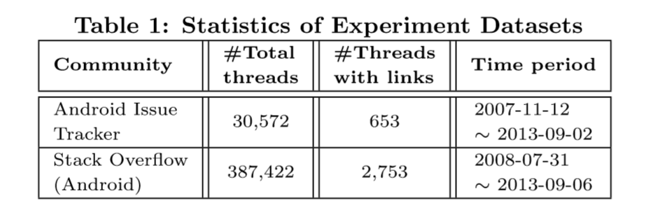
EVALUATION AND IMPLEMENTATION
Android Issue Tracker and Android-related posts in SO
We use these issues as the query issues and the contained links as the ground-truth to test the tool CrossLink

Slide 14
Evaluation Metrics
where Q means the set of query samples. For resulti, if the correct answer appear in the top-k results, then its value is 1, elsewhere 0
Mean Reciprocal Rank(MRR) of Top-K, which represent how many links are correctly predicted and the average rank of correct links in Top-K recommendations.
RankKi is the rank of the correct answer in the top-k recommendations

Slide 15
result
We compare the performances of diﬀerent approaches which based on the Semantic Similarity(SS), combination of Semantic similarity and Temporal Similarity(STS), and the combination of Semantic, Temporal and internal Links(STL) respectively for recommendation.
top 10

Slide 16
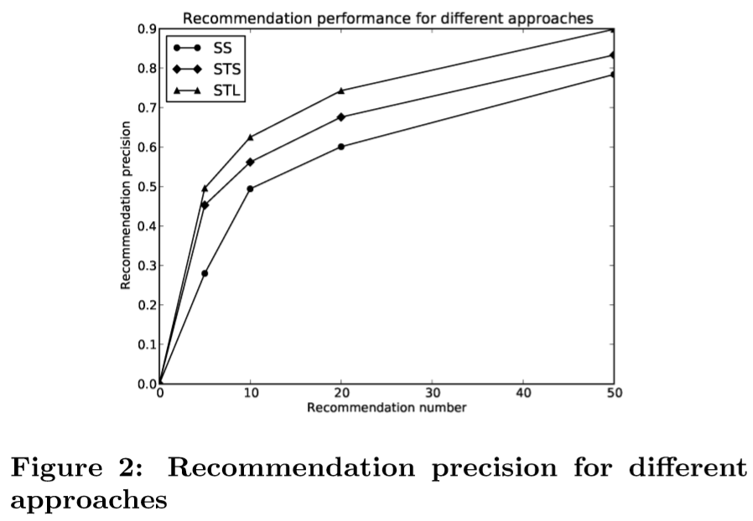
result
the actual precision should be higher than the results presented here

Slide 17
Thanks

