Slide 1
GitHub Projects.
Quality Analysis of Open-Source Software
Oskar Jarczyk, Blazej Gruszka, Szymon Jaroszewicz, Leszek Bukowski,and Adam Wierzbicki
the series Lecture Notes in Computer Science, springer
Presented by Yutao Huang

Slide 2
Introduction
Very often Open-Source Software (OSS) is developed by decentralized teams of programmers, who cooperate globally using web-based source code repositories.
There are several features typically associated with such Collaborative Innovation Networks (COINs): (a) voluntary work; (b) low organizational costs; (c) meritocracy.
COINs’s typical example is Github website.

Slide 3
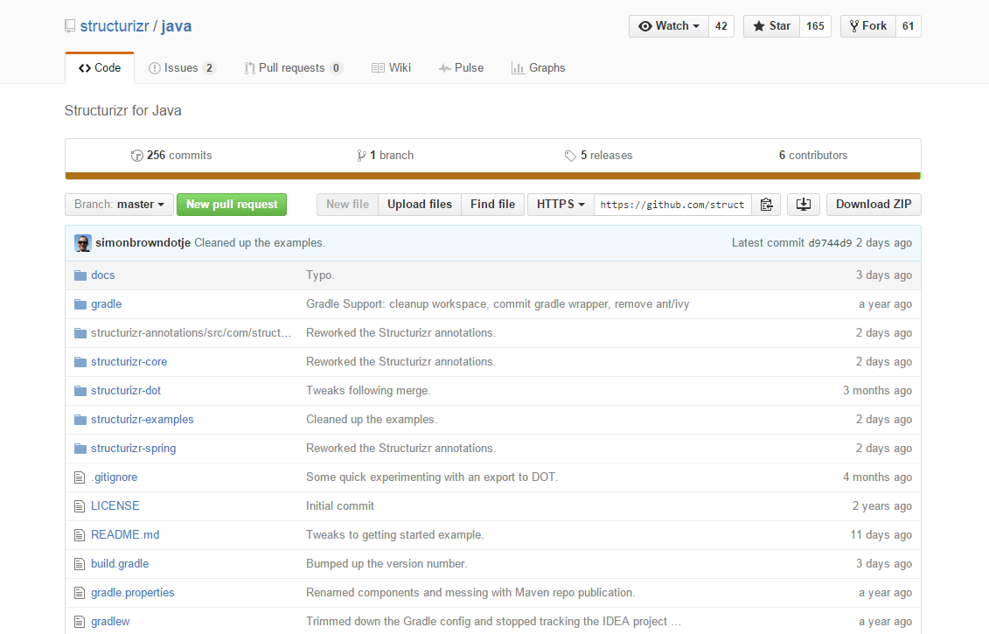

Slide 4
Introduction
This paper finds the interest in investigating if there are any significant correlations between project quality and characteristics of the team members.
Consider project quality as consisting of two aspects: one is the number of stars that any project might receive from GitHub users,
and the second one is the response of project team to issues reported for a given repository.

Slide 5
Dataset
Data source for projects:
Selected 2000 of the github repos with the highest increase in popularity during a month.
Popularity is measured by the project’s number of stars(stargazers).
Tools: Google BigQuery

Slide 6
Dataset
Each record in the dataset has 12 Columns:
’repository owner’
’repository url’
’repository name’
’biggest increase in popularity’
’repository description’
’is a fork’
’wiki enabled’
’when pushed at’
’master branch’
’issues enabled’
’downloads enabled’
’repository creation date’

Slide 7
Dataset
Receiving information on developers in those entry teams from the 2000 repos:
’date when developer registered’
’developer location’
’is developer hireable’
’is developer working during business hours’
’developer typical working period’
’gists count’
’private repos count’
’developer username (login)’
’developer name’
’developer followers count’
’developer following count’
’developer company’
’number of repos developer contributed to’
’number of repos he owns’

Slide 8
Dataset
Repositories issues attributes:
repository owner (a person or organization who manages the code repository as a privileged user),
repository url (an 1-1 identifying repository key, a web address which
allows to view the repository in a browser),
repository name,
issue number,
issue status (opened or closed),
’opened at’ (when was the issue created),
’closed at’ (when was the issue last time resolved),
difference in minutes (also hours and days, difference between fields ’opened at’ and ’closed at’).

Slide 9
Dataset
Since we are drawing conclusions on the whole projects, not individual developers, characteristics of project members had to be aggregated into single attributes.
Here, we use average to measure each attribute.
Many attributes exhibited highly skewed, power-law like distributions, which are difficult to model with statistical methods. Logarithmic transformation x = log10(x + 10) has been applied to the following attributes to decrease the skew.

Slide 10
Measures of the project’s quality
To discover factors influencing project quality we need to be able to precisely measure project quality is not an easy task.
Two Github project quality metrics:
Attractiveness and Popularity – Stargazers
Quality of Support – Survival of Issues

Slide 11
Attractiveness and Popularity – Stargazers
Since the stargazers count follows a power-law distribution (it means there are lots of projects with few stars and a few projects with a very large number of stars).
We applied logarithmic transformation x = log10(x + 10) before using it as a metric of project quality.

Slide 12
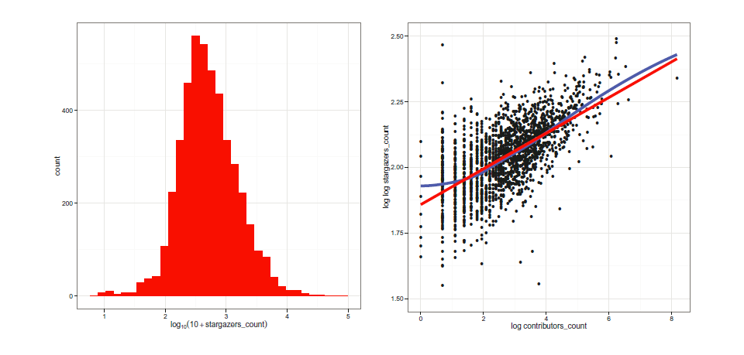
It is not yet clear to us whether it is the project’s popularity that attracts contributors or, vice-versa, the large number of contributors results in good and, consequently, popular projects.

Slide 13
Quality of Support – Survival of Issues
Survival analysis typical question:
What is the proportion of a population which survived a certain amount of time?
In case of Github Issues:
What proportion of issues was not closed before some particular point in time?

Slide 14
Quality of Support – Survival of Issues
A key aspect of survival analysis is censoring - if an issue was opened just a month ago, at the current time point we do not know, whether it will be closed within a year or not.
In order to handle censoring in a statistically proper way we use the Kaplan-Meier estimates of survival time for issues of a given project.

Slide 15
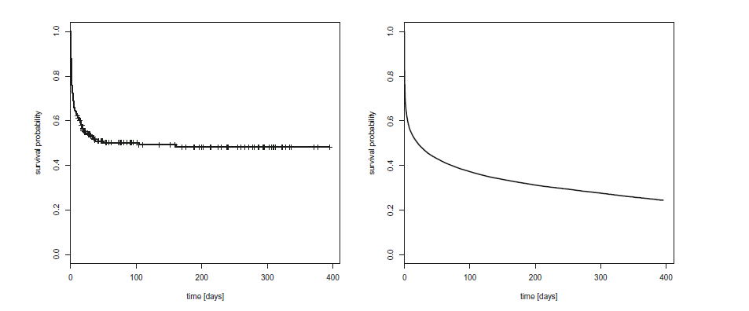
The left part shows the survival curve for issues of an example project.
The right part shows the combined survival curve for
issues of all analyzed GitHub projects.

Slide 16
Quality of Support – Survival of Issues
In order to facilitate the assessment of project quality, we devised summary metric for survival curves. To this end, we computed survival probabilities for issues after 1, 2, 3, 7, 30, 100, and 365 days.
Performing the PCA (Principal Components Analysis ) on those probabilities revealed that just two components are enough to explain 96% of the variance of the seven probabilities.

Slide 17
Quality of Support – Survival of Issues
Further, the first component describes (roughly) the average of the percentages of bugs closed after different amounts of time, and the second one differentiates the probabilities of issues being closed rapidly, in a matter of days.
Consequently, we decided to summarize the survival curve for each project with just two numbers: the percentage of issues closed after 3 and 365 days. It turned out that those two numbers explain about 94% of the total variability of the seven issue survival probabilities—almost the same as the first two principal components—while being much easier to understand.

Slide 18
What Affects the Project Popularity?
Application of linear regression resulted in a model with a very high multiple R² coefficient of 0.779.
In other words, almost 80% of the variability of projects popularity (after the logarithmic transform) is explained by project features.
However, these features which has significant impacts on the model like forks_count, we have to exclude them since they are more likely to be the effects, not the reasons which affect the project popularity.
So we redesign the model by reducing these attributes.

Slide 19
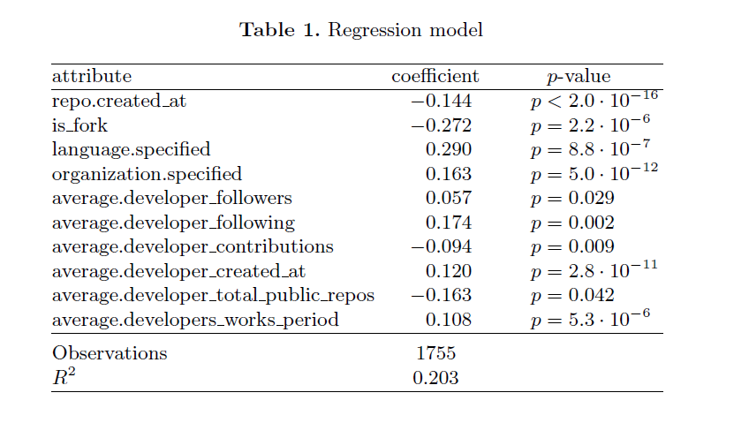

Slide 20
Programming language
Since there are 55 values (54 specified languages and 0 for no language specified) for the programming language attribute, we exclude them from the initial analysis and build a regression model based on just one attribute, repository language.
Conclusion: programming language has little effect on the projects
popularity.
Exception:
Common Lisp: coefficient -0.702 p-value 2.3 · 10⁻³
No specified language: less popular
CSS: more popular

Slide 21
What Affects the Quality of a Support?
Since the survival probabilities are not normally distributed, we
have used binomial regression (a variant of logistic regression) to model it.

Slide 22
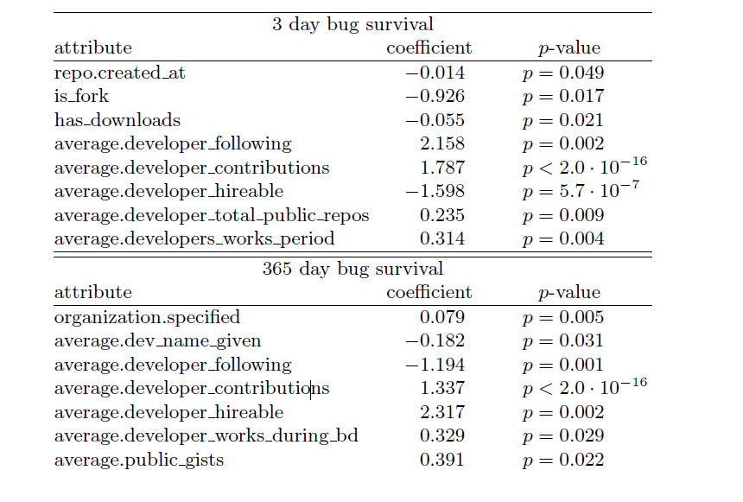

Slide 23
Conclusion
Our paper presented two measures of quality for GitHub Open-Source Software projects.
One is based on a project popularity, the other one is based on how
fast the project’s team solves issues reported by users.
Interesting discovery:
It is better for a software project to have focused developers involved in the community rather than having in the team popular, often followed developers.

Slide 24
Thank you!

