Slide 1
It Takes Two to Tango: an Exploration of Domain Pairs for Cross-Domain Collaborative Filtering
Shaghayegh Sahebi¹ and Peter Brusilovsky^{1,2}
1 Intelligent Systems Program, University of Pittsburgh 2 School of Information Sciences, University of Pittsburgh
@pawslab

Slide 2
Our Goals
Explore added value of cross-domain recommendations
compared to single-domain recommenders
Characterize useful auxiliary domains for a target domain
Or promising domain-pairs

Slide 3
How We Got There: Ideas
Using external information for better recommendation (especially in cold-start)
Using ratings/data from external domain (i.e., books rating to recommend movies) – does it help?
Some pairs can tango, some can’t. What’s the secret?
Canonical correlation could be the key
Could we also use it as recommendation approach?

Slide 4
How We Got There: Papers
Sahebi, S., Wongchokprasitti, C., and Brusilovsky, P. (2010) Recommending research colloquia: a study of several sources for user profiling. In: Proceedings of the 1st International Workshop on Information Heterogeneity and Fusion in Recommender Systems (HetRec 2010) at RecSys 2010
Sahebi, S. and Brusilovsky, P. (2013) Cross-Domain Collaborative Recommendation in a Cold-Start Context: The Impact of User Profile Size on the Quality of Recommendation. In: Proceedings of UMAP 2013
This paper

Slide 5
Our Work
Propose to use Canonical Correlation of the domains as the main factor for domain analysis
Propose a cross-domain recommender system based on Canonical Correlation Analysis (CCA)
Analyze 158 domain pairs to find out:
Whether the recommendation algorithm also matters in the cross-domain recommendation results;
the data characteristics that affect the prediction error of approaches;
the domain-pair characteristics that affect the amount of recommendation improvements;
and the nature of suitable domain pairs.

Slide 6
Canonical Correlation Analysis
Multivariate statistical model
interrelationships among sets of multiple dependent and multiple independent variables
Goal: produce the maximum correlation between the dimensions
linear combination representing the weighted sum of two or more variables
relationship between two linear composites: strength of the relationship between the sets of variables

Slide 7
Canonical Correlation Analysis (2)
b₂
m₂
b₁
m₁
0.2b₂+0.8b₁
0.7m₂+0.3m₁

Slide 8
Canonical Correlation Analysis (3)
Notes:
The value \rho shows the maximum canonical correlation that can be achieved by rotating the X and Y spaces in direction of wx and wy, respectively.

Slide 9
Application of CCA to Cross-Domain Recommenders
Common users in two domains
Dependent variables: items in target domain
Independent variables: items in source domain
Calculates components of each domain
2 sets of items
most similar to each other based on user rating behavior
Determines how much the two components are correlated to one another

Slide 10
CCA-based Cross-Domain Recommender (CD-CCA)
Projection vectors w_{x} and w_{y} show:
how the ratings in source domain (X) affect the ratings in target domain
how much this effect is

Slide 11
CD-CCA (2)
Estimate ratings in target domain (Y) by using:
projection vectors (w_{x} and w_{y});
source domain ratings (X);
and canonical correlation value (ρ)

Slide 12
Propose to use Canonical Correlation of the domains as the main factor for domain analysis
Propose a cross-domain recommender system based on Canonical Correlation Analysis (CCA)
Analyze 158 domain pairs to find out:
if the recommendation algorithm also matters in the cross-domain recommendation results;
the data characteristics that affect the prediction error of approaches;
the domain-pair characteristics that affect the amount of recommendation improvements;
and the nature of suitable domain pairs.

Slide 13
The Design
Yelp academic dataset
21 categories (domains)
ratings between 1 and 5
Does it depends on a pair
Evaluate cross-domain recommendation on all meaningful pairs
Does the algorithm matter?
Compare 2 cross-domain and one single-domain approaches

Slide 14
Yelp Dataset
A rich dataset containing a varied set of domain characteristics
 | Min | Max | Mean | Median
Number of Users | 9 | 11013 | 1064.09 | 424
Number of Items | 8 | 4435 | 406.89 | 252.5
Rating Density | 0.0017 | 0.1581 | 0.017 | 0.0084
Notes:
Density = ratio of ratings to the number of possible ratings OR #Ratings/(#Users * #Items)

Slide 15
Which Pairs Can Tango?
Exclude category pairs that #common_users < #items
158 domain pairs
Run Experiments twice per domain pair
switching the source (independent) and target (dependent) domains (variable sets)

Slide 16
The Role of the Approach
Single-domain setting (SD-SVD): using only target domain’s ratings
Does not consider information from source domain
Cross-domain setting (CD-SVD): concatenating source and target rating matrices
Users information from the source domain, but maybe not in the best way
CD-CCA as the main approach
Possibly, maximizing the value of source information

Slide 17
Experimental Setup
Baseline: SVD++
Single-domain setting (SD-SVD): using only target domain’s ratings
cross-domain setting (CD-SVD): concatenating source and target rating matrices
 |  | ? |  |  | ?
 | ? |  |  | ? |  |  | ?
 |  | ? |  |  | ?
 | ? |  |  | ? |  |  | ?
Common Users
Target Items
Source Items
All Items

Slide 18
Experimental Setup (2)
5-fold user-stratified cross-validation on target domain
80% of the users in training; 20% of the users in testing; 15% of train as validation set (for finding parameters)
to obtain a partial profile for each user
add 20% of each test user's target ratings to training
? |  | ? | ? | ? | ? | ?
? | ? |  |  | ? | ? | ? | ?
Eval Users
Training Target Data
Train Users
Testing Target Data
Test Users

Slide 19
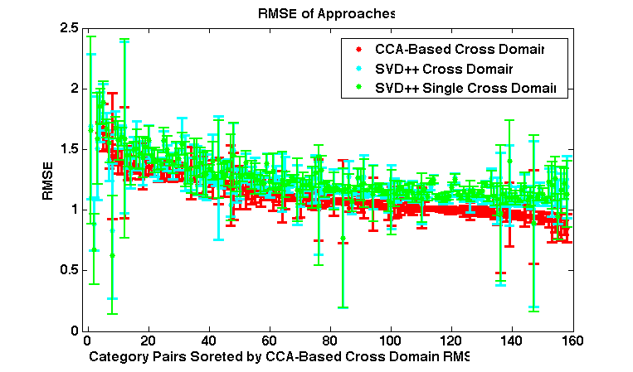
Results: Mixed Results for RMSE of Domain Pairs
Notes:
Explanation of the figure: It shows the RMSE of algorithms on each domain-pair with errorbars (confidence interval = 95%)
domain pairs on X axis, sorted based on RMSE of CD-CCA (to show the trend correlation between RMSEs of algorithms) The results show that in some domain pairs, cross-domain algorithms are performing better than single-domain and in some domains they don’t.
Also, the trend shows that RMSE of different algorithms are correlated in domain-pairs

Slide 20
RMSE of Approaches are Correlated
If RMSE is low in single-domain, it is most likely low for cross-domain, and vice versa
**: significant with p_value < 0.01
Correlation (R-Values) | CD-CCA | CD-SVD | SD-SVD
CD-CCA | - | 0.7896** | 0.7779**
CD-SVD | 0.7896** | - | 0.9550**
SD-SVD | 0.7779** | 0.9550** | -

Slide 21
Propose to use Canonical Correlation of the domains as the main factor for domain analysis
Propose a cross-domain recommender system based on Canonical Correlation Analysis (CCA)
Analyze 158 domain pairs to find out:
if the recommendation algorithm matters in the cross-domain recommendation results;
the data characteristics that affect the prediction error of approaches;
the domain-pair characteristics that affect the amount of recommendation improvements;
and the nature of suitable domain pairs.
21

Slide 22
What is the Approach Effect on Recommendation Results?
Cross-domain collaborative filtering either improves, or will not significantly change results
CD-CCA >* SD-SVD in 77 domain pairs;
CD-CCA >* CD-SVD in 74 domain pairs;
CD-SVD >* SD-SVD in 9 domain pairs;
In rest of the domain pairs: work similarly
The algorithm matters: CD-CCA captures more common information than CD-SVD

Slide 23
Propose to use Canonical Correlation of the domains as the main factor for domain analysis
Propose a cross-domain recommender system based on Canonical Correlation Analysis (CCA)
Analyze 158 domain pairs to find out:
if the recommendation algorithm also matters in the cross-domain recommendation results;
the data characteristics that affect the prediction error of approaches;
the domain-pair characteristics that affect the amount of recommendation improvements;
and the nature of suitable domain pairs.

Slide 24
What Data Characteristics Affect Prediction Error?
Study correlation of domain characteristics with RMSE
user space size, items space size, domain densities
*: significant with p_value < 0.05
Correlation (R-Values) | User Size | Target Item Size | Source Item Size | Target Density | Source Density
CD-CCA | -0.1782* | -0.1250 | -0.1239 | -0.0502 | 0.0515
CD-SVD | -0.1745* | -0.1445 | -0.1274 | -0.1346 | -0.1161
SD-SVD | -0.1455 | -0.1225 | - | -0.1525 | -

Slide 25
What Data Characteristics Affect Prediction Error?
The more common users, the better the cross-domain recommendations
Other factors are insignificant

Slide 26
Propose to use Canonical Correlation of the domains as the main factor for domain analysis
Propose a cross-domain recommender system based on Canonical Correlation Analysis (CCA)
Analyze 158 domain pairs to find out:
if the recommendation algorithm also matters in the cross-domain recommendation results;
the data characteristics that affect the prediction error of approaches;
the domain-pair characteristics that affect the amount of recommendation improvements;
and the nature of suitable domain pairs.
26

Slide 27
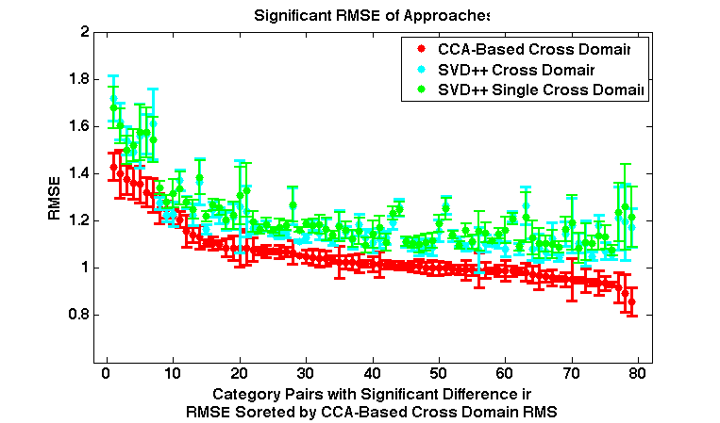
What Data Characteristics Affect Cross-Domain Recommendation Improvement?
Notes:
Explanation of the figure: It shows the RMSE of algorithms on domain-pai rWITH SIGNIFICANT DIFFERENCE BETWEEN RMSE OF APPROACHES ONLY with errorbars (confidence interval = 95%)
domain pairs on X axis, sorted based on RMSE of CD-CCA (to show the trend correlation between RMSEs of algorithms) The results show that if there is a significant difference between CD_CCA and SD_SVD (orCD_SVD), CD_CCA is always performing better OR CD_CCA is NEVER significantly worse than the other two

Slide 28
What Data Characteristics Affect Cross-Domain Recommendation Improvement? (2)
Additional domain characteristics:
user size to item size ratio
source item size to target item size ratio
source density to target density ratio
percentage of CCA correlation coefficients > 0.8, 0.9, and 0.95
Improvement Ratio (IR)
Notes:
We define improvement ratio to understand what domain characteristics result in more improvement of cross-domain vs. single-domain

Slide 29
What Data Characteristics Affect Cross-Domain Recommendation Improvement? (Single-Domain Features)
Correlations (R-value) | User Size | Source Item Size | Target Item size | Source Density | Target Density
CD-CCA vs. CD-SVD | 0.3924*** | 0.3292** | 0.4332*** | -0.4450*** | -0.7313***
CD-CCA vs. SD-SVD | 0.3287*** | 0.2825* | 0.4206*** | -0.4031*** | -0.6973***
CD-SVD vs. SD-SVD | 0.3072 | 0.3989 | 0.916 | -0.6881* | -0.2070
***:significant with p_value < 0.001; **: significant with p_value < 0.01; *: significant with p_value < 0.05

Slide 30
What Data Characteristics Affect Cross-Domain Recommendation Improvement? (Cross-Domain Features)
Correlations (R-value) | User to Target Item Ratio | User to Source Item Ratio | % of CCA > 0.8 | % of CCA > 0.9 | % of CCA > 0.95 | Source to Target Density Ratio | Source to Target Item Size Ratio
CD-CCA vs. CD-SVD | 0.0565 | 0.2805* | 0.2603* | 0.3563** | 0.4000*** | 0.2723* | -0.1711
CD-CCA vs. SD-SVD | -0.0659 | 0.2207 | 0.2503* | 0.3633** | 0.4155** | 0.2096 | -0.2620*
CD-SVD vs. SD-SVD | 0.0646 | -0.3506 | 0.5999 | 0.6579 | 0.6701* | -0.4295 | 0.1343

Slide 31
What Data Characteristics Affect Cross-Domain Recommendation Improvement? (4)
Correlation with improvement ratio:
most positive correlation:
source density
percentage of CCA coefficients > 0.95
Negative correlation:
source-domain density
Target domain density
ratio of source item size to target item size
Only “user size to target item size Ratio” is not significant

Slide 32
Propose to use Canonical Correlation of the domains as the main factor for domain analysis
Propose a cross-domain recommender system based on Canonical Correlation Analysis (CCA)
Analyze 158 domain pairs to find out:
if the recommendation algorithm also matters in the cross-domain recommendation results;
the data characteristics that affect the prediction error of approaches;
the domain-pair characteristics that affect the amount of recommendation improvements;
and the nature of suitable domain pairs.
Are domain pairs with high correlation suitable cross-domain pairs?
Do domain pairs with a high improvement ratio have a high correlation factor?

Slide 33
What is the Nature of Good Domain-Pair Choices?
Are domain pairs with high correlation suitable cross-domain pairs?
Do all domain pairs with a high improvement ratio have a high CCA correlation factor? (Or is having high CCA enough?)

Slide 34
Are domain pairs with high correlation suitable cross-domain pairs?
Look at category pairs in 10percentile higher percentage of CCA correlation coefficients > 0.8
Large CCA correlation affects improvement of cross-domain recommenders in:
“Food ➔ Arts and Entertainment”
“Arts and Entertainment ➔Food”
“Restaurants ➔Food.”
Notes:
Restaurants ➔Food means source domain is “Restaurants“ and target domain is “Food“

Slide 35
Are domain pairs with high correlation suitable cross-domain pairs? (2)
For some domain pairs CD-CCA works better than CD-SVD.
Domain pairs that are inherently closer to each other, but CD-SVD doesn’t get it
“Restaurants ➔Nightlife” (and vice versa)
“Event Planning ➔Hotels & Travel” (and vice versa)
Domain pairs with high CCA that don’t look inherently similar
“Shopping ➔Arts & Entertainments”
“Pets ➔Nightlife”

Slide 36
Is High CCA Enough?
High IR and low CCA
“Education ➔Local Flavor”
Source and target domains' item sizes and user sizes are low
“Event Planning ➔Active Life”
high user size and target item size, low source to target item size ratio and target and source sparsity
High CCA and not significant improvement ratio
“Home Services ➔Professional Services” (and vice versa)

Slide 37
Conclusions
Proposed to use Canonical Correlation of the domains as the main factor for domain analysis
Proposed a cross-domain recommender system based on Canonical Correlation Analysis (CCA)
Analyzed 158 domain pairs characteristics with cross and single-domain recommendation results

Slide 38
Conclusions
Number of common users is an important factor for RMSE of cross-domain recommenders
Canonical Correlations
An important factor in increasing quality improvement ratio and determining suitable domain pairs
Other factors affect improvement ratio
source and target domain densities, number of common users, and number of items
Although some domain pairs do not seem similar, they might share hidden and useful information that can be captured by CCA
However relying only on CCA might not be enough

Slide 39
Thank You!
peterb@pitt.edu
shs106@pitt.edu

