Slide 1
Recursive Deep Models for Semantic Compositionality Over a Sentiment Treebank
Socher R, Perelygin A, Wu J Y, et al. Recursive deep models for semantic compositionality over a sentiment treebank[C]//Proceedings of the conference on empirical methods in natural language processing (EMNLP). 2015, 1631: 1642.

Slide 2
Introduction
Example of the Recursive Neural Tensor Network accurately predicting 5 sentiment classes, very negative to very positive (– –, –, 0, +, + +), at every node of a parse tree and capturing the negation and its scope in this sentence.

Slide 3
Introduction

Slide 4
Recursive Neural Models
Ws ∈ R 5×d is the sentiment classification matrix

Slide 5
RNN: Recursive Neural Network
e f = tanh is a standard element-wise nonlinearity

Slide 6
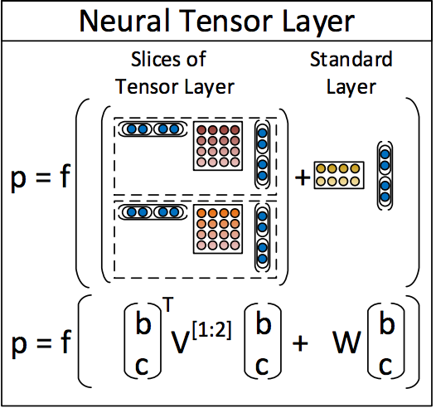
RNTN:Recursive Neural Tensor Network

Slide 7
Tensor Backprop through Structure

Slide 8
Experiments
Accuracy for fine grained (5-class) and binary predictions at the sentence level (root) and for all nodes

Slide 9
Experiments
Accuracy curves for fine grained sentiment classification at each n-gram lengths. Left: Accuracy separately for each set of n-grams. Right: Cumulative accuracy of all ≤ n-grams.

Slide 10
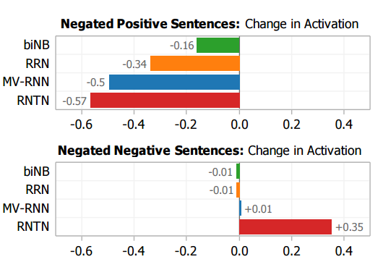
Experiments

Slide 11
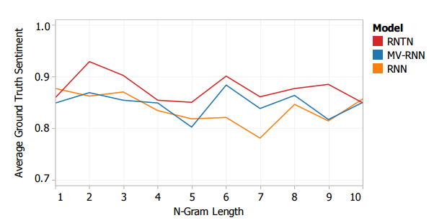
Experiments

Slide 12
THANKS

