Slide 1
Deep NLP
Wenkai Mo

Slide 2
Word2Vec Preview
Mikolov T, Sutskever I, Chen K, et al. Distributed representations of words and phrases and their compositionality[C]//Advances in neural information processing systems. 2013: 3111-3119.

Slide 3
Word2Vec Preview

Slide 4
Agenda
Optimization and Loss Function
Neutral Network
Word Vector and Neutral Network
Recurrent Neutral Network
Recursive Neutral Network
Convolutional Neutral Network

Slide 5
Agenda
Optimization and Loss Function
Neutral Network
Word Vector and Neutral Network
Recurrent Neutral Network
Recursive Neutral Network
Convolutional Neutral Network

Slide 6
Optimization and Loss Function
Generator (G) generates observations x (typically in R^{n}), independently drawn from some fixed distribution F(x)
Supervisor (S) labels each input x with an output value y according to some fixed distribution F(y|x)
Learning Machine (LM) “learns” from an i.i.d. l-sample of (x,y)-pairs output from G and S, by choosing a function that best approximates S from a parameterised function class f(x,α), where α is in Λ the parameter set
x
y
G
S
^
LM
y

Slide 7
Optimization and Loss Function
x
y
G
S
^
LM
y
Loss Function: the error between y and
Hinge Loss (SVM)
Least-Square Loss (LR)
Cross-entropy
etc.

Slide 8
Optimization and Loss Function
Optimization

Slide 9
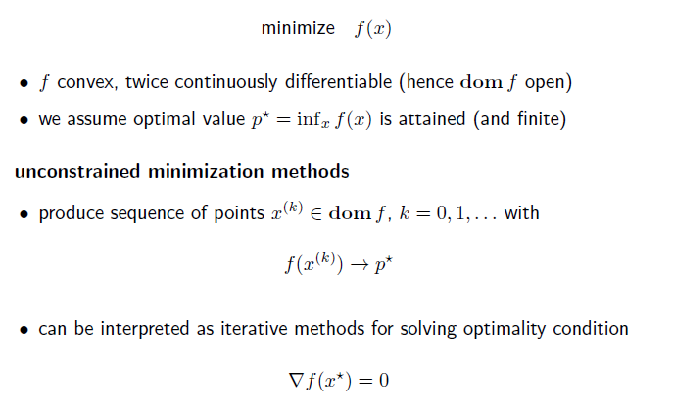
Optimization and Loss Function
Without Constrains:
First-order derivative
Inequality
Gradient Descent
Newton Method
Etc.

Slide 10
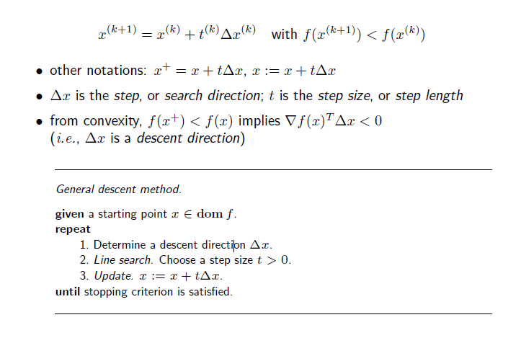
Optimization and Loss Function
Without Constrains:
First-order derivative
Inequality
Gradient Descent
Newton Method
Etc.
Notes:
Descent method

Slide 11
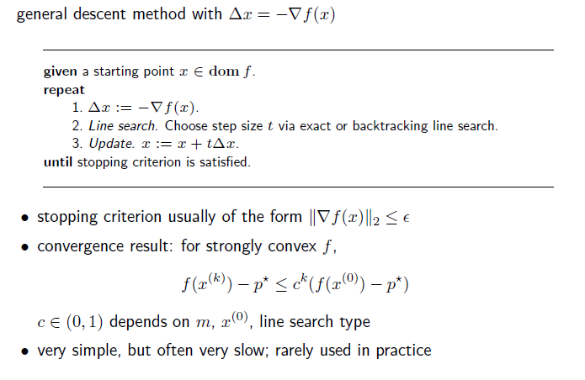
Optimization and Loss Function
Without Constrains:
First-order derivative
Inequality
Gradient Descent
Newton Method
Etc.

Slide 12
Agenda
Optimization and Loss Function
Neutral Network
Word Vector and Neutral Network
Recurrent Neutral Network
Recursive Neutral Network
Convolutional Neutral Network

Slide 13
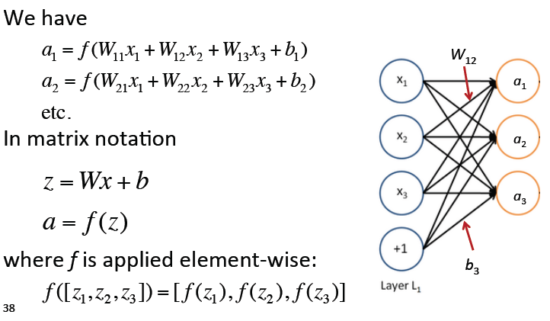
Neutral Network

Slide 14
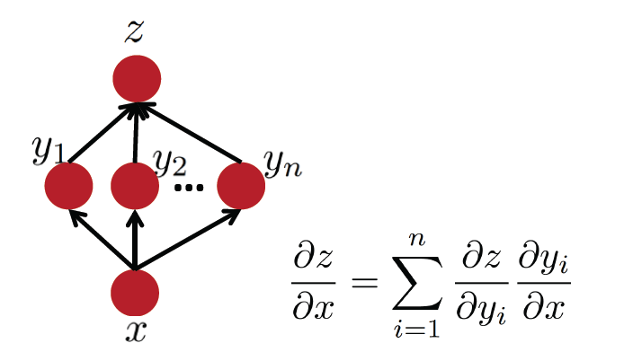
Neutral Network

Slide 15
Agenda
Optimization and Loss Function
Neutral Network
Word Vector and Neutral Network
Recurrent Neutral Network
Recursive Neutral Network
Convolutional Neutral Network

Slide 16
Neutral Network

Slide 17
Neutral Network

Slide 18
Agenda
Optimization and Loss Function
Neutral Network
Word Vector and Neutral Network
Recurrent Neutral Network
Recursive Neutral Network
Convolutional Neutral Network

Slide 19
Recurrent Neutral Network

Slide 20
Recurrent Neutral Network

Slide 21
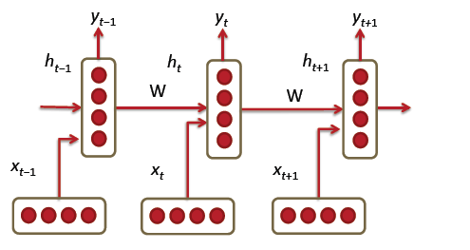
Recurrent Neutral Network
Mikolov T, Karafiát M, Burget L, et al. Recurrent neural network based language model[C]//INTERSPEECH 2010, 11th Annual Conference of the International Speech Communication Association, Makuhari, Chiba, Japan, September 26-30, 2010. 2010: 1045-1048.

Slide 22
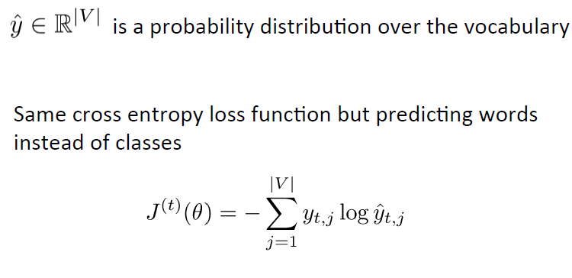
Recurrent Neutral Network

Slide 23
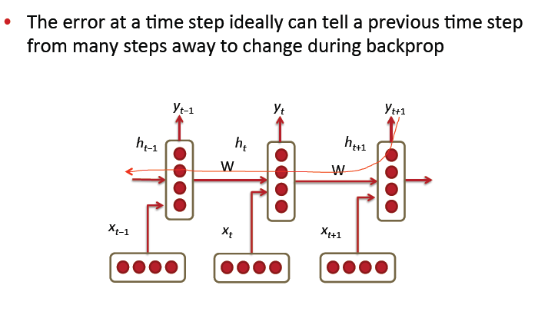
Recurrent Neutral Network

Slide 24
Recurrent Neutral Network

Slide 25
Recurrent Neutral Network

Slide 26
Recurrent Neutral Network
Irsoy O, Cardie C. Opinion mining with deep recurrent neural networks[C]//Proceedings of the 2014 Conference on Empirical Methods in Natural Language Processing (EMNLP). 2014: 720-728.

Slide 27
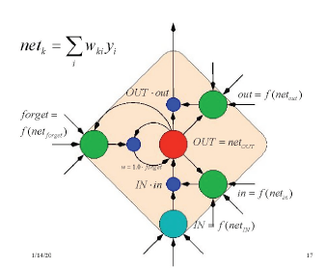
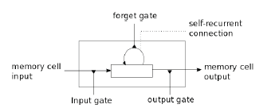
Recurrent Neutral Network
More:
Gated Recurrent Units (Cho et al. 2014)
Long-­short-­term-­memories (LSTMs)

Slide 28
Agenda
Optimization and Loss Function
Neutral Network
Word Vector and Neutral Network
Recurrent Neutral Network
Recursive Neutral Network
Convolutional Neutral Network

Slide 29
Recursive Neutral Network

Slide 30
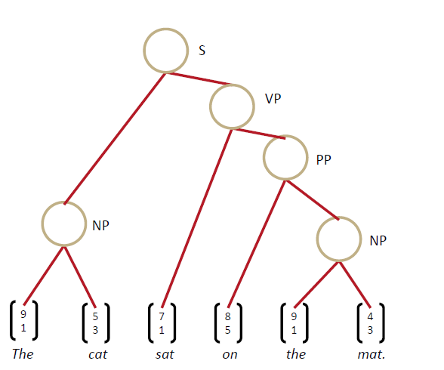
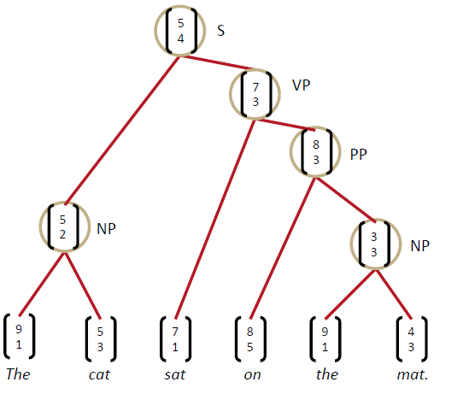
Recursive Neutral Network

Slide 31
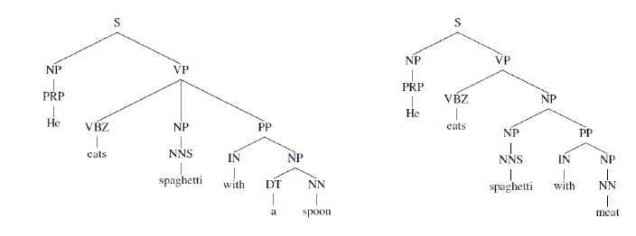
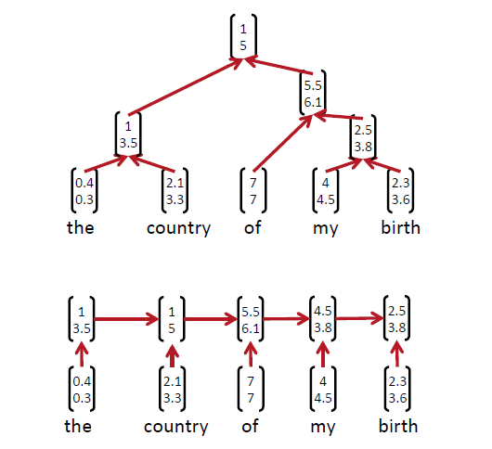
Recursive Neutral Network

Slide 32
Recursive Neutral Network

Slide 33
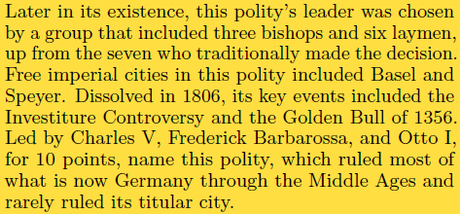
Recursive Neutral Network
Iyyer M, Boyd-Graber J, Claudino L, et al. A neural network for factoid question answering over paragraphs[C]//Proceedings of the 2014 Conference on Empirical Methods in Natural Language Processing (EMNLP). 2014: 633-644.
Q
A
Different W
Loss Function:
c: correct wordVec,
z: incorrect wordVec

Slide 34
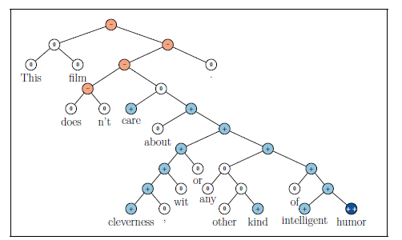
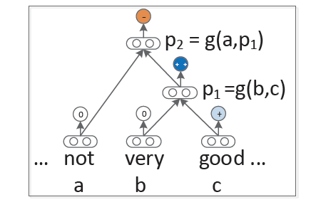
Recursive Neutral Network
Socher R, Perelygin A, Wu J Y, et al. Recursive deep models for semantic compositionality over a sentiment treebank[C]//Proceedings of the conference on empirical methods in natural language processing (EMNLP). 2013, 1631: 1642.

Slide 35
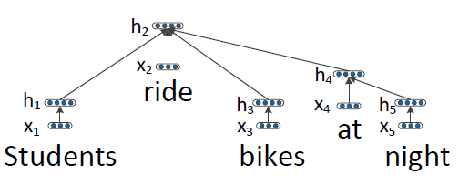
Recursive Neutral Network

Slide 36
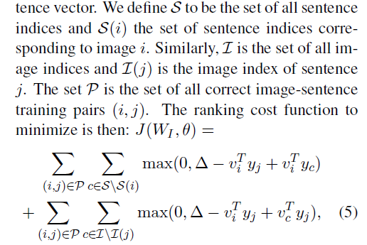
Recursive Neutral Network
Socher R, Karpathy A, Le Q V, et al. Grounded compositional semantics for finding and describing images with sentences[J]. Transactions of the Association for Computational Linguistics, 2014, 2: 207-218.

