Slide 1
Assessment Models for Open Source Software
Qian Zhenzheng

Slide 2
Why using Open Source Software?

Slide 3
Convenient
Flexible
Cost Saving

Slide 4
Outline
Assessment Models(OSMM Model, OpenBRR, SQO-OSS)
Learning Assessment Models And Assess Software From user’s reviews
^{Contributions}
^{Methodology}
^{NaiveBayes Classifity}
^{Latent Dirichlet Allocation}
^{Automatic Labeling Topics}
^{Rank}
^{Sentiment analysis}

Slide 5
Assessment Models for Open Source Software
Capgemini Open Source Maturity Model
Evaluation Framework for Open Source Software
A Model for Comparative Assessment of OpenSource Products
Navica Open Source Maturity Model
^{Woods and Guliani’s OSMM}
Open Business Readiness Rating (OpenBRR)
Atos Origin Method for Qualification andSelection of Open Source Software (QSOS)
Evaluation Criteria for Free/Open SourceSoftware Products
A Quality Model for OSS Selection
Selection Process of Open Source Software
Notes:
使用开源软件的好处，利益驱动，可以做到cost saving
所以一开开源软件评估模型是商业驱动的
2003年凯捷Capgemini公司提出第一个开源软件成熟度评估模型，用于为其顾客评估开源软件质量
此页10个模型都是早期的一些开源软件评估模型
OSMM是商业驱动的开源软件评估模型的代表
OpenBRR即使是以商业目的为驱动又是以研究目的为驱动

Slide 6
Assessment Models for Open Source Software
Observatory for Innovation and TechnologicalY ear Source
Notransfer on Open Source software (OITOS)
Framework for OS Critical Systems Evaluation (FOCSE)
^{Balanced Scorecards for OSS}
Software Quality Observatory for Open SourceSoftware (SQO-OSS)
Evaluating OSS through Prototyping
A Comprehensive Approach for Assessing OpenSource Projects
An operational approach for selecting open sourcecomponents in a software development project
Open Business Quality Rating (OpenBQR)
^{QualiPSo trustworthiness model}
OpenSource Maturity Model (OMM)
Notes:
SQO-OSS，第一个提出实现开源软件自动化评估的一个模型，Alitheal平台，通过插件的方式插入评估模型，数据收集等工作由各插件自动完成

Slide 7
The OSMM（Open Source Maturity Model ） model
The OSMM is designed to enable organizations to evaluate open source products and understand whether a product can fulfill the organization's requirements.
Product software,
Support,
Documentation,
Training,
Product integrations
Professional services
Notes:
如果有100个候选开源软件需要你去评估的时候，你需要一个formal的方法去评估，即一套标准，这样才能够让100个人评估的结果和1个人的是一样的
OSMM开源软件成熟度模型，是2005年提出的
他的初衷是使组织可以评估开源产品，理解这个产品是否可以满足我们的需求。
OSMM除了开源产品的源代码之外的一些需求，
比如说support（支持）, training（培训）, documentation（文档）, integration（集成）, and services（服务）.

Slide 8
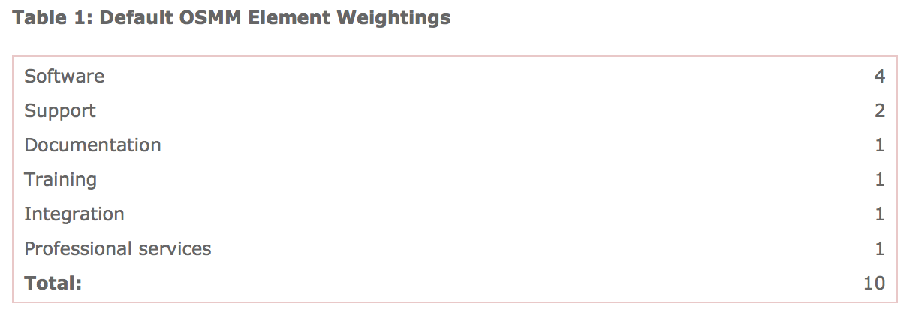
three phases
Assess vital product elements for maturity and assign a maturity score.
Define a weighting for each element based on the organization's requirements.
Calculate the product‘s overall maturity score(score*weight).
Notes:
1.对上面提到的6个元素做一个评估，给出相应的分值
2.为每一个元素根据我们的需求设定一个权重

Slide 9
Conclusion
Disadvantage： covering a wide range
Notes:
太宽泛

Slide 10
The Open Business Readiness Rating (OpenBRR)
quick assessment
detailed
Notes:
英特尔和卡耐基梅隆大学提出的，商业&研究
迄今为止测量面最全的

Slide 11
Notes:
和OSMM不同之处在于他把metric也定义出来了

Slide 12
The process of assessment
1.a “quick assessment” to rule in or rule out software packages and create a shortlist of viable candidates
2.ranking the importance of categories or metrics
3.processing the data
4.translating the data into the Business Readiness Rating. A software component’s Business Readiness Rating is scored from 1-5, with one being “Unacceptable,” and 5 being “Excellent.”
Notes:
1.选一些候选的属性
2.对一级指标的重要性排序，对二级指标的重要性排序
3.处理数据
4.数据的打分

Slide 13
Conclusion
Disadvantage： Some Attributes is not available
Notes:
有一些标准不易评估，比如说usability下的end user ui experience

Slide 14
The SQO-OSS quality model
an automated software evaluation system
evaluates all aspects of OSS development, both the product (code) and the community
Notes:
Europen research的一个项目，历时2年，200人、月
他的变量都是面向标准的，将人为的干预降到最低

Slide 15
The SQO-OSS quality model

Slide 16
Step
Phase One: Definition of the evaluation model
1. Definition of the model criteria (attributes and sub-attributes).
^{2. Definition of metrics.}
Phase Two: Definition of the aggregationmethod
1. Definition of the evaluation categories
2. Definition of the profiles of those categories
Notes:
定义评估模型
定义聚集方法（收集数据，计算评分）

Slide 17
Evaluation Process
Notes:
圈复杂度“用来衡量一个模块判定结构的复杂程度，数量上表现为独立现行路径条数，即合理的预防错误所需测试的最少路径条数
如果要达到excenllent圈复杂度要小于等于4

Slide 18
conclusion
Advantage：automated software evaluation system
Disadvantage：the evaluation procedure is too rigid and a bit cumbersome
Notes:
评估有点生搬硬套，比如说为了强调自动化，它特意去掉了usebility这个属性

Slide 19
Learning Assessment Models
And
Assess Software From user’s reviews

Slide 20
divided into three different areas:
internal quality
target usage quality
external quality

Slide 21
Contributions
Measuring software quality with minimum human interference
Taking into account all the aspects that are relevant to the user
Flexible，strong scalability
Fine grained quality assessment
Notes:
1从评估模型到软件质量得分全部自动完成，不需要人工干预
2.完全面向最终用户，针对性强（评估模型得出的是用户关注的质量属性，而不是生搬硬套已定义好的模型，我要做的是去发现用户关心的质量属性，而不是限定一些tag做分类）
3.灵活，可扩展性强（随着评论的不同会有不同的质量关注点）
4.以用户提出的质量的关注点去评估可以大到像usibility这样的概念也可以小到像picture upload这样的功能点

Slide 22
Methodology

Slide 23
Methodology

Slide 24
NaiveBayes Classifity
class | type（rule） | example
informative | Functional flaw that produces incorrect or unexpected | None of the pictures will load in my news feed.
 | Performance flaw that degrades the performance of Software | It lags and doesn't respond to my touch which almost always causes me to run into stuff.
 | Requests to add/modify features | Amazing app, although I wish there were more themes to choose from.
 | Requests to remove advertisements/notifications | So many ads its unplayable!
 | Requests to remove permissions | This game is adding for too much unexplained permissions.
Noninformative | Pure user emotional expression | Great fun can't put it down!
 | Advertisement | http://alias-i.com/lingpipe/demos/tutorial/eclipse/read-me.html

Slide 25
N Gram
If T is a sentence constructed by words(W1 W2 W3…….Wn)
P(T)=P(W1W2W3……..Wn)
=P(W1)P(W2|W1)P(W3|W1W2)…P(Wn|W1W2…Wn-1)
P(T) =P(W1W2W3…Wn)
=P(W1)P(W2|W1)P(W3|W1W2)…P(Wn|W1W2…Wn-1)
≈P(W1)P(W2|W1)P(W3|W2)…P(Wn|Wn-1)
Notes:
马尔科夫假设：一个词的出现仅仅依赖于它前面出现的有限的一个或者几个词。

Slide 26
Methodology

Slide 27
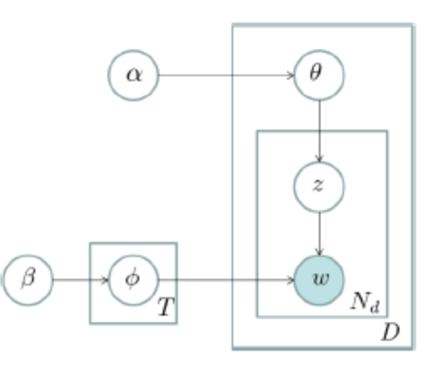
Topic model
P(w|d) = sigma{ p(w|z)*p(z|d) }
Doc
|
----------------------------------------
| | ... |
topic_1 topic_2 topic_m
topic_i
|
----------------------------------------
| | ... |
word_1 word_2 word_n
Notes:
不过从统计模型的角度来说， 我们是用一个特定的词频分布来刻画主题的，并认为一篇文章、一段话、一个句子是从一个概率模型中生成的。
word出现在topic中的概率，topic出现在doc中概率
对于语料库中的每篇文档，LDA定义了如下生成过程（generative process）：
对每一篇文档，从主题分布中抽取一个主题；
2. 从上述被抽到的主题所对应的单词分布中抽取一个单词；
3. 重复上述过程直至遍历文档中的每一个单词。
阿法，贝塔是狄利克雷先验分布，对于一篇文档中的每一个单词，我们从文档对应的多项式分布θ中抽取一个主题z，再从主题z中对应的多项式分布抽取一个单词这个过程重复Nd次就产生了文档

Slide 28
Methodology

Slide 29
Automatic Labeling Topics

Slide 30
Methodology

Slide 31
Rank
 | T1 | T2 | T3 | T4 | . | . | . | . | Tn
r1 | Pr | Pr | Pr | Pr | . | . | . | . | Pr
r2 | Pr | Pr | Pr | Pr | . | . | . | . | Pr
r3 | Pr | Pr | Pr | Pr | . | . | . | . | Pr
r4 | Pr | Pr | Pr | Pr | . | . | . | . | Pr
r5 | Pr | Pr | Pr | Pr | . | . | . | . | Pr
r6 | Pr | Pr | Pr | Pr | . | . | . | . | Pr
. | Pr | Pr | Pr | Pr | . | . | . | . | Pr
. | Pr | Pr | Pr | Pr | . | . | . | . | Pr
. | Pr | Pr | Pr | Pr | . | . | . | . | Pr
. | Pr | Pr | Pr | Pr | . | . | . | . | Pr
rn | Pr | Pr | Pr | Pr | . | . | . | . | Pr

Slide 32
Rank
 | T1 | T2 | T3
r1 | 1.0 | 0 | 0
r2 | 1.0 | 0 | 0
r3 | 0.5 | 0.1 | 0
r4 | 0.4 | 0.2 | 0.1
r5 | 0.5 | 0.3 | 0.2
r6 | 0.1 | 0.3 | 0
. | . | . | .
. | . | . | .
. | . | . | .
. | . | . | .
rn | 1.0 | 0 | 0

Slide 33
Methodology

Slide 34
Sentiment analysis

Slide 35
Thanks

