Slide 1
AutoQuery
Automatic construction of dependency queries for code search
[Automated Software Engineering - 2014]
Shaowei Wang, David Lo, Lingxiao Jiang
School of Information Systems, Singapore Management University
Cai Xuyang
4/10/2016

Slide 2
Outline
Introduction
Overall Framework
PDGs Generation Engine
Query Generation Engine
Evaluation

Slide 3
Introduction
Many software projects contain a large amount of source code.
Searching takes much time and resource
Scenario: bug fixing
Hard to find (tap on experience)
Have found
Bug File
Bug File
Bug File
Bug File
Bug File
Similar bugs in relevant source code files
Tedious and Error-prone!

Slide 4
Introduction
Existing code search tools
Text-based
Accept texts and search code fragments
Match identifier names to the words in query
Dependency-based
Contain dependency relations and structures
Improve search accuracy
Hard to construct such queries
AutoQuery:
It can automatically constructing dependency queries from code examples.

Slide 5
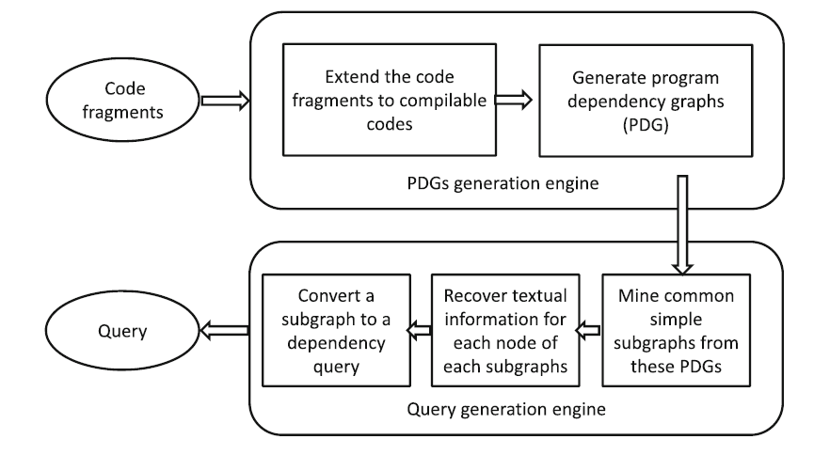
Overall framework

Slide 6
PDGs Generation Engine
Program dependence graph
A graph G = (N, E), where N is a set of nodes and E is a set of edges.
Node Set: {n1 = (ntype1, text1) , . . . ni =(ntypei , texti) , . . .}.
ntypei -> the node type
texti -> textual representations
Edge Set: {e1 = (n^{L}1 , n^{R}1 , etype1), . . . , ei =(n^{L}i , n^{R}i , etypei), . . .}.
etype -> data dependency or control dependency

Slide 7
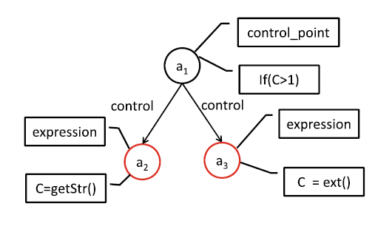
PDGs Generation Engine
Program dependence graph - Example
Code Fragment
{
If(C > 1)
C = getStr()
Else
C = ext()
}

Slide 8
PDGs Generation Engine
Dependence Query Language (DQL)
Node declaration (ndecl): Node variables and their types
- function call, expression, declaration, etc.
Node description (ndesc): Constraints on declared node variables
- contains, inFile, inFunc, atLine, etc.
Relationship description (rdesc): Constraints on the relations among declared node variables
- dataDepends, controls, Onestep, etc.
Targets (target): The variables specified in ndecl that are desired search targets

Slide 9
PDGs Generation Engine
Dependence Query Language (DQL) - Example

Slide 10
PDGs Generation Engine
Code Extension
Infer the types of variables and signatures of invoked functions in a code fragment.
1. Declarations of undeclared variables
2. Definitions of undefined functions
3. New classes (data types) that specify undefined types
Steps
Create the parse tree by using pycparser
Traverse the parse tree and get all elements
Infer the undeclared/undefined elements iteratively

Slide 11
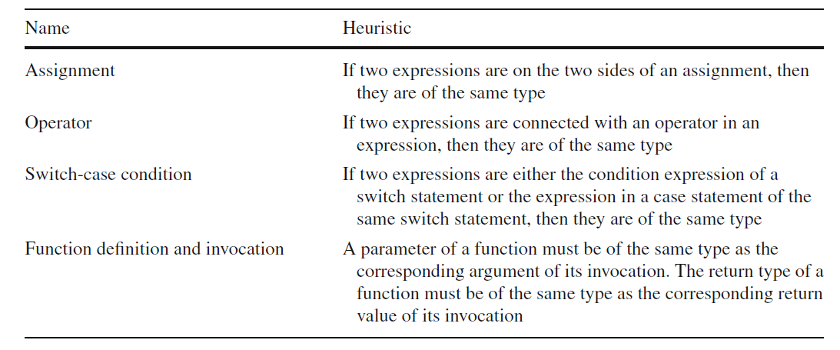
PDGs Generation Engine
Code Extension
Inference Heuristics

Slide 12
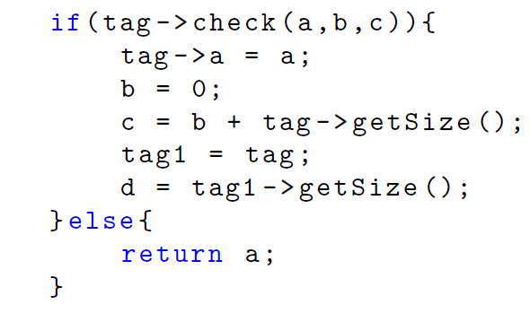
PDGs Generation Engine
Code Extension - Example
Inference Steps

Slide 13
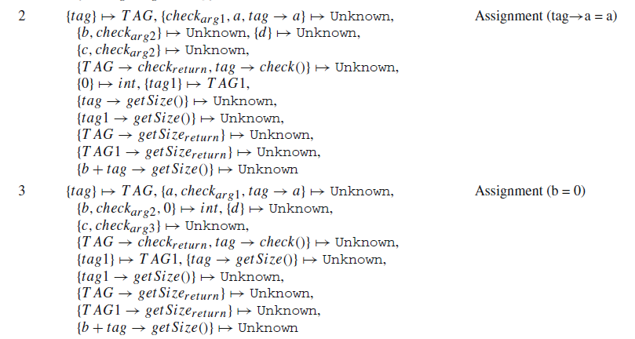
PDGs Generation Engine
Code Extension - Example
Inference Steps

Slide 14
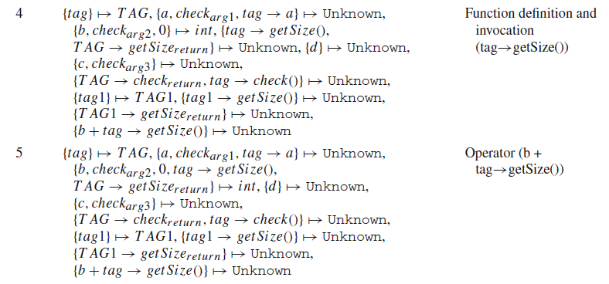
PDGs Generation Engine
Code Extension - Example
Inference Steps

Slide 15
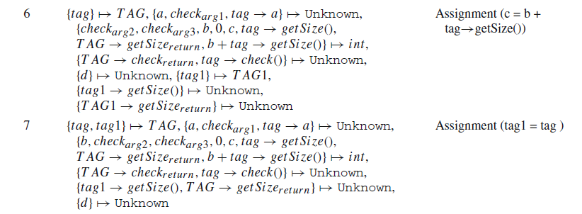
PDGs Generation Engine
Code Extension - Example
Inference Steps

Slide 16
PDGs Generation Engine
Code Extension - Example
Inference Steps

Slide 17
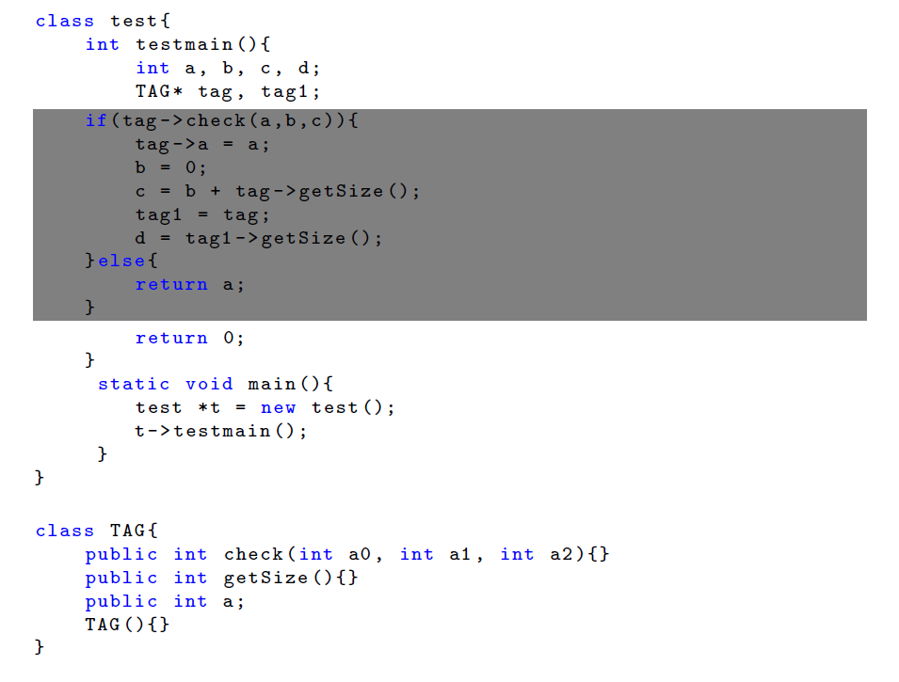
PDGs Generation Engine
Code Extension - Example
Extended Code

Slide 18
PDGs Generation Engine
PDG Generation
We feed the extended code to CodeSurfer and get a PDG.
Code Fragment
PDG
CodeSurfer

Slide 19
Query Generation Engine
We then find commonalities among multiple PDGs generated from a set of example code fragments.
Mine simple maximal common subgraph
Recover textual information
PDG1
PDG2
Common sub-PDG
Textual sub-PDG
PDG3

Slide 20
Query Generation Engine
Mine simple maximal common subgraph
Convert each PDG G into their simple graph representation G^{notext}
Mine for maximal subgraphs that appear on all G^{notext}
PDG1
Gaston
PDG2
Common sub-PDG
PDG3

Slide 21
Query Generation Engine
Recover textual information
Selecting representative candidates
For each node in subPDG:
If all candidate set of size 1
- Take all candidate nodes as the representative nodes
else if there are candidate set of size 1
- Take the nodes in these sets as the representative nodes
- Get the node that are most similar to the REP in other sets
else
- Pick an arbitrary node as representative nodes
- Get the node that are most similar to the REP in other sets
PDG2
Common sub-PDG
PDG1
Node Matching based on labels ntype and etype
PDG3

Slide 22
Query Generation Engine
Recover textual information
Unifying textual labels
1. Text filtering
function: only name of the function is kept
expression: keep the right side of the expression
2. Get the longest common text from the pre-processed text labels.
3. Split the resultant text and remove special symbols

Slide 23
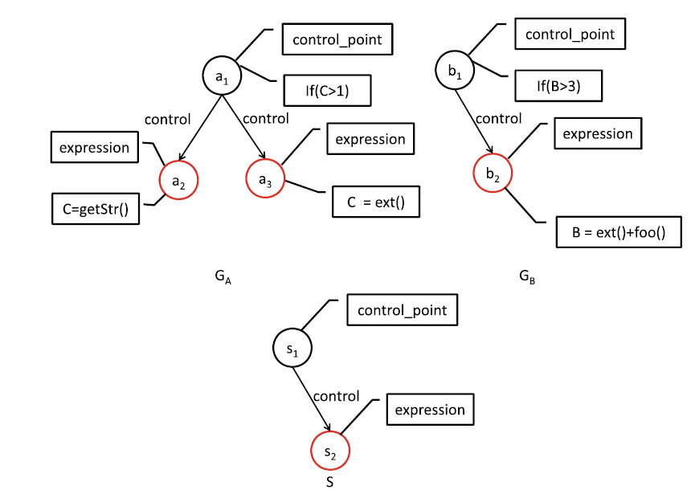
Query Generation Engine
Example:
PDG
Sub common PDG

Slide 24
Query Generation Engine
Example:
PDG
if
Sub common PDG
ext

Slide 25
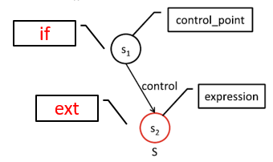
Query Generation Engine
Example:
Textual PDG
DQL

Slide 26
Evaluation
Experimental settings:
Commits: Touch many files that modified in a similar way structurally and semantically

Slide 27
Evaluation
47 widespread changes
5–53 code locations
478 fragments
2–20 lines of code of each fragment
A user study (generate DQL Query)
10 PhD students perform 47 code search tasks
At least two years of C and C++ programming experience
Familiar with Program Dependency Graph
Have taken a course on program analysis
20 min tutorial and 10 min exercise

Slide 28
Evaluation
Experiment results
Three research questions to answer:
Can AutoQuery generate good dependency queries that can retrieve relevant search results?
Can AutoQuery perform comparably well as developers in constructing good dependency queries?
Can AutoQuery improve the time it takes to construct queries?

Slide 29
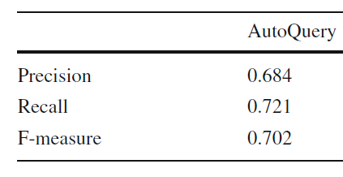
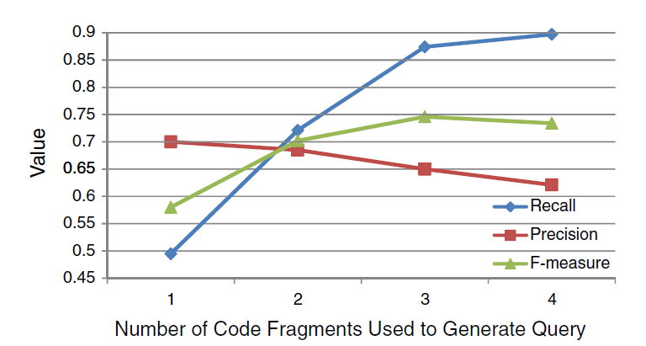
Evaluation
Effectiveness of AutoQuery
Index | Number
Recall = 1 | 21
Precision = 1 | 25
F-measure = 1 | 12

Slide 30
Evaluation
AutoQuery versus UserQuery
Wilcoxon signed-rank Test
Index | p value
Recall | 0.17
Precision | 0.02
F-measure | 0.49
significant

Slide 31
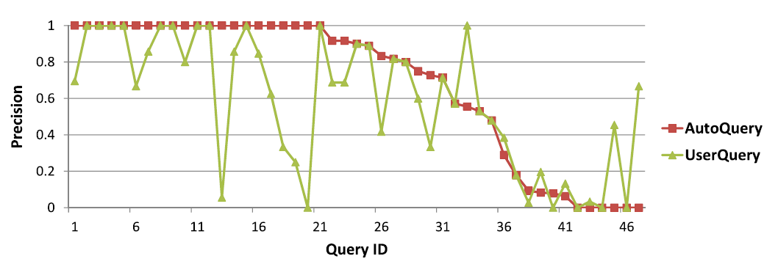
Evaluation
User always misses important constraints!
AutoQuery versus UserQuery

Slide 32
Evaluation
AutoQuery versus UserQuery
Improvement:
Develop a machine learning technique that can remove or weaken some of the generated constraints automatically.

Slide 33
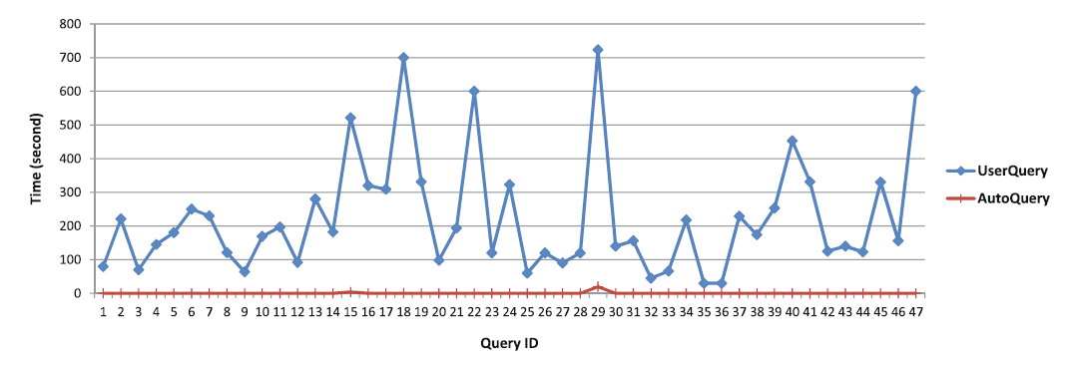
Evaluation
Efficiency of AutoQuery compared with UserQuery
Method | Total Time | Aver Time
AutoQuery | 27.5s | 0.6s
UserQuery | 10,509s | 223.6s
723s
521s
3.9s
19.8s

Slide 34
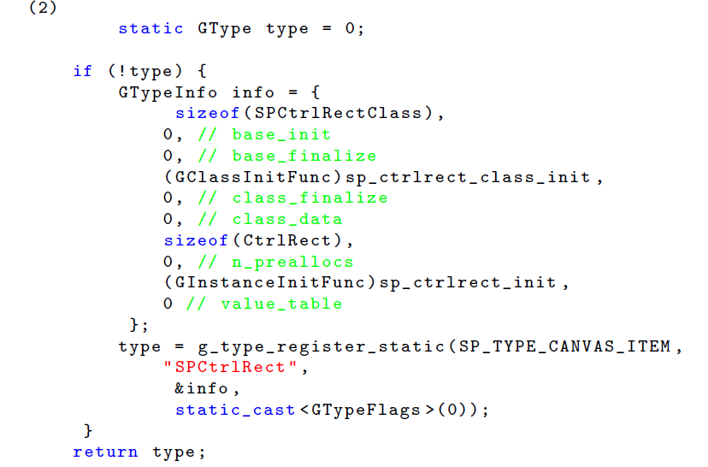
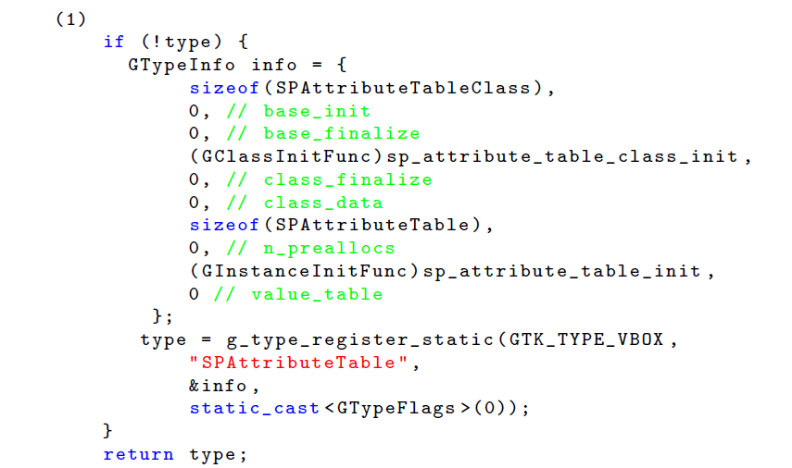
Evaluation
Efficiency of AutoQuery compared with UserQuery
Improvement:
Compress the dependence graph by removing some unimportant nodes and edges.

Slide 35
Thanks
Q&A

