Slide 1
Connecting Users across Social Media Sites: A Behavioral-Modeling Approach
Weizhi Huang
2015.11.19
Reza Zafarani,Han Liu
KDD’13,Chicago,USA
Notes:
People use various media for different purpose. The information on an individual site is often incomplete. When sources of complementary information are integrated, a better profile of a user can be build to improve online services such as verifying online information.

Slide 2
Content
Introduction
MOBIUS
Experiment
Discussion
Conclusion

Slide 3
Problem Statement
Information shared by users on social media sites provides a social fingerprint of them and can help identify users across different sites.
Username
Unique on each site and can help identify individuals
Two general problem
Given two usernames u 1 and u 2, can we determine if they belong to the same individual?
Given a single username u from individual I, can we find other usernames of I?

Slide 4
Why important
Verifying ages online is important as it attempts to determine whether someone is “an 11-year-old girl or a 45-year-old man”.
“Skout, a mobile social networking app, discovered that, within two weeks, three adults had masqueraded as 13- to 17-year olds. three separate incidents, they contacted children and, the police say, sexually assaulted them.” New York Times
Notes:
This paper proposes an alternative solution addressing the age verification problem by exploiting the nature of social media and its networks MOBIUS, maps among identities across social media sites, which is based on behavioral patterns.

Slide 5
Question 1
Given two usernames u 1 and u 2, can we determine if they belong to the same individual?
we find the set of all usernames C that are likely to belong to individual I. We denote set C as candidate usernames
for all candidate usernames c ∈ C, we check if c and u belong to the same individual.
Identification function
f(U, c) = 1 If c and set U belong to I ;
f(U, c) = 0 Otherwise ;
Notes:
we can assume that username u is known to be owned by some individual I and c is the candidate username whose ownership by I we would like to verify. In other words, u is the prior information (history) provided for I.

Slide 6
Content
Introduction
MOBIUS
Experiment
Discussion
Conclusion

Slide 7
Methodology
Modeling Behavior for identifying Users across Sites (MOBIUS)
Identifies users’ unique behavioral patterns that lead to information redundancies across sites
Constructs features that exploit information redundancies due to these behavioral patterns
Employs supervised machine learning for effective user identification
Notes:
Modeling Behavior for Identifying Users across Sites

Slide 8
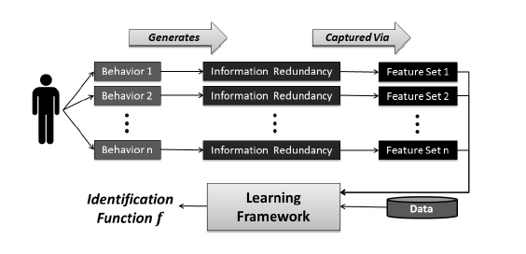
Outline
MOBIUS:Modeling Behavior for Identifying Users across Sites
Notes:
When individuals select usernames, they exhibit certain behavioral patterns. This often leads to information redundancy, helping learn the identification function. In MOBIUS, these redundancies can be captured in terms of data features. Following the tradition in machine learning and data mining research, we can learn an identification function by employing a supervised learning framework that utilizes these features and prior information

Slide 9
Behavioral patterns and feature construction
Individuals can avoid such redundancies
short-term memory capacity of 7 ±2 items
Human memory thrives on redundancy
not long, not random, and have abundant redundancy
Notes:
Human memory also has limited capability in storing random content and often, selectively stores content that contains familiar items, known as “chunks”

Slide 10
Behavioral patterns and feature construction
Behavioral patterns
Patterns due to Human Limitations
Exogenous Factors
Endogenous Factors
Features
(Candidate) Username Features,e.g., username length
Prior-Usernames Features,e.g.,the number of observed prior usernames
Username↔Prior-Usernames Features,e.g.,similarity
Notes:
1. (Candidate) Username Features: these features are extracted directly from the candidate username c, e.g., its length, 2. Prior-Usernames Features: these features describe the set of prior usernames of an individual, e.g., the number of observed prior usernames, and 3. Username↔Prior-Usernames Features: these features describe the relation between the candidate username and prior usernames, e.g., their similarity.

Slide 11
Patterns due to Human Limitations
Limited time and memory
59% of individuals prefer to use the same usernames repeatedly
Users commonly have a limited set of potential usernames from which they select
Users often prefer not to create new usernames
approximated by the number of unique usernames (uniq(U)) among prior usernames U
uniqueness = | uniq(U)|/| U|
Limited knowledge
Limited Vocabulary: Our vocabulary is limited in any language
Limited Alphabet: alphabet letters used in the usernames are highly dependent on language.
no Arabic word transcribed in English contains the letter x
Notes:
In general, as humans, we have 1) limited time and memory and 2) limited knowledge. Both create biases that can affect our username selection behavior.

Slide 12
Exogenous Factors
Typing Patterns
layout of the keyboard significantly impacts how random usernames are selected
e.g., qwer1234 and aoeusnth are two well-known passwords
Construct 15 features for each keyboard layout
(1 feature) The percentage of keys typed using the same hand used for the previous key
(1 feature) Percentage of keys typed using the same finger used for the previous key.
(8 features) The percentage of keys typed using each finger. Thumbs are not included.
...
Language Patterns
Users often use the same or the same set of languages when selecting usernames.
n-gram statistical language detector over the European Parliament Proceedings Parallel Corpus 3,which consists of text in 21 European languages
Notes:
Exogenous factors are behaviors observed due to cultural influences or the environment that the user is living in
The higher this value the less users had to change hands for typing.
2. Top Row, Home Row, Bottom Row, and Number Row.Space bar is not included 3. Normal typing keys are assumed to be (1.8cm) 2 (including gap between keys)
The detected language feature is limited to European languages. Our language detector will not detect other languages. The language detector is also challenged when dealing with words that may not follow the statistical patterns of a language, such as location names, etc. However, these issues can be tackled from a different angle, as we discuss next.

Slide 13
Endogenous Factors
Endogenous factors play a major role when individuals select usernames.
Personal attributes (name, age, gender, roles and positions, etc.)
characteristics, e.g., a female selecting username fungirl09, a father selecting geekdad, or a PlayStation 3 fan selecting PS3lover2009.
habits, such as abbreviating usernames or adding prefixes/suffixes.
Notes:
endogenous [en'dɑːdʒənəs]

Slide 14
Personal Attributes and Personality Traits
Personal Information
language detection model is incapable of detecting several languages, as well as specific names, such as locations, or others that are of specific interest to the individual selecting the username
Kalambo, a waterfall in Zambia, or K2 and Rakaposhi, both mountains in Pakistan
patterns in these words can be captured by analyzing the alphabet distribution
Kalambo,
‘I’ in languages such as Arabic or Tajik, if detection fails
Username Randomness
describe individuals’ level of privacy and help identify them

Slide 15
Habits
Username Modification
Add prefixes or suffixes
e.g., mark.brown → mark.brown2008,
Abbreviate there usernames
e.g., ivan.sears → isears,
Change characters or add characters in between
e.g., beth.smith → b3th.smith
Capture the modifications
detect added prefixes or suffixes
detecting abbreviations, Longest Common Subsequence
swapped letters and added letters, Edit Distance(Lev-enshtein) and Dynamic Time Warping (DTW) distance
Notes:
Individuals often select new usernames by changing their previous usernames. Some,
one can check if one username is the substring of the other
detect non-consecutive letters that match in two strings.
No detail in paper

Slide 16
Habits
Generating Similar Usernames
Users tend to generate similar usernames.
Gateman, nametag
Kullback-Liebler divergence(KL), measure distribution, and Jensen-Shannon divergence(JS) compare distribution
JS(P||Q) = 1/2[KL(P||M) + KL(Q||M)]
Where M = ½(P + Q)
KL(P||Q) = $\sum_{i=1}^{|P|}{Pi ∙log⁡(\frac{Pi}{Qi})}$
P and Q are the alphabet distributions for the candidate username and prior usernames.
Notes:
Since we store the alphabet distribution for both the candidate username and prior usernames, we can compare these using different similarity measures.

Slide 17
Habits
Username Observation Likelihood
order in which users letters to create usernames depends on their prior knowledge.
based on how letters come after one another in prior usernames.
N-gram model
P(u) $≈ \prod_{i=1}^{n}{P(ci|ci−(n−1)∙∙∙∙∙∙∙ci−1)}$
p(jon) ≈ p(j|*)p(o|j)p(n|o)p(•|n) beginning and the end of a word, * and •

Slide 18
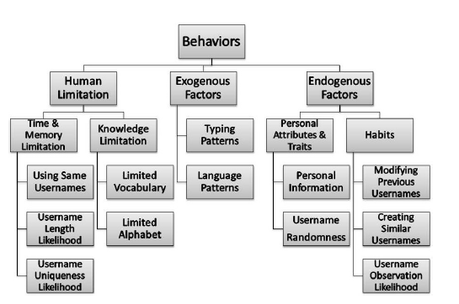
Summary
Individual Behavioral Patterns

Slide 19
Content
Introduction
MOBIUS
Experiment
Discussion
Conclusion

Slide 20
Data preparation
Social Networking Sites:
Google+ or Facebook, list their IDs on other sites,
Blogging and Blog Advertisement Portals
List not only blogs, but also their profiles on other sites
Forums
Content Management Systems: allow users to add their usernames on social media sites to their profiles
100,179(c-U) pairs are collected from 32 sites.
Notes:
A simple method for gathering identities across so cial networks is to conduct surveys and ask users to provide their usernames across social networks. Another method for identifying usernames across sites is by finding users manually
For negative instances, we construct instances by randomly creating pairs (ci-Uj)

Slide 21
Learning the Identification Function
Compare MOBIUS performance to other methods
method of Zafarani et al.[19]
method of Perito et al.[15]
baseline b1: Exact Username Match
baseline b2:Substring Matching
baseline b3: Patterns in Letters

Slide 22
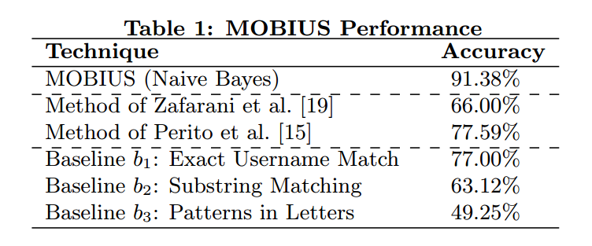
Result
100,179 positive + 100,179 negative ≈200,000 instances

Slide 23
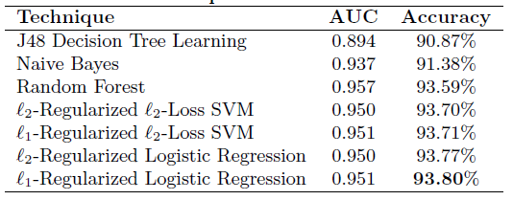
Learning Algorithm
Perform the classification task using a range of learning techniques
J48 Decision Tree Learning
Naive Bayes
Random Forest
SVM
Logistic Regression

Slide 24
Feature Importance Analysis
Utilize odds-ratios(logistic regression coefficients) for importance analysis and ranking features
edit distance
longest common substring
observation likelihood
...
Logistic regression provides an accuracy of 92.27% only with these 10 features

Slide 25
Content
Introduction
MOBIUS
Experiment
Discussion
Conclusion

Slide 26
Discussion
Only focus on username? Not enough.
In real world, no enough database to support this method
Eg. Bunnymartini, litchilover
If we know other than username,
Search history
Interest
…
User migration

Slide 27
Content
Introduction
MOBIUS
Experiment
Discussion
Conclusion

Slide 28
Conclusion
MOBIUS contains behavioral patterns
Features constructed to capture information redundancies due to these patterns
A learning framework

Slide 29
Thank you !

