Slide 1
Multimodal Embeddings
Wenkai Mo

Slide 2
Multimodal Embeddings
Multimodal embedding methods project data from multiple sources.

Slide 3
Multimodal Embeddings
Texts
Images
Representation Learning -> Joint Optimization

Slide 4
Multimodal Embeddings
Representation Learning Phase
Text: Recursive NN, LSTM, Recurrent NN
Code: Parser Tree
Image: CNN
Joint Optimization

Slide 5
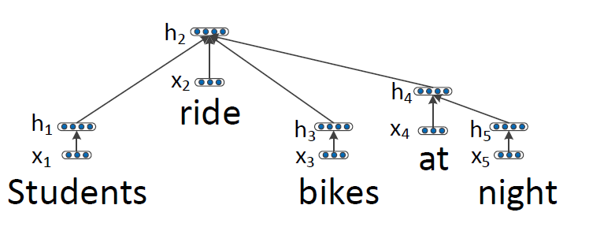
Representation – Text – Recursive NN
Dependency Tree
Composition
Parameters: {$W_{pos}\}$ Initialization: Vector Model (CBOW, Glove, etc.)

Slide 6
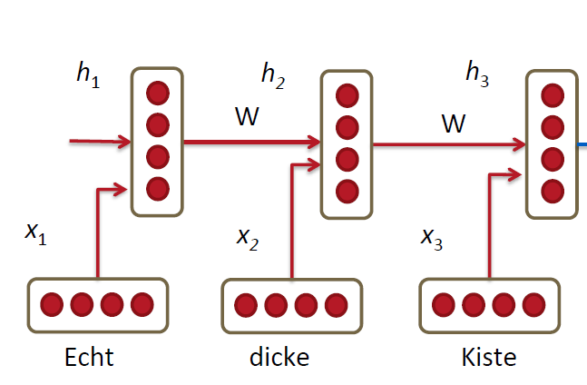
Representation – Text – Recurrent NN

Slide 7
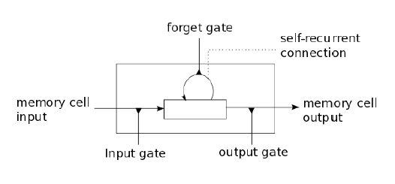
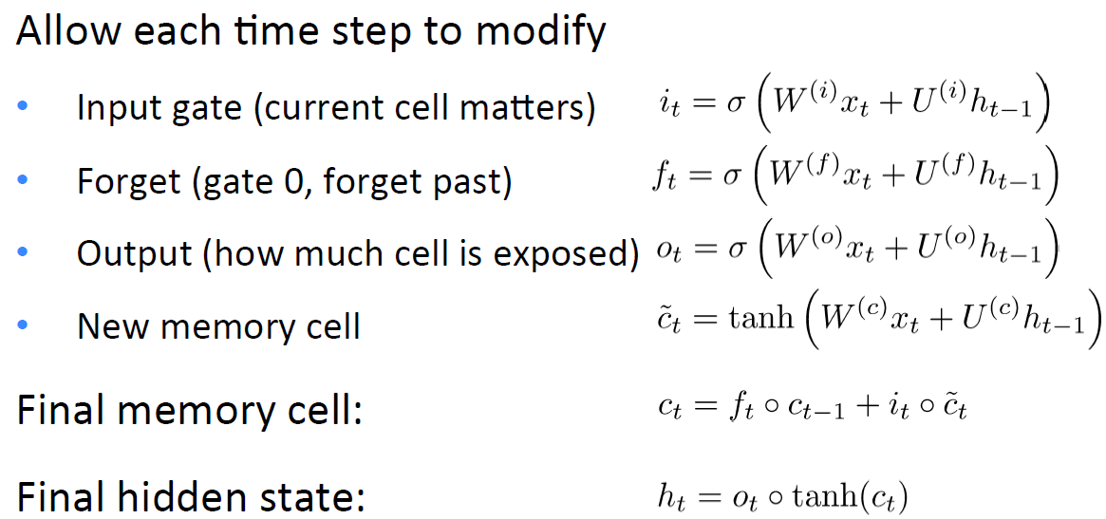
Representation – Text – LSTM RNN
Long-short-term-memories
How much should remember input into cell
How much should forget last cell
How much should output
$$A°B :Hadamard \left(elementwise\right) product$$

Slide 8
Representation – Text
Topic Model
LDA, LSA, etc.
BOW
TF-IDF

Slide 9
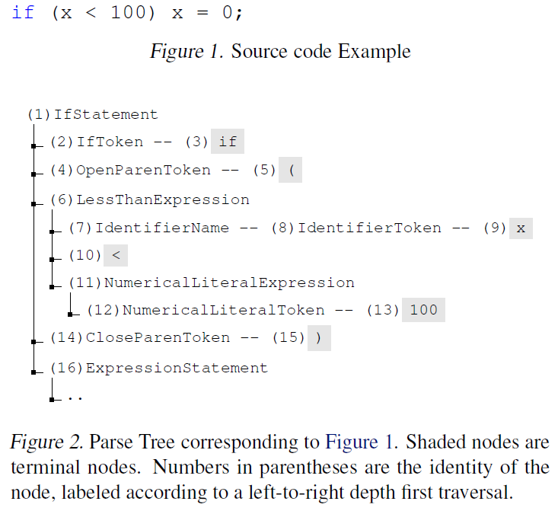
Representation – Code
Feature values (e.g., int, i, =)
Positions (e.g., previous token, two tokens back, three tokens back).
Embedding every subtree.
How about Recursive Neutral Network?

Slide 10
Representation - Image
Two Step: Unsupervised Learning (Restricted Bolzmann Machine) + Supervised Training (Classification)

Slide 11
Joint Optimization
Hinge Loss by Inner Product
L2 Loss by Euclidean Distance

Slide 12
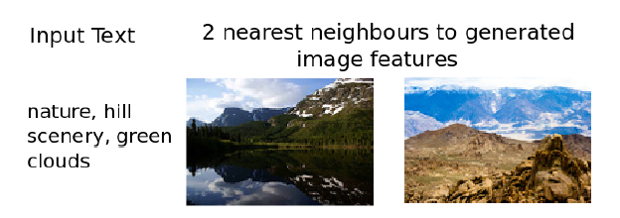
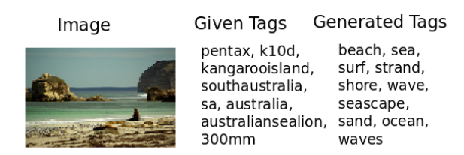
Usage
Zero-shot learning
Information Retrieval
Generation

Slide 13
Usage
Cold Start Problem in RS (Hybrid)
$${\hat{r}}_{u,i}=μ+b_{u}+b_{i}+x_{u}^{T}c_{i}+p_{u}^{T}q_{i}$$
Content
New Item (Content)
×
×
×
CF (history)

Slide 14
Reference
Deep Visual-Semantic Alignments for Generating Image Descriptions
Multimodal Learning with Deep Boltzmann Machines
Multimodal Neural Language Models
DeViSE: A Deep Visual-Semantic Embedding Model
From Captions to Visual Concepts and Back
Grounded Compositional Semantics for Finding and Describing Images with Sentences
Representation Learning: A Review and New Perspectives
Show and Tell: A Neural Image Caption Generator
Zero-Shot Learning Through Cross-Modal Transfer
Bimodal Modelling of Source Code and Natural Language

