Slide 1
Issue Cold Start Problem in Recommender System
Wenkai Mo

Slide 2
Cold Start Problem
Targeting new users or items which only have a little or none useful information in the system.
Difficulty: Few amount of data.
Knowledge-based
Fast Profiling
Content-based
Neighbor method
Introduce Other Sources
Content-based
Neighbor Method
Collaborating Filtering
With a little information.
Without any information.
Only have some in profiles.
Content-based
Neighbor Method
With huge information.

Slide 3
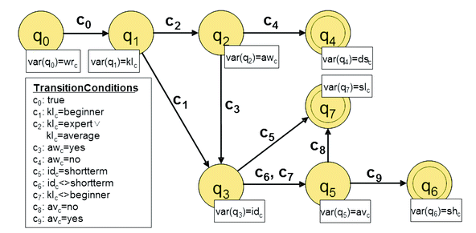
Constraints(Knowledge)-based

Slide 4
Content-based
Content-based Recommender or Hybrid Recommender
Recommendations are based on the information on the content of items rather than on other users’ opinions. (For users, content refers to profiles.)
Old Item/user
New Item/user
sim1
sim2
SIM
Neighbor Method
sim3
Can also use SNS as neighbor
Similarity Function
Content
Content
Old User
New Item
sim1
sim2
Matching
Threshold
sim3
Machine Learning
Feature
Content

Slide 5
Neighbor by Clustering
Old Items Clusters 2
New User
?
Old Items Clusters 1
Old Items Clusters 3
?
Old Users Clusters 1
Old Users Clusters 3
?
?
?
Old Users Clusters 2
?
New Item

Slide 6
Content-based Matching
Joint Features Regression for Cold-Start Recommendation on VideoLectures.Net
A Hybrid Approach for Cold-start Recommendations of Videolectures
Lightweight Approach to the Cold Start Problem in the Video Lecture Recommendation
Old User
New Item
sim1
sim2
Matching
Threshold
sim3
Machine Learning
Feature
Content
SVM, L2R, etc.

Slide 7
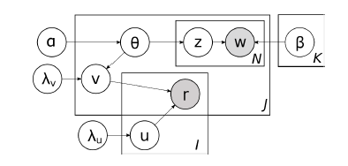
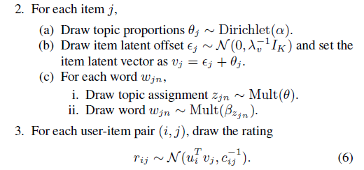
Content-based (For Items)
Collaborative Topic Regression
Wang C, Blei D M. Collaborative topic modeling for recommending scientific articles[C]//Proceedings of the 17th ACM SIGKDD international conference on Knowledge discovery and data mining. ACM, 2011: 448-456.

Slide 8
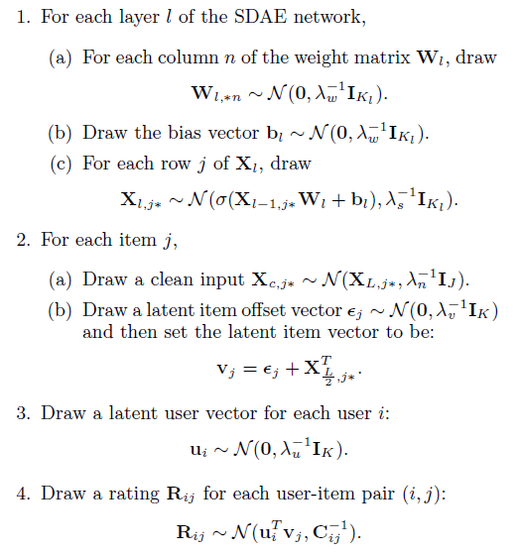
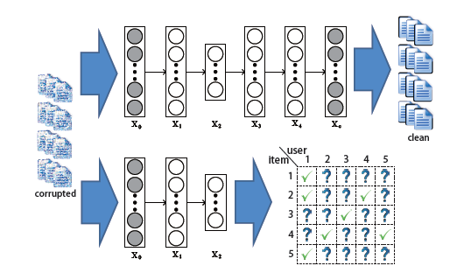
Content-based (For Items)
Deep Learning – Consider Noise
Wang H, Wang N, Yeung D Y. Collaborative deep learning for recommender systems[C]//Proceedings of the 21th ACM SIGKDD International Conference on Knowledge Discovery and Data Mining. ACM, 2015: 1235-1244.

Slide 9
Content-based (For Items)
Content + CF -> Hybrid -> Cold Start
Saveski M, Mantrach A. Item cold-start recommendations: learning local collective embeddings[C]//Proceedings of the 8th ACM Conference on Recommender Systems. ACM, 2014: 89-96.

Slide 10
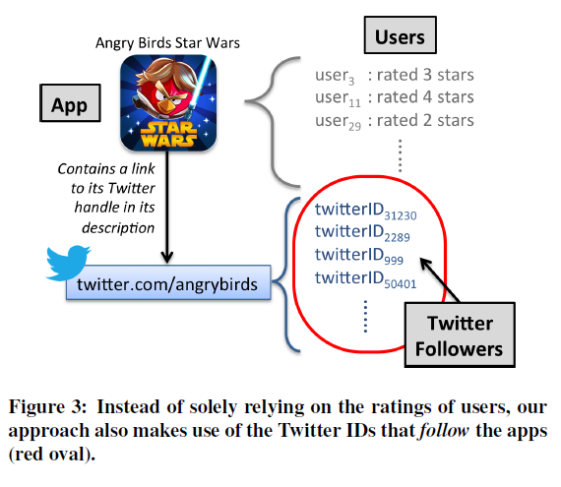
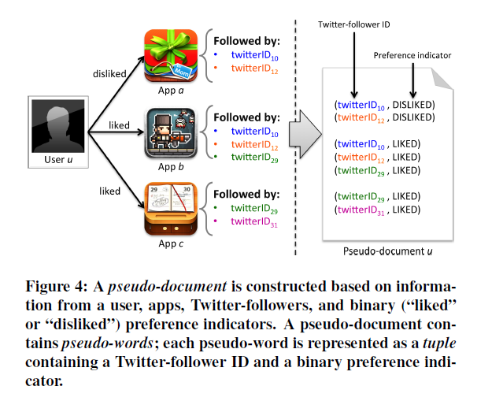
Borrow Data from Other Platforms
Lin J, Sugiyama K, Kan M Y, et al. Addressing cold-start in app recommendation: latent user models constructed from twitter followers[C]//Proceedings of the 36th international ACM SIGIR conference on Research and development in information retrieval. ACM, 2013: 283-292.

Slide 11
Exploration
Selecting users with distinct tastes until obtaining the first feedback.
Once a user provides feedback, ExcUseMe selects users that are similar to this user and are thus more likely to provide feedback on the new item.
Aharon M, Anava O, Avigdor-Elgrabli N, et al. ExcUseMe: Asking Users to Help in Item Cold-Start Recommendations[C]//Proceedings of the 9th ACM Conference on Recommender Systems. ACM, 2015: 83-90.
Notes:
To illustrate why ExcUseMe converges towards selecting the interested users, consider Figure 1. To simplify presentation, assume an offline setting. In 1(a), a set of candidates is revealed and in 1(b) the first selected user is the one with the maximal positive interactions. Assume this user does not provide feedback to the new item. The UseMe vector (in dashed arrow) is updated to capture this negative interaction, and the next user with the highest score is in the opposite direction of that user’s vector. Then, in 1(c), the second selected user does not provide feedback either and the UseMe vector is updated to be orthogonal to the two users’ vectors.
In 1(d), the third selected user is the first to provide feedback and thus the UseMe vector roughly remains in the same direction as this user’s vector. The following selected users are assumed to have vectors roughly in the same direction as well. In 1(e) and 1(f), the two selected users are also assumed to provide feedback, which strengthens the direction of the UseMe vector towards the interested users, thus converging towards the mean vector of the interested users.

Slide 12
Fast Profiling
How to select proper seeds for a new user?
Diversity
Seed, when a user’s rating for it is known, can reveal the best the user’s identity.
The same with new items.

Slide 13
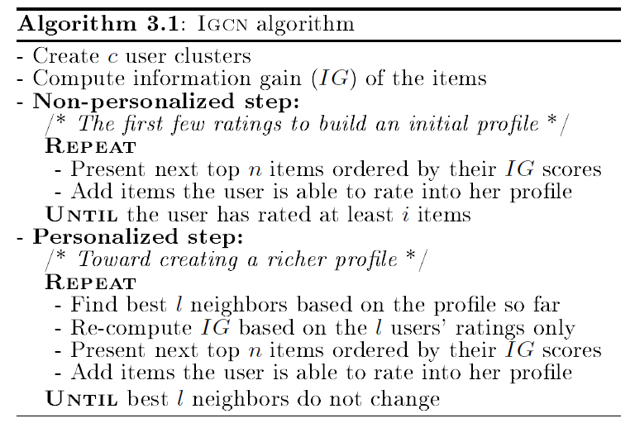
Fast Profiling
Rashid A M, Karypis G, Riedl J. Learning preferences of new users in recommender systems: an information theoretic approach[J]. ACM SIGKDD Explorations Newsletter, 2008, 10(2): 90-100.

Slide 14
Fast Profiling for Users
Select items from these aspects
Random
Popularity
Pure entropy: Informally, a movie that has some people who hate it and others who like it should tell us more than a movie where almost everyone liked it.
Balanced strategies: Popularity*Entropy, Log Popularity*Entropy
Personalized: Item-Item personalized
Rashid A M, Albert I, Cosley D, et al. Getting to know you: learning new user preferences in recommender systems[C]//Proceedings of the 7th international conference on Intelligent user interfaces. ACM, 2002: 127-134.

Slide 15
Fast Profiling
How to select proper seeds for a new user?
(1) Diversity
(2) Seed, when a user’s rating for it is known, can reveal the best the user’s identity.
How to select? (My Thought)
Heuristics Sampling (For (2))
Genetic Algorithm (For Optimizing(1))

Slide 16
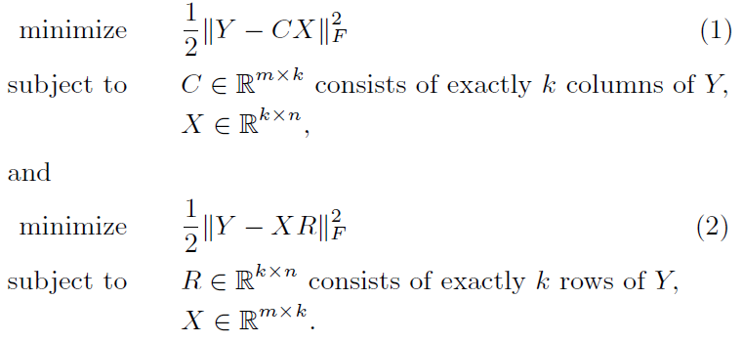
Exploration (Fast Profiling)
Obtain ratings from the k representative users for a new item in order to recommend it to other users.
Similarly, we only need to ask a new user to rate k representative items to recommend other items to him.
Liu N N, Meng X, Liu C, et al. Wisdom of the better few: cold start recommendation via representative based rating elicitation[C] //Proceedings of the fifth ACM conference on Recommender systems. ACM, 2011: 37-44.
K: The Most Representative Terms
Notes:
Y: Rating Matrix

Slide 17
Cold Start Problem
Targeting new users or items which only have a little or none useful information in the system.
Difficulty: Few amount of data.
Knowledge-based
Fast Profiling
Content-based
Neighbor method
Introduce Other Sources
Content-based
Neighbor Method
Collaborating Filtering
With a little information.
Without any information.
Only have some in profiles.
Content-based
Neighbor Method
With huge information.

Slide 18
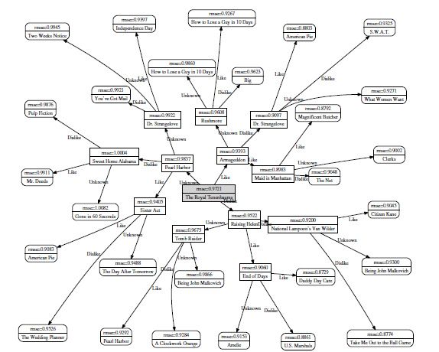
Bootstrap
Golbandi N, Koren Y, Lempel R. Adaptive bootstrapping of recommender systems using decision trees[C]//Proceedings of the fourth ACM international conference on Web search and data mining. ACM, 2011: 595-604.
Each tree node represents a group of users. Each node of the tree predicts item ratings by taking the mean rating by its corresponding users.
Splitting Criteria: item that partitions the users into three sets such that the total squared prediction error is minimized.

Slide 19
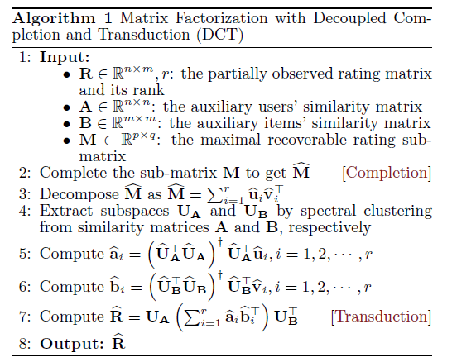
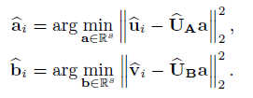
Matrix Factorization
Barjasteh I, Forsati R, Masrour F, et al. Cold-Start Item and User Recommendation with Decoupled Completion and Transduction //Proceedings of the 9th ACM Conference on Recommender Systems. ACM, 2015: 91-98.0
Assume that there is a sub-matrix M, which includes enough rating data to be fully recovered via standard methods such as matrix factorization or matrix completion.
Noise
Notes:
U hat is a sample matrix of U
Use M , A and B to complete R to R*
Barjasteh I, Forsati R, Masrour F, et al. Cold-Start Item and User Recommendation with Decoupled Completion and Transduction[C]//Proceedings of the 9th ACM Conference on Recommender Systems. ACM, 2015: 91-98.

