Slide 1
Open Information Extraction from the Web
Michele Banko, Michael J Cafarella, Stephen Soderland, Matt Broadhead and Oren Etzioni
Turing Center Department of Computer Science and Engineering University of Washington Box 352350 Seattle, WA 98195, USA {banko,mjc,soderlan,hastur,etzioni}
Dong Xiang
2015.11.26

Slide 2
Outline
Preview KnowItAll
TextRunner vs KnowItAll
TextRunner
Query Processing & Analysis
Experiments
Summary

Slide 3
Review
KnowItAll

Slide 4
KnowItAll
templates:
<proper noun> is author of <proper noun>
<proper noun> is based in <proper noun>
…
Web Page
Tuples: T(A ,is author of, B)
Class M: entity A

Slide 5
KnowItAll
Analysis:
1.Too much manual work
2.unanticipated relation?
3.Large search engine query and downloads
D for Document, R for relation time:O(D*R)

Slide 6
Introduction
TextRunner

Slide 7
TextRunner
1.Self-Supervised Learner
2.Single-Pass Extractor
3.Redundancy-Based Assessor
Notes:
Google Set only for English.

Slide 8
TextRunner
1.Self-Supervised Learner
Training data & Build Classifier
Stanford Parser[Klein and Manning,2003]
Naive Bayes Classifier

Slide 9
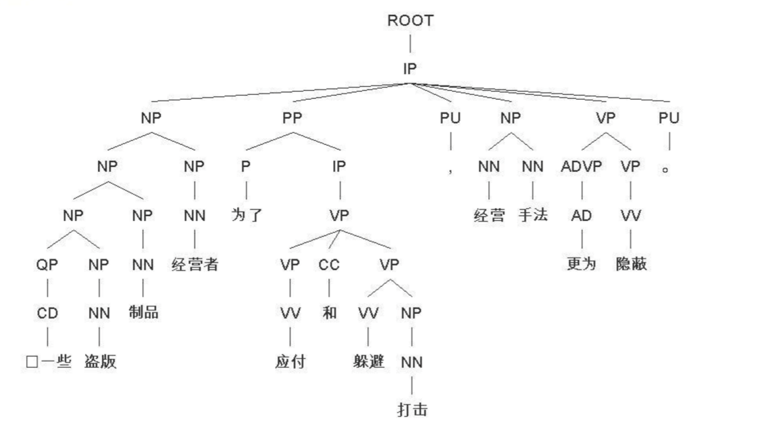
1.Self-Supervised Learner
Stanford Parser

Slide 10
1.Self-Supervised Learner
Stanford Parser => t(ei,r(ij),ej)
positive & negative(label):
constraints:
1.ei & ej is no longer than a certain length.
2.path from ei to ej along the syntax tree does not cross a sentence-like boundary.
3.Neither ei nor ej consist solely of a pronoun

Slide 11
1.Self-Supervised Learner
t(ei,r(ij),ej) => feature vector
features:
1.presence of part-of-speech tag sequences in r(ij).
2.number of tokens in r(ij).
3.number of stop words in r(ij).
4.part-of-speech tag to the left of ei,right to the ej.
Feature vector => Native Bayes Classifer

Slide 12
TextRunner
1.Self-Supervised Learner
2.Single-Pass Extractor
3.Redundancy-Based Assessor
Notes:
Google Set only for English.

Slide 13
TextRunner
2.Single-Pass Extractor
Do not need Parser, tagging each word in each sentence with its most probable part-of-speech.
using maximum-entropy models for part-of-speech tagging and noun-phrase chunking

Slide 14
TextRunner
2.Single-Pass Extractor
Tuples finding: t(Ei,R,Ej)
1. entity R entity
2. entity prep R “Scientists from many universities are studying…”
3. adv R “…definitely developed…”

Slide 15
TextRunner
2.Single-Pass Extractor
noun-phrase chunking
provides the probability with each word is believed to be part of the entity.
discard low levels of confidence.

Slide 16
TextRunner
1.Self-Supervised Learner
2.Single-Pass Extractor
3.Redundancy-Based Assessor
Notes:
Google Set only for English.

Slide 17
TextRunner
1.Self-Supervised Learner
2.Single-Pass Extractor
3.Redundancy-Based Assessor
Notes:
Google Set only for English.

Slide 18
TextRunner
3.Redundancy-Based Assessor
(1) Merge Tuples and Counts
“was developed by” vs “was originally developed by”
(2) Assigned probability and discard
using KnowItAll probabilistic model

Slide 19
TextRunner
Query Processing & Timing Analysis
Distributed:Machine Pool
Every machine computes an inverted index, ensuring all of the tuples containing a reference.
Tuple extraction: O(D), D for number of Documents
Count and Sort: O(TlogT), T for number of Tuples

Slide 20
TextRunner
Experiments

Slide 21
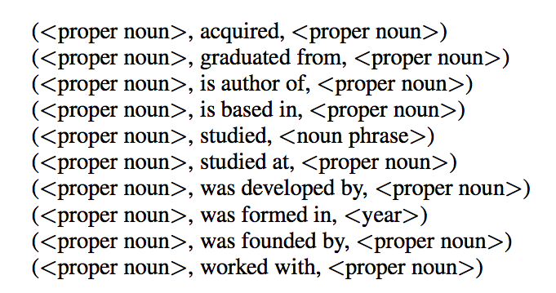
Experiments
1.TextRunner vs KnowItAll
9 million web page corpus

Slide 22
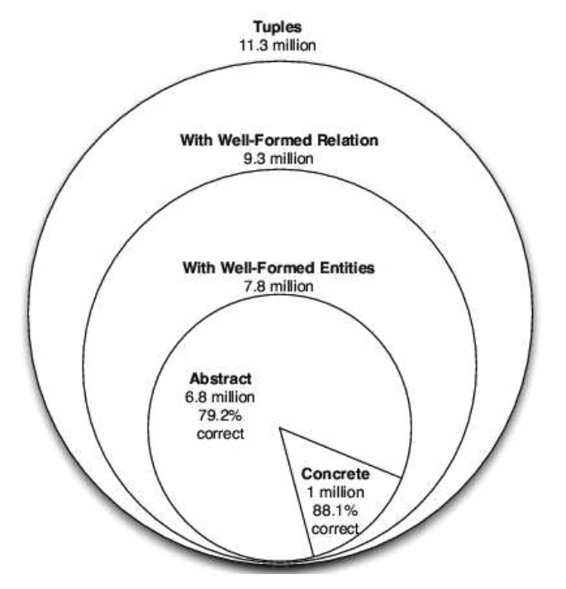
Experiments
2.Estimating the Correctness of fact
Abstract: (Einstein,derived,theory)
Concrete: (Tesla,invented,coil transformer)

Slide 23
Experiments
3.Estimating the Number of Distinct facts
Merge same relations & synonymous entities
11.3 million tuples
1/3 tuples belongs to “synonymy clusters”
100 synonymy clusters
2/3 + ((1/3)*(3/4)) = 92%
1/4 tuples reformulate other tuples

Slide 24
Summary

Slide 25
Thanks

