Slide 1
Linking Issue Tracker with Q&A Sites for Knowledge Sharing across Communities
Huaimin Wang, Member, IEEE, Tao Wang, Student Member, IEEE, Gang Yin, Member, IEEE, Cheng Yang
IEEE Transactions on Services Computing,2015
Notes:
期刊影响因子3.049 SCI检索期刊

Slide 2
Contents
INTRODUCTION
BENEFITS OF KNOWLEDGE SHARING BETWEEN ANDROID ISSUE TRACKER AND STACK OVERFLOW
APPROACH
EXPERIMENT
RESULTS AND DISCUSSION
CONCLUSION

Slide 3
INTRODUCTION
There are two types of communities which involved in software development with unprecedented level
collaborative development community such as SourceForge and Github,
knowledge sharing community like StackOverflow and OsChina
These two communities are interconnected
they overlap each other as having shared participants and issues in them
they are mutually complementary
It’s crucial to reveal the associations between them and link them to bridge the communities for knowledge sharing.
different mechanisms and emphasizes
the knowledge is expressed in informal free texts
Notes:
provide infrastructures like version con- trol and issue tracking services for software development
which host huge amounts of comments and discussions around how software should be used,

Slide 4
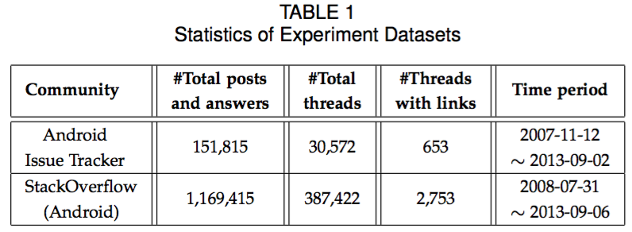
BENEFITS OF KNOWLEDGE SHARING BETWEEN ANDROID ISSUE TRACKER AND STACK OVERFLOW
Data from Android Issue Tracker and Stack Overflow
Notes:
SO 带有安卓的标签的问题
Thread
Post, Answers, Comments
Issue, Answers
Links both to external and internal

Slide 5
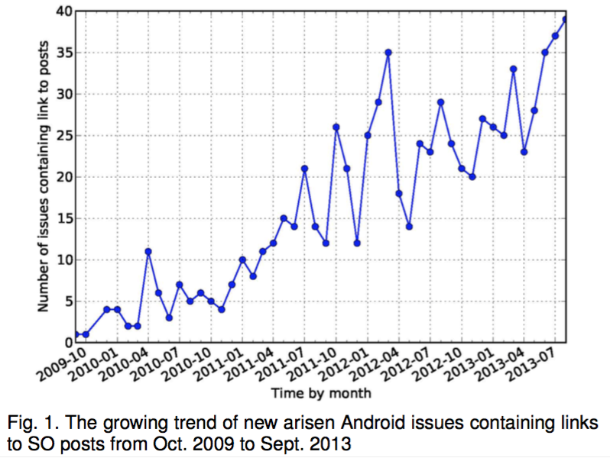
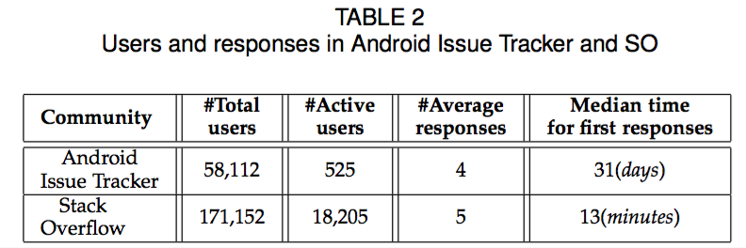
BENEFITS OF KNOWLEDGE SHARING BETWEEN ANDROID ISSUE TRACKER AND STACK OVERFLOW (Cont.)
Benefits of Knowledge Sharing for Android Issue Tracker

Slide 6
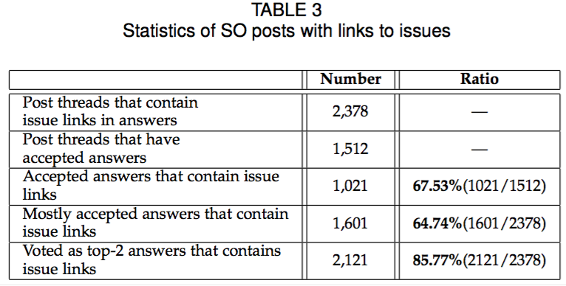
BENEFITS OF KNOWLEDGE SHARING BETWEEN ANDROID ISSUE TRACKER AND STACK OVERFLOW (Cont.)
Benefits of Knowledge Sharing for StackOverflow
Notes:
解释数字

Slide 7
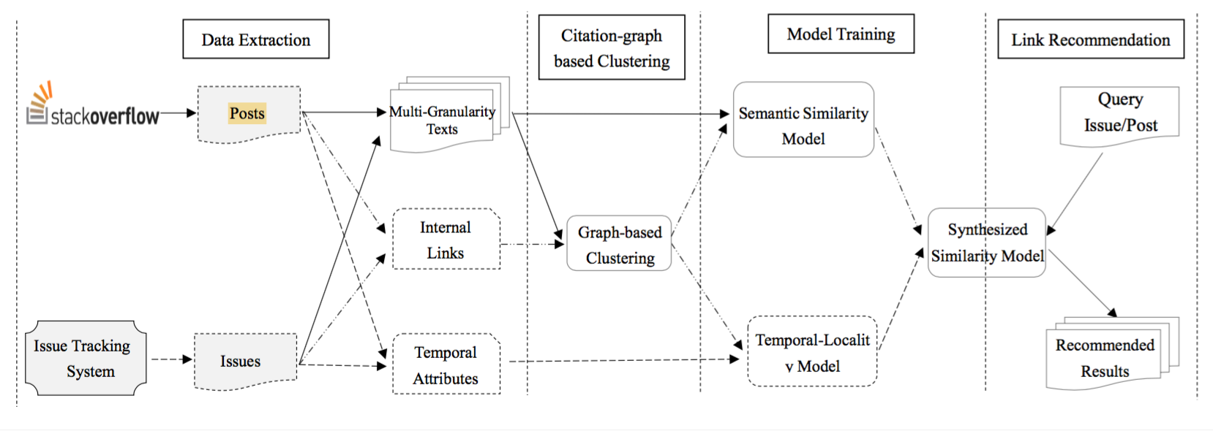
APPROACH
Overview of Our Approach

Slide 8
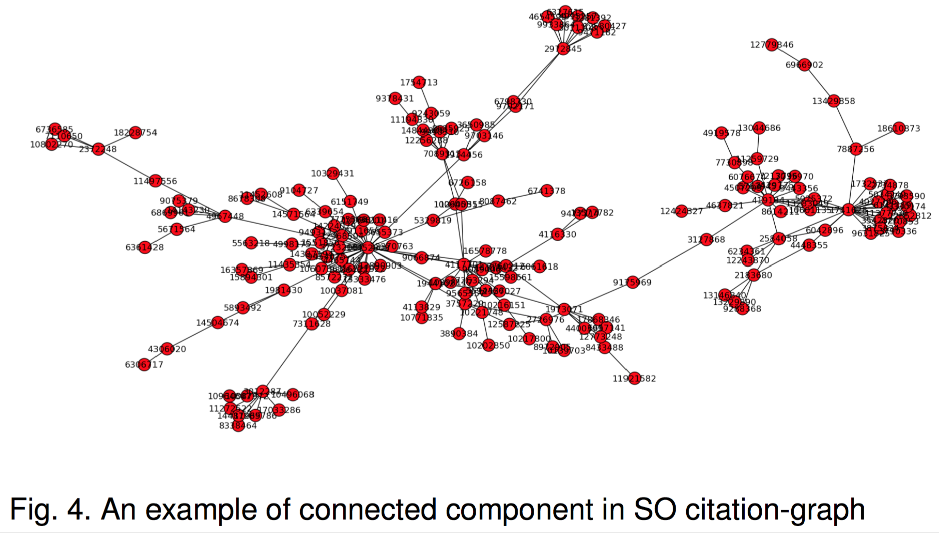
APPROACH (Cont.)
Citation-Graph based Clustering

Slide 9
APPROACH (Cont.)
Semantic-Similarity Based Recommendation
Vector Space Model(TFIDF)
Latent Semantic Indexing Model
Latent Dirichlet Allocation Model

Slide 10
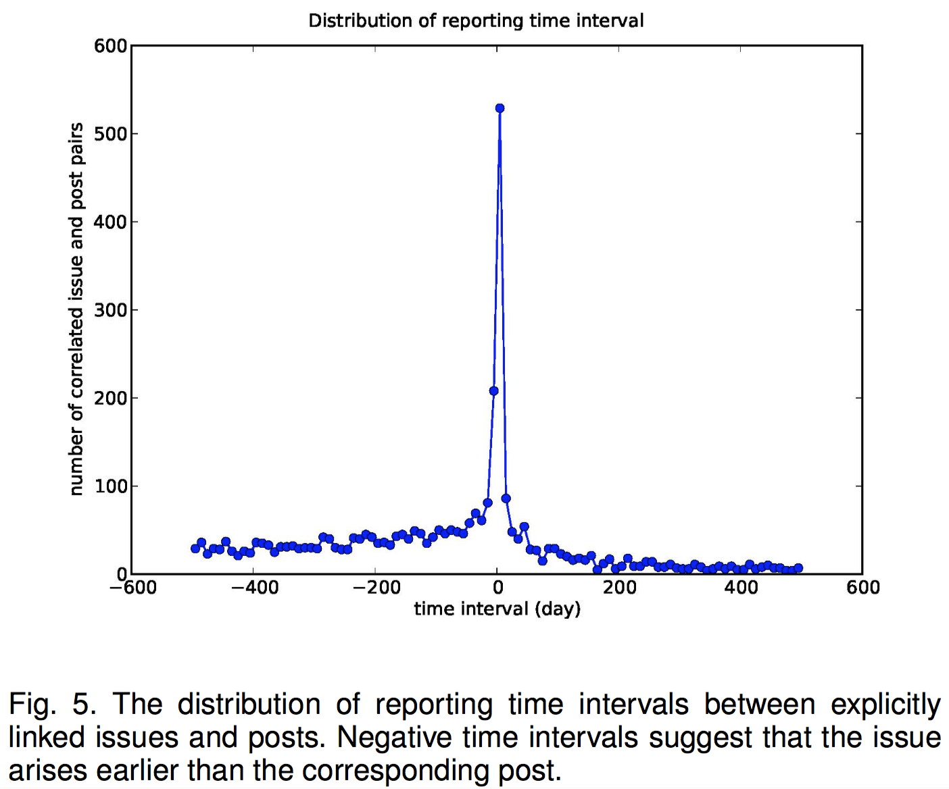
APPROACH (Cont.)
Temporal-Locality Based Recommendation
Reporting-Time Locality
Responding-Time Locality
Temporal Locality based Approach

Slide 11
EXPERIMENT
Research Questions
RQ1: Which Information Retrieval approach is most effective for linking issues and posts?
RQ2: What granularity of thread information is most effective for linking issues and posts?
RQ3: Whether or not temporal locality could improve the linking accuracy?
RQ4: Can citation-graph based clustering improve the linking accuracy?
Evaluation Metrics

Slide 12
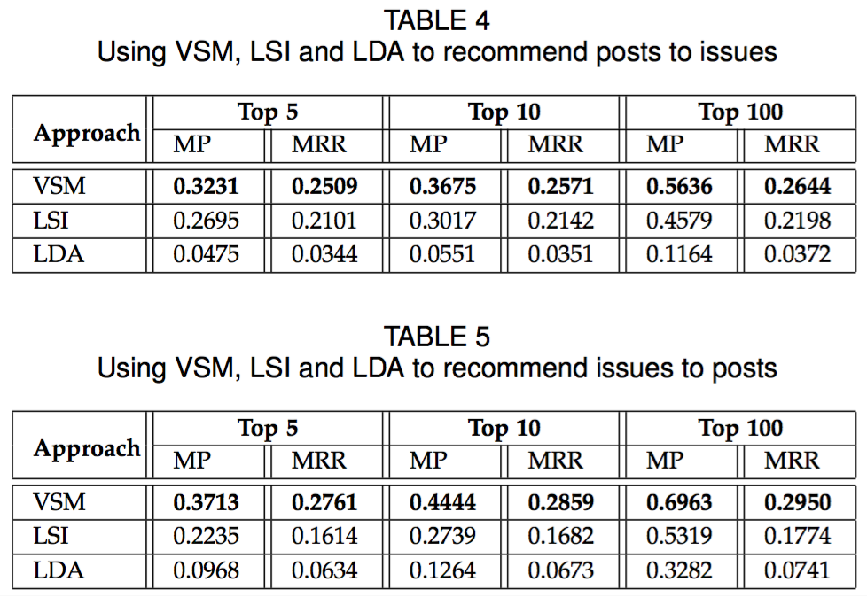
RESULTS AND DISCUSSION
RQ1: Different Information Retrival Approaches

Slide 13
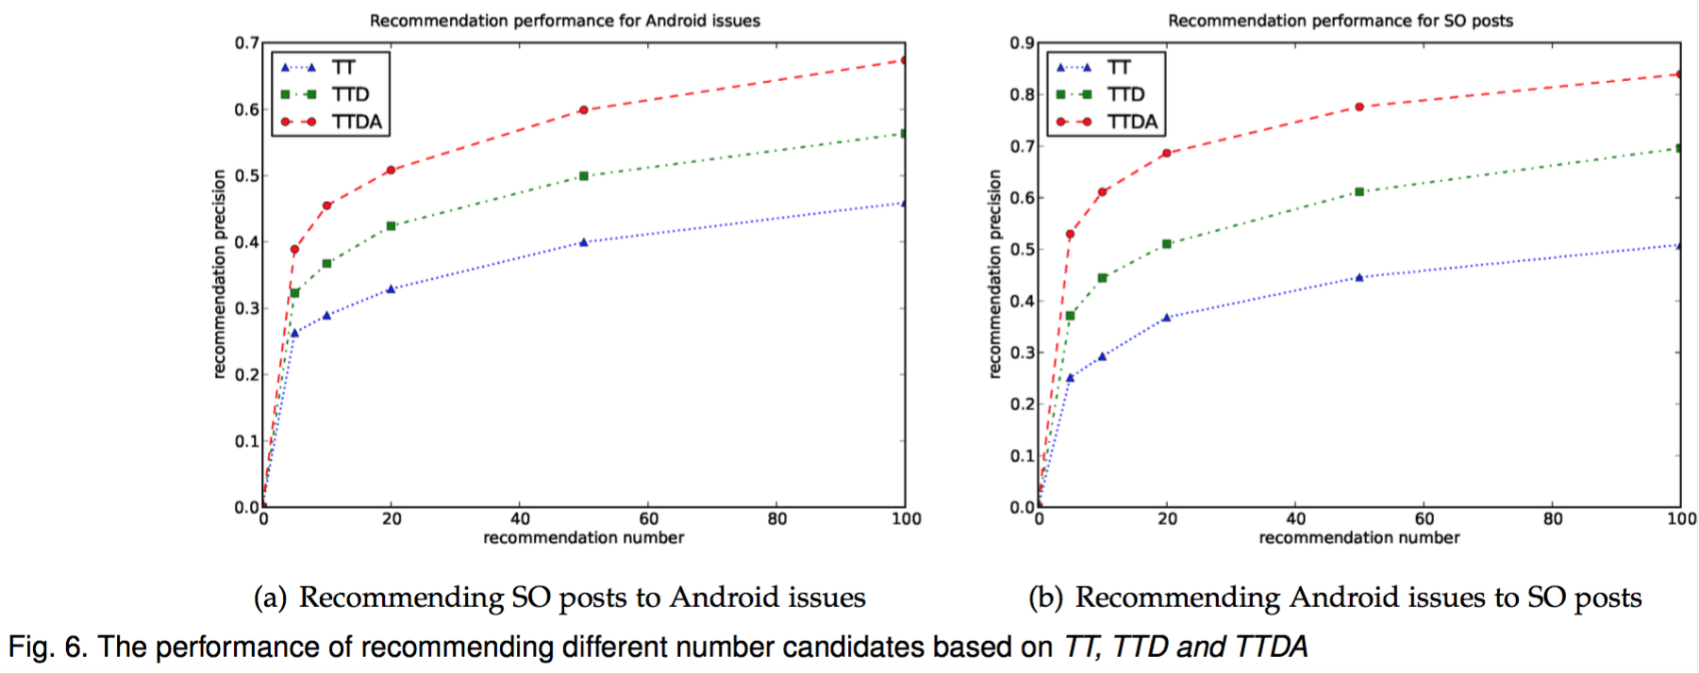
RESULTS AND DISCUSSION (Cont.)
RQ2: Different Granularities of Thread Information

Slide 14
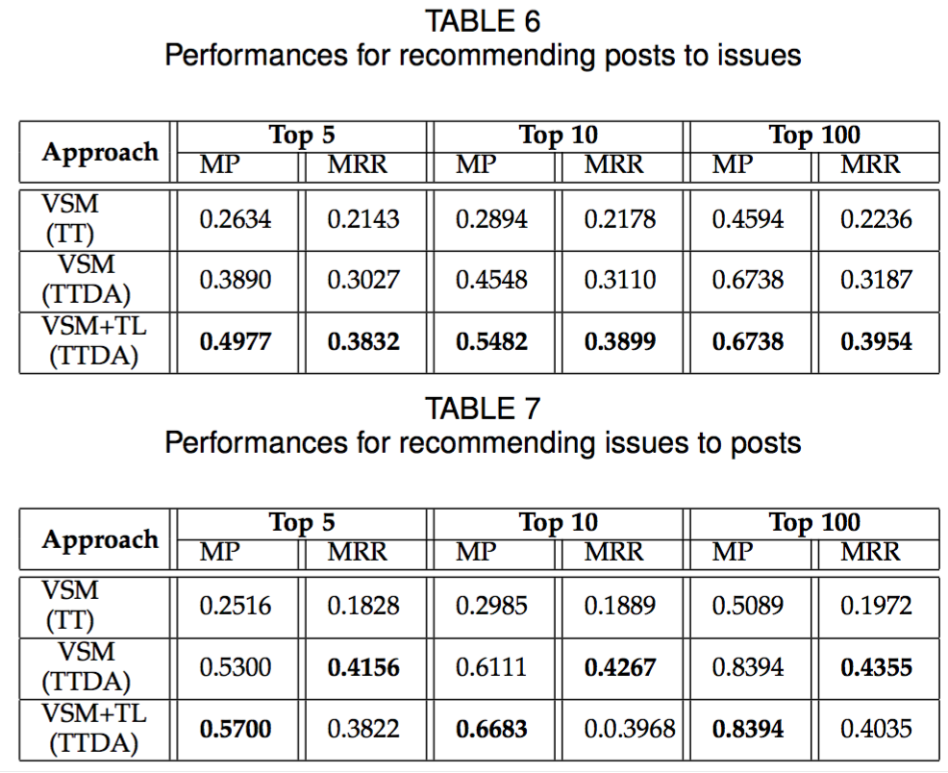
RESULTS AND DISCUSSION (Cont.)
RQ3: Temporal-Locality based Approach

Slide 15
RESULTS AND DISCUSSION (Cont.)
RQ4: Citation-Graph based Approach

Slide 16
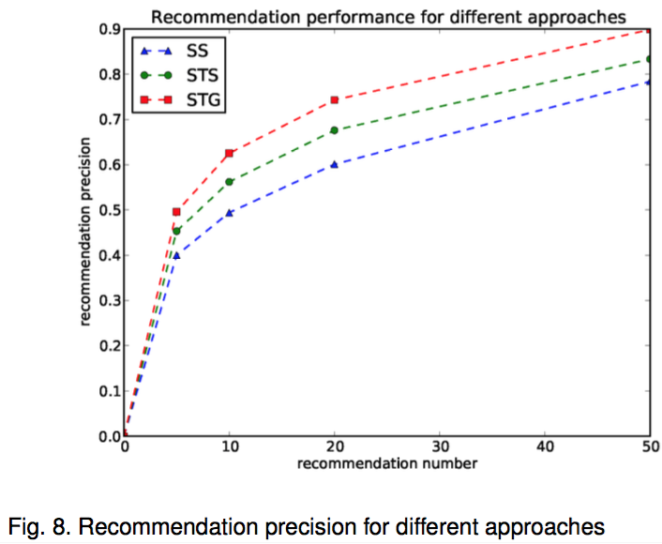
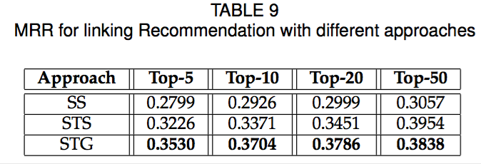
RESULTS AND DISCUSSION (Cont.)
RQ4: Citation-Graph based Approach

Slide 17
CONCLUSION
The mutual benefits of knowledge sharing between Android Issue Tracker and StackOverflow
explored from different perspectives
attention has been rarely paid before.
A novel approach combining internal citations, semantic similarity with temporal-locality is proposed, and a uniform similarity
Three typical IR approaches are investigated and different granularities of text information for issues and posts are explored
Comprehensive experiments are conducted and different approaches are compared which demonstrate the validation of our method.

Slide 18
Pros and Cons
Pros
Experimental Analysis
Brand new features
Cons
Ignore feature interaction
Not in-depth semantic
Android Threads Limited
Notes:
不同类型的issue的Response Time可能不一样
安卓类型的限制，却没有深入分析安卓相关问题的特性

Slide 19
Thanks
Q&A

