Slide 1
Automatic mapping of user tags to Wikipedia concepts: The case of a Q&A website – StackOverflow
Journal of Information Science 2015, Vol. 41(5) 570–583 Department of Electronic and Computer Engineering, University of Limerick, Ireland
Arash Joorabchi, Michael English, Abdulhussain E. Mahdi
{Email: Hussain.Mahdi@ul.ie}
Dong Xiang
2016.05.16

Slide 2
Outline
StackOverflow -> Wikipedia
Methodology
Experiments
Summary

Slide 3
StackOverflow -> Wikipedia
Background: the importance of tagging
User tagging (a.k.a. crowdsourced tagging, social tagging, collaborative tagging) has become a popular approach to generate subject metadata for a wide range of online materials.
The crowdsourced nature of user tagging reduces the cost of indexing significantly and makes it a viable option for subject metadata generation in many online settings.

Slide 4
StackOverflow -> Wikipedia
Background: drawbacks of tagging
As an alternative to the professional indexing with controlled vocabularies, user tagging relies on user communities to collaboratively index resources of their interest with uncontrolled vocabularies
The inconsistencies caused by spelling variations, synonyms, acronyms and hyponyms

Slide 5
StackOverflow -> Wikipedia
Background: the usage of Wikipedia
The investigation conducted by Nature suggested that Wikipedia comes close to Encyclopaedia Britannica in terms of the accuracy of its science entries.
Mapping user tags to their corresponding Wikipedia articles, as well-formed concepts, offers multifaceted benefits to the process of subject metadata generation and management in a wide range of online environments.

Slide 6
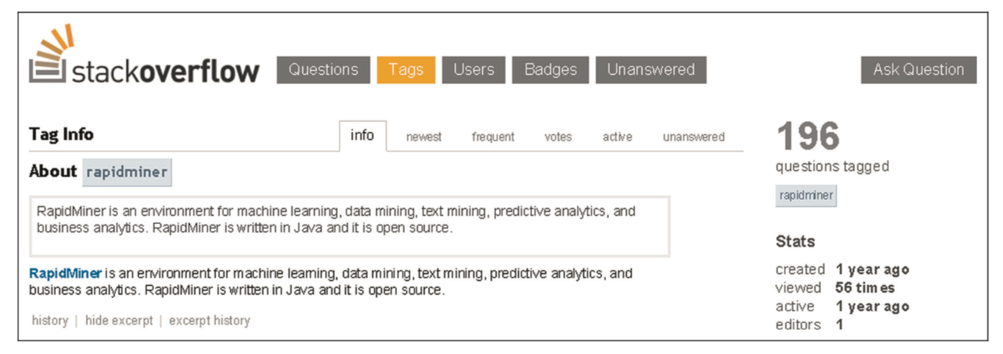
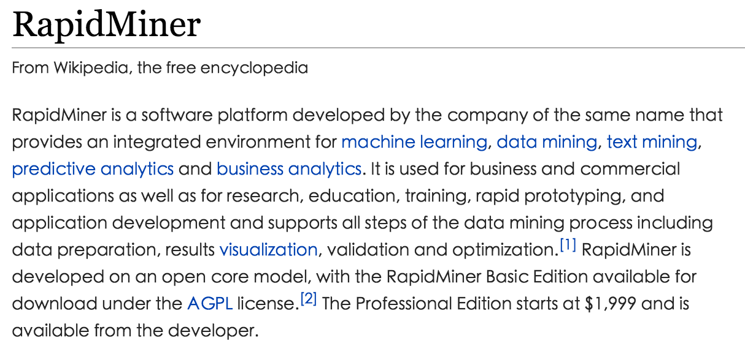
StackOverflow -> Wikipedia
Problem description:

Slide 7
Outline
StackOverflow -> Wikipedia
Methodology
Experiments
Summary

Slide 8
Methodology
(a) identification of all of the Wikipedia concepts appearing in the wiki page of the tag to be mapped
(b) binary classification of detected concepts into equivalent or non-equivalent concepts

Slide 9
Stage (a)
Wikipedia-Miner:detecting Wikipedia concepts occurring in the tags’ wiki pages
use the topic detection functionality of the Wikipedia-Miner to identify all the Wikipedia concepts whose descriptor or non-descriptor lexical representations occur in a tag’s wiki page
rapidminer(StackOverflow) -> RapidMiner, Environment, Machine, Machine learning, Learning Data, Data mining, Mining

Slide 10
Stage (a)
Features for Wikipedia concepts I.
1. Frequency - the occurrence frequency of the candidate concept and its synonyms in the tag’s wiki page.
2. First Occurrence - the distance between the start of the tag’s wiki page and the first occurrence of the candidate concept.
3. Last Occurrence - the distance between the end of the tag’s wiki page and the last occurrence of the candidate concept.
4. Spread – the distance between the first and last occurrences of the candidate concept.

Slide 11
Stage (a)
Features for Wikipedia concepts II.
5. Max Link Probability - the ratio of the number of times it occurs in Wikipedia articles as a hyperlink.
6. Average Disambiguation Confidence - each term in the wiki page can only correspond to a single concept that has the highest probabilistic confidence.
7. Max Disambiguation Confidence - the maximum disambiguation confidence value of a candidate concept that appear in the tag’s wiki page.
8. Link-based Relatedness to Other Concepts - according to the number of Wikipedia concepts that discuss/mention and have hyperlinks to both the two concepts being compared.(Wikipedia Link-based Measure)
9. Link-based Relatedness to Context - the relatedness of the candidate concept is only measured against those of other candidate concepts in the tag’s wiki page that are unambiguous.

Slide 12
Stage (b)
Building a training and testing dataset
Adopt a semi-supervised labelling method to build our required dataset. This method consists of two main stages :
1> The tag’s wiki page should contain one or more hyperlinks to Wikipedia articles.
2> One of those hyperlinks should be to the Wikipedia article corresponding to the first Wikipedia concept detected in the tag’s wiki page.

Slide 13
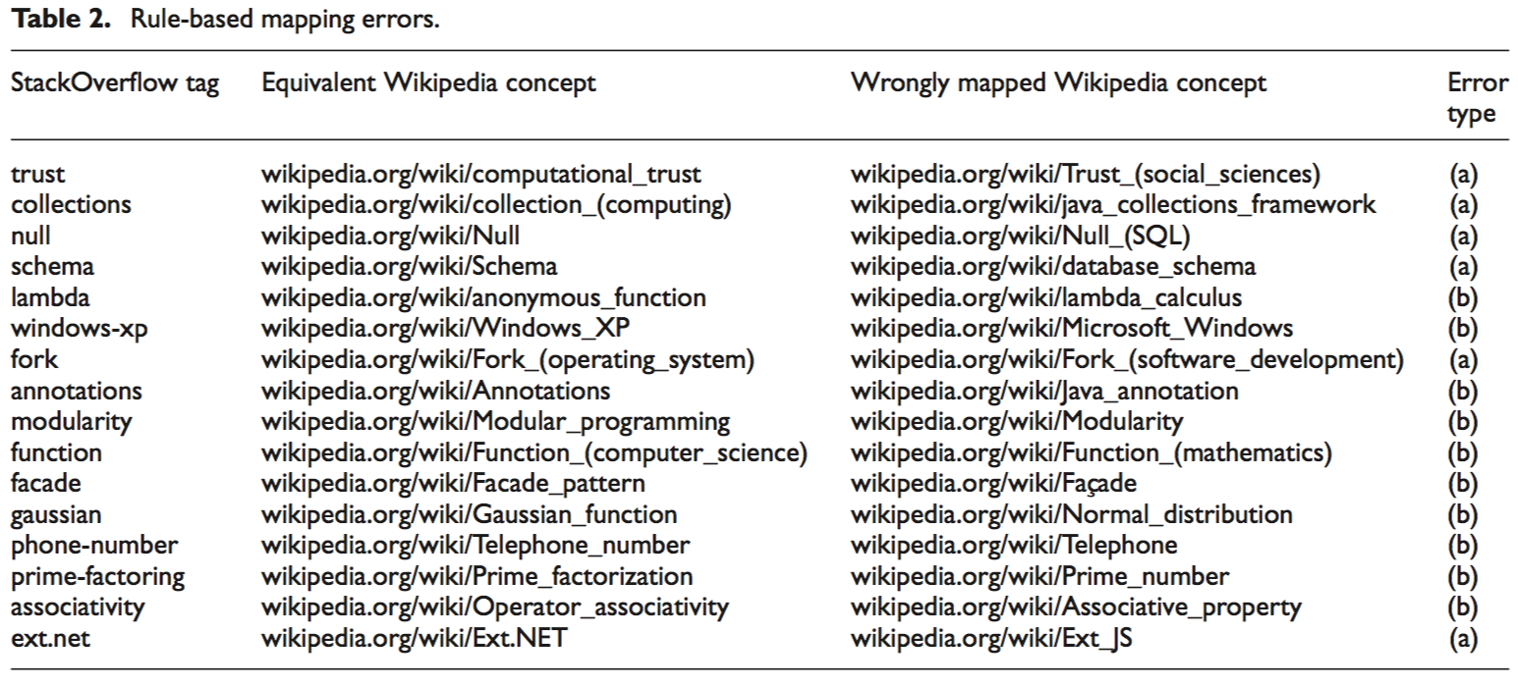
Stage (b)
Building a training and testing dataset
The final dataset contains a total of 38,184 Wikipedia concept instances, out of which 1250 (3.27%) belong to the equivalent class and the remaining 36,934 (96.73%) concepts belong to the non-equivalent class.

Slide 14
Outline
StackOverflow -> Wikipedia
Methodology
Experiments
Summary

Slide 15
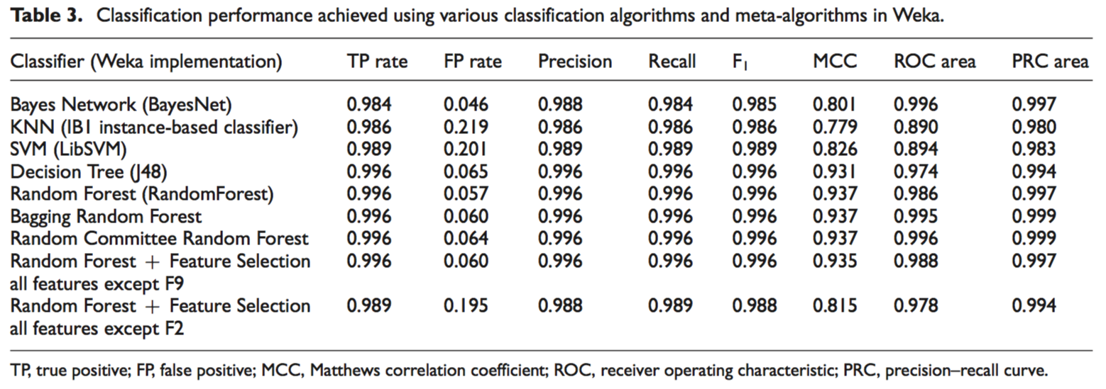
Experiment I.
Classification algorithms comparison

Slide 16
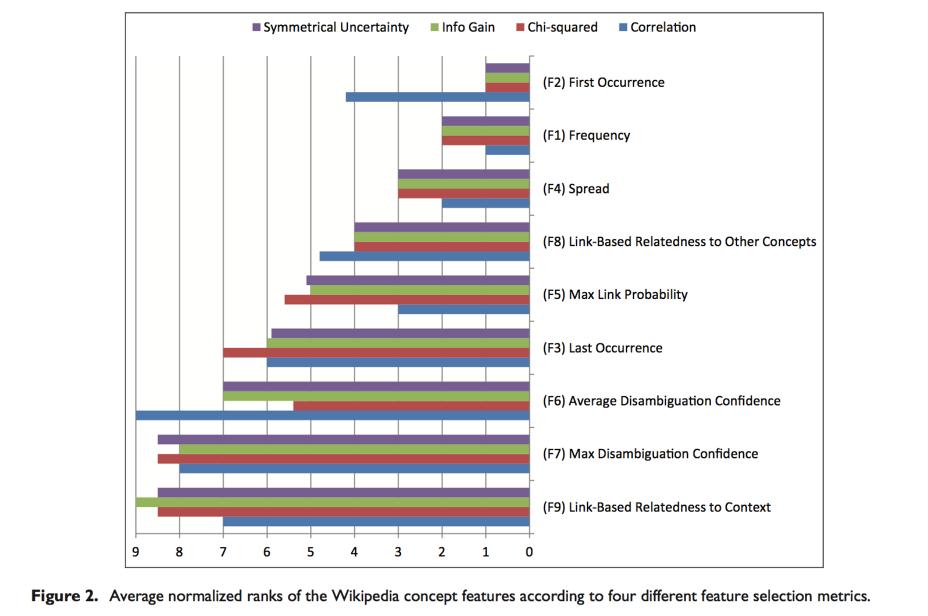
Experiment II.
Ranks of Wikipedia concept features

Slide 17
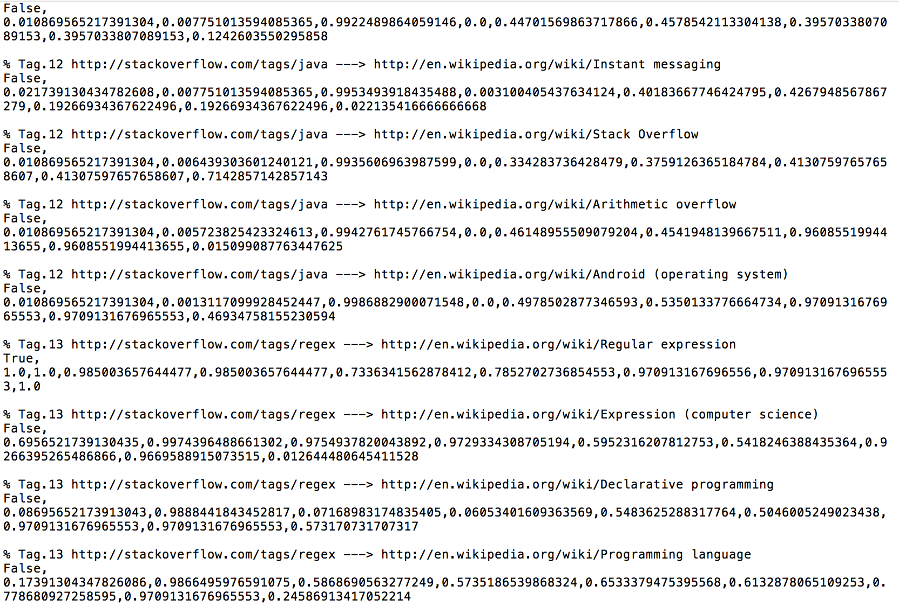
Results of dataset

Slide 18
Outline
StackOverflow -> Wikipedia
Methodology
Experiments
Summary

Slide 19
PIDGIN
Summary

Slide 20
Thanks

