Slide 1
Tagging Your Tweets
A Probabilistic Modeling of Hashtag Annotation in Twitter
[CIKM2014]
Zongyang Ma, Aixin Sun, Quan Yuan, Gao Cong
Cai Xuyang
11/4/2015

Slide 2
Outline
Introduction
Hashtag Annotation Models
EM Algorithm
Experiment

Slide 3
Introduction
Twitter is one of the most popular social networking and microblogging platforms. It has accumulated a tremendous amount of text data.
Effectiveness of Hashtags:
Bring organization to the sparse information
Enhance information diffusion and tweet search
Facilitate social chatting

Slide 4
Introduction
Freedom Limitation for users:
Whether or not to annotate tweets with hashtags
Which hashtags to use (e.g., #cikm, #cikm14, or #cikm2014)
Research Point:
Formal modeling of the latent relationship between the important factors in affecting hashtag annotation.

Slide 5
Introduction
Tweets cover a large number of diverse topics, such as personal activities and comments on recent or ongoing events.
Model the latent topical relationship between:
User interest
Posting time
Tweet content
Hashtag
A probabilistic
framework
better understanding hashtag annotation at Topic-Level

Slide 6
Introduction
Tweet content.
Tweet content is the most important factor affecting the usage of hashtags.
Tweet Content -> Hashtags
Hashtags -> Tweet Content
Two different
generation processes
User.
A large portion of tweets from a common user are about her personal interests/activities. The hashtags adopted by a user often reflect such interests and activities.
Time. Twitter is a real-time social media. Many of the tweets are about recent or ongoing events.

Slide 7
Introduction
Considering the three factors and the two generation processes, we propose two PLSA-style models.
CPM:
Assumes that a user composes a tweet and then finds the appropriate hashtags to describe the tweet.
HPM:
Assumes that a user composes a tweet with pre-selected hashtag(s) in mind.
Impact of Social Factor:
Assumes that users mention each other more often are more likely to adopt similar hashtags.
- Social network regularization

Slide 8
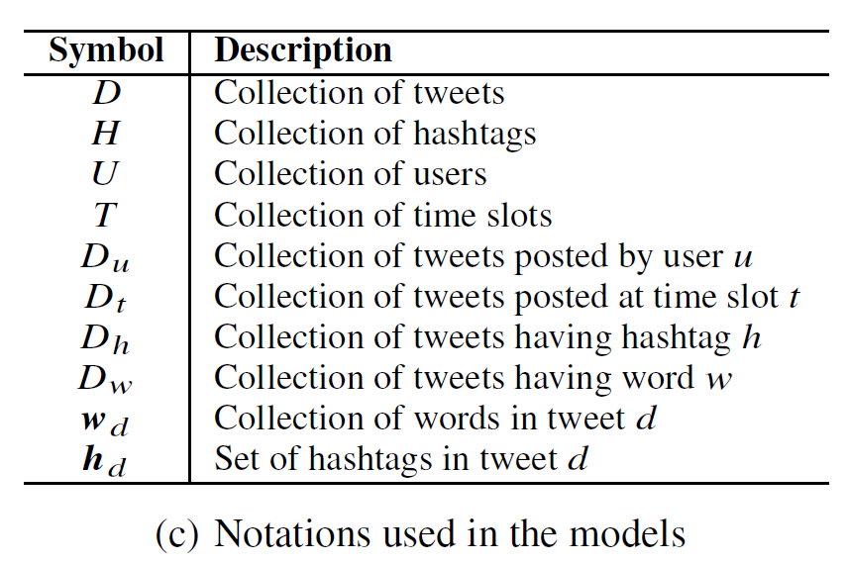
Model Notations

Slide 9
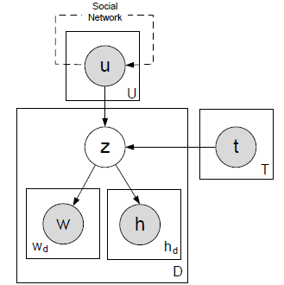
Content-Pivoted Model (CPM)
The topic z of tweet d can be generated from the user topic distribution p(z|u) and the time topic distribution p(z|t).
After a topic z is generated, all words wd in the tweet d are sampled from p(w|z). Then the hashtags of tweet d, hd, are sampled from p(h|z).
Bayesian graphical representation of CPM

Slide 10
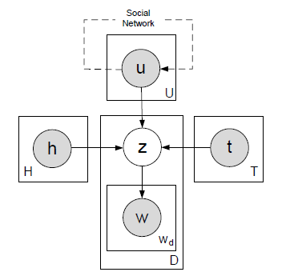
Hashtag-Pivoted Model (HPM)
In HPM, a user may also choose to directly comment on a specific hashtag.
The topic z of a tweet may be drawn
from user topic distribution p(z|u), time topic distribution p(z|t), or hashtag topic distribution p(z|hd ).
Bayesian graphical representation of HPM

Slide 11
Inference Algorithms
We propose an Expectation-Maximization (EM) algorithm for appropriately inferring z in both models.
Maximum Likelihood Estimation

Slide 12
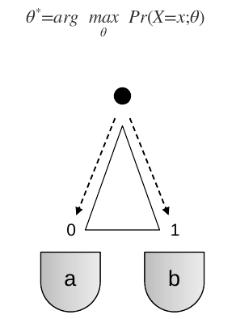
Maximum Likelihood Estimation
probability density function
X10=（b,b,b,a,b,b,b,b,b,a）
p=0.2

Slide 13
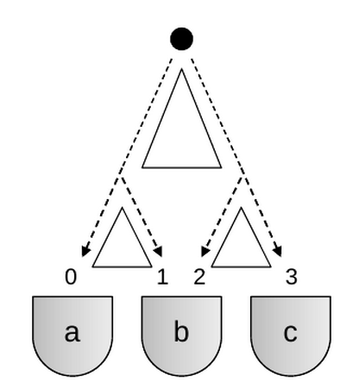
Maximum Likelihood Estimation
Model Parameter: p={p0,p1,p2}
Latent variable: Y
P0
P1
P2
Assumption: Y={N0,N1,N2,N3}
Y =
X =

Slide 14
Maximum Likelihood Estimation
Considering the probabilistic model:
P0
Observed Variables: X
Unknown Variables: Y and θ
Pr(X,Y;θ)
P1
P2
Y =
Observing a set of value x=(x1,x2,…,xn):
X =
Compute optimal value of θ:

Slide 15
Maximum Likelihood Estimation
EM is a iterative algorithm trying to find a set of estimated parameter, in order to increase the marginal likelihood.
Randomly assign value to θ0 at start.
Each iteration has a E-Step and M-Step.
It is in convergence until: θ^{(i+1)} ≈ θ^{(i)}

Slide 16
Maximum Likelihood Estimation
E-Step
Compute the posterior probability when X=x and Y=y
f(x|X) is a weighted value

Slide 17
Maximum Likelihood Estimation
M-Step
Compute the parameter θ(i+1)
Computed in E-Step

Slide 18
Maximum Likelihood Estimation
Computation Example
Randomly assign
E-Step

Slide 19
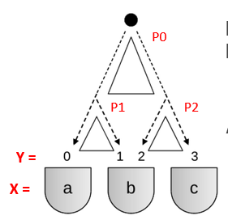
Maximum Likelihood Estimation
Computation Example
M-Step

Slide 20
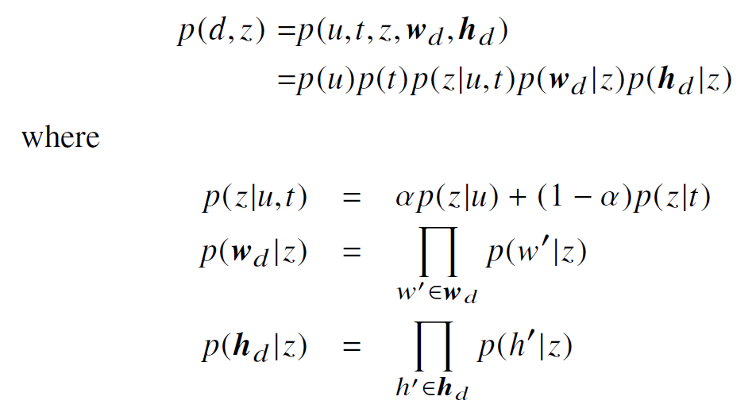
Inference Algorithms
We propose an Expectation-Maximization (EM) algorithm for appropriately inferring z in both models.
In CPM, the joint probability over tweet d and topic z can be represented as:
The joint probability for HPM over tweet d and topic z is

Slide 21
Inference Algorithms
The log-likelihood in CPM is

Slide 22
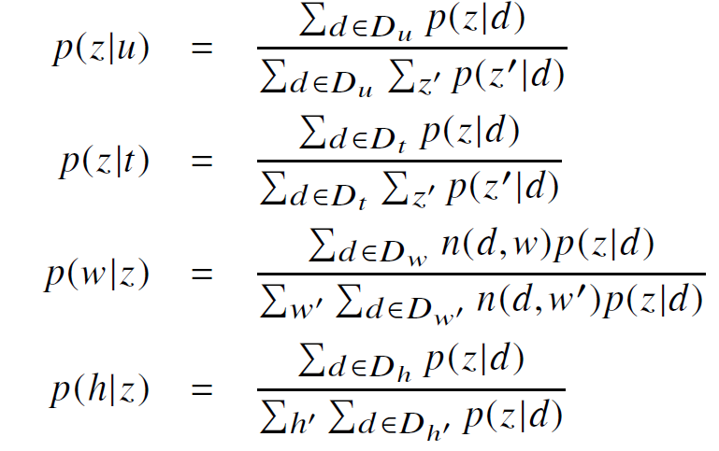
Inference Algorithms
The log-likelihood in CPM is
In M-step, it is complicated to estimate p(z|u) and p(z|t)
Jensen’s inequality

Slide 23
Social Network Regularization
Users who often mention each other are more likely to share similar topics.
Minimize:
Cuv : times of mention each other in their tweets
Regularized log-likelihood is expressed as RL = L − R

Slide 24
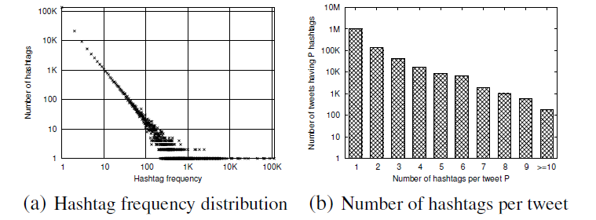
Experiment
The tweets used in our evaluation are published by Singapore-based users from January 1, 2011 to August 31, 2011.

Slide 25
Evaluation by Perplexity
Perplexity is a standard metric for evaluating topic models. It measures the ability of a model in generating unseen data.
Lower perplexity indicates better model performance.
200,000 tweets to be the testing data set, and the remaining 1,017,928 tweets are used to train the models.

Slide 26
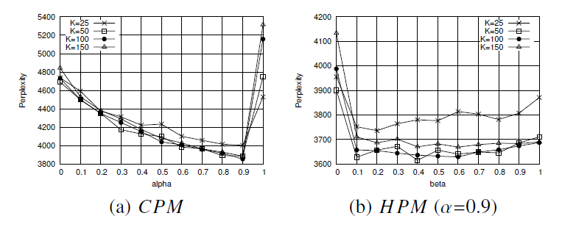
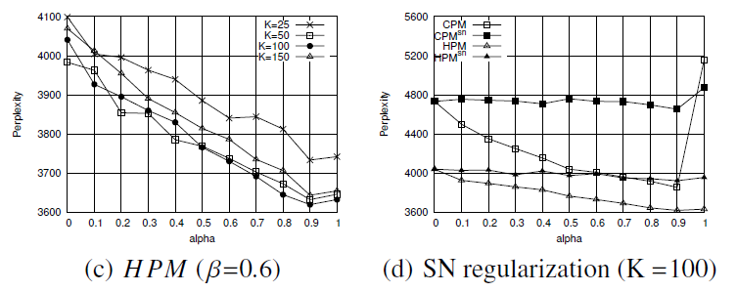
Evaluation by Perplexity

Slide 27
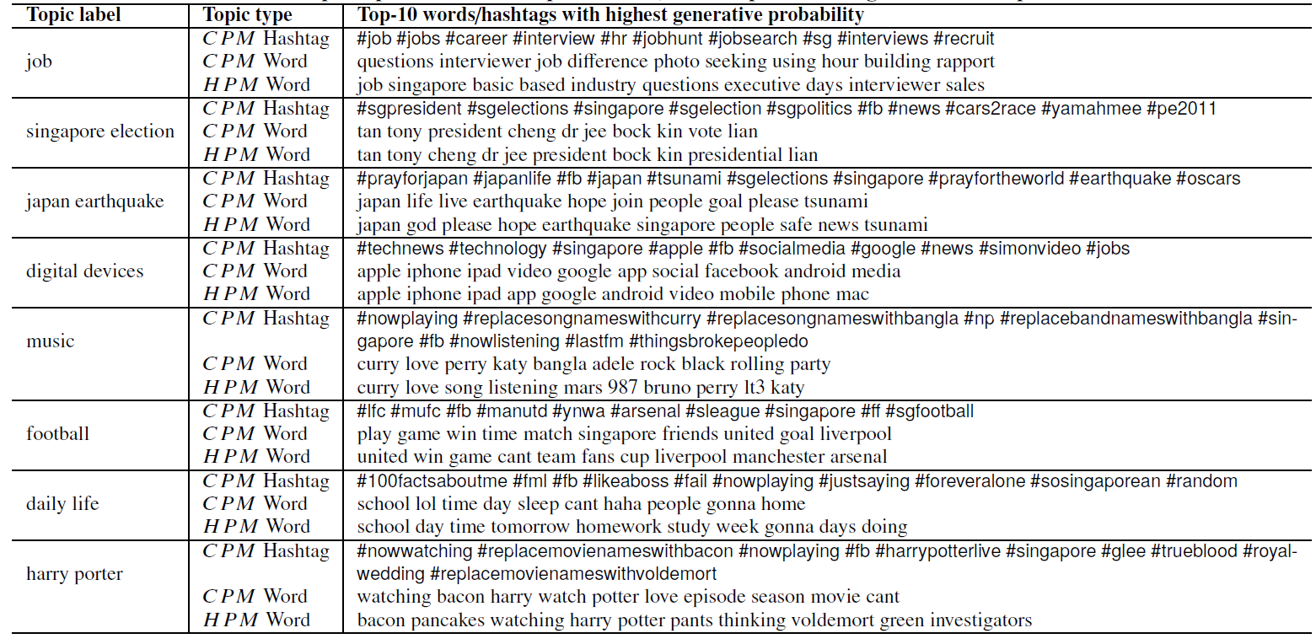
Topic Discovery
We now present 8 sample topics discovered by the two models CPM and HPM.
1.Most top-ranked hashtags of hashtag topic are well associated semantically with the corresponding word topics.
2. CPM are relatively more specific while topical hashtags of CPM are more general.
3. HPM is more powerful in finding less popular topics like business and shopping.

Slide 28
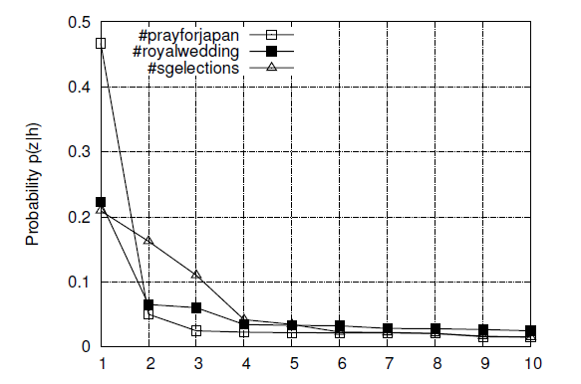
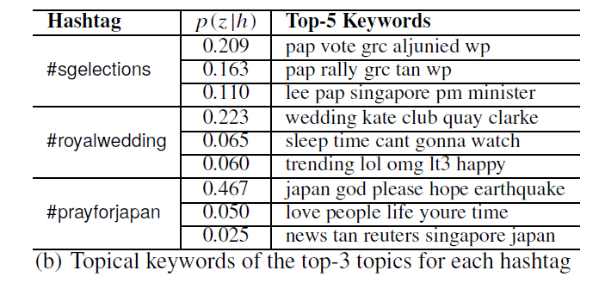
Topic Distribution
We show the topic distribution generated by HPM for three example hashtags: #sgelections, #royalwedding and #pray-forjapan.

Slide 29
Thanks
Q&A
Notes:
The growth of the Semantic Web [4] has contributed signicantly to the construction and availability of such KBs.

