Slide 1
Mining Location-Based Social Networks: A Predictive Perspective
Defu Lian, Xing Xie, Fuzheng Zhang, Nicholas J. Yuan, Tao Zhou, Yong Rui
Big Data Research Center, University of Electronic Science and Technology of China
Microsoft Research, Beijing, China
Dong Xiang
2016.11.29

Slide 2
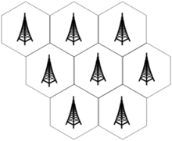
Background
(1) The increased scale of location information

Slide 3
Background
(2) The development of location-based social network
Gowalla
Foursquare
Wechat

Slide 4
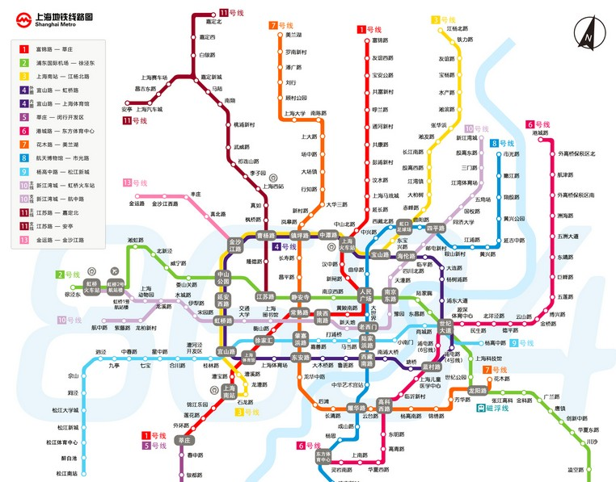
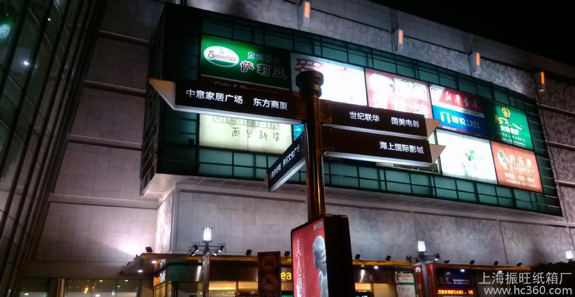
Significance
1. Unban Planning
2. Traffic forecasting
3. Advertising
4. Commercial Analysis

Slide 5
Problem Definition
Mining the location where the user check-in, predict the location he/she will arrive with high probability
A typical scenario for next check-in location prediction

Slide 6
Problem Analysis
1. Spatial Analysis
2. Temporal Analysis

Slide 7
Spatial Analysis
Finding the distance distribution between consecutive mobility records given regular and irregular (novel) mobility behaviors coexisted.
1) most check-ins (over 80%) are within 10 kilometers from the immediately preceding locations.
2) when we already know that users have checked in at regular locations, the next regular location is significantly nearer to them than next novel location.
3) users are more willing to explore continuously. This
means that when a user has visited a new attraction, she may also try a nearby restaurant.

Slide 8
Temporal Analysis
1) returning probability is characterized by peaks of each day, capturing a strong tendency to daily revisit regular locations
2) It confirms the existence of temporal regularity, which
is thus necessarily introduced into the prediction model

Slide 9
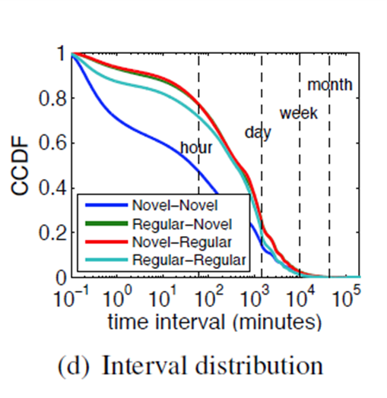
Temporal Analysis
1) when a user has visited a regular location, she is less inclined for exploration soon after
2)users will be more likely to visit novel neighboring locations consecutively within a short interval

Slide 10
Problem Solving
1. Regularity Mining for Regular Mobility Prediction
2. Location Recommendation for Irregular Mobility Prediction
3. Mining Propensity of Novelty Seeking
4. A Novelty-Seeking Driven Framework for General Mobility Prediction

Slide 11
1. Regularity Mining for Regular Mobility Prediction
(1) Markov-based Predictors
Learning the Markov model mainly depends on the estimation of location transition (due to the small amount of personal data, only first-order Markov models are taken into account)
Particularly, in most mobility datasets from LBSNs, the number of parameters in the Markov estimator is around 40× 40 since there are 40 POIs for each user on average, while there are only about 60 training instances (mobility records) on average.
Laplace smoothing techniques or Kneser-Ney smoothing techniques

Slide 12
1. Regularity Mining for Regular Mobility Prediction
(2) Temporal Regularity
In temporal regularity, the conditional probability P(l|d, h) must be estimated accurately, where d is the day of week and h is the hour of day. Assuming the conditional independence d and h given location l
6 pm. Or centered 6 p.m? => Gaussian kernel smoothing function

Slide 13
1. Regularity Mining for Regular Mobility Prediction
(3) Hidden Markov Model
Temporal regularity and Markov model can be integrated in a unified Hidden Markov Model, where locations are considered as hidden states and the temporal information is considered as the observations of Hidden Markov Model.
Supervised learning to estimate the parameters corresponds to the above estimation process
Use Maximum Likelihood Estimate for the initial state probability

Slide 14
2. Location Recommendation for Irregular Mobility Prediction
Method
1. User Preference Learning
2. Geographical Constraint
3. Social Influence
4. Hybrid Recommendation

Slide 15
1. User Preference Learning
(1)User-based collaborative filtering
User u represents as
ru ∈ {0, 1}N
, N means N locations in total
Similarity calculation formula:
范数：||A||=(∑aij^2)^(1/2)
(2)Use Matrix factorization as dimension reduction

Slide 16
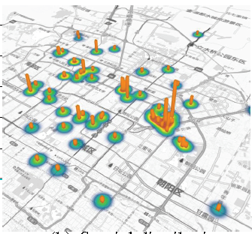
2. Geographical Constraint
The geographical information of location requires physical interactions, near
things are more related than distant things
(1) Kernel density estimation
infers the probability a user will show up around location lj
(2)Learning-based geographical inference
seamlessly integrating geographical modeling with matrix factorization based user preference learning

Slide 17
2. Geographical Constraint
Graph Laplacian regularization: is more often exploited for capturing social influence for the sake of
seamless integration with matrix factorization based preference learning, although social-based filtering tends to be more intuitive. Given all users’ symmetric similarities S based on social network ties, such as the ratio of common friends, this regularizer can be defined as follows:

Slide 18
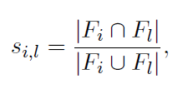
3. Social Influence
Similar to user-based collaborative filtering, except it captures user commonality based on social network information
where Fi and Fl represent the friend sets of user ui and ul, respectively

Slide 19
3. Social Influence
Graph Laplacian regularization: is more often exploited for capturing social influence for the sake of
seamless integration with matrix factorization based preference learning, although social-based filtering tends to be more intuitive. Given all users’ symmetric similarities S based on social network ties, such as the ratio of common friends, this regularizer can be defined as follows:

Slide 20
4. Hybrid Recommendation

Slide 21
3. Mining Propensity of Novelty Seeking
(1) Exploration Prediction
It determines whether people will seek novel (irregular) locations next. Given mobility data, whether a visit to a location is regular or not can be determined by searching the mobility history of the user. If the visit location has already been visited earlier, the visit is considered as regular; otherwise, it is irregular.
Exploration Prediction is a binary classification problem.
Features Building: Historical features, Temporal features, Spatial features

Slide 22
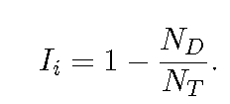
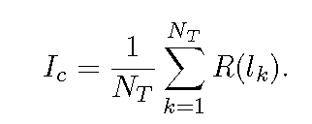
3. Mining Propensity of Novelty Seeking
(2) Mobility Indigenization
classifying people as native and non-natives
indigenization coefficients: individual behavioral Index & collaborative behavioral index
counts the ratio of repeated mobility records in a city
ND for different location，NT for all the location record
average normalized popularity of a user’s visit locations, native is less likely to visit popular locations than a non-native
These two indigenization coefficients can be used to define an integrated coefficient
Parameters are learned by LR

Slide 23
3. Mining Propensity of Novelty Seeking
(3) Irregularity Detection
further distinguishes several levels of propensity of novelty seeking, and detects the level of novelty seeking by measuring the popularity of the visit locations and the transition frequency to visiting location with respect to individual mobility history before the visit time.

Slide 24
4. A Novelty-Seeking Driven Framework for General Mobility Prediction
Provided the probabilistic output of the regularity mining algorithm Pr(l) (r indicates regular) and recommendation algorithm Pn(l) (n indicates novel), we exploit novelty seeking to combine them based on the probability of exploration Pr(Explore) as follows:

Slide 25
Thanks

