Slide 1
SEES: A Unified Method for Semi-Automatic Early Effort Estimation
Wenkai Mo, Yang Zhou, Shensi Tong, Beijun Shen, Yong Xia
School of Electronic Information and Electrical Engineering, Shanghai Jiao Tong University, Shanghai, China

Slide 2
Outline
Introduction
Approach
Improvement
Experiment
Future work

Slide 3
Outline
Introduction
Approach
Improvement
Experiment
Future work

Slide 4
Introduction
Software effort estimation is a crucial step in project management.
Existing estimation methods, such as COCOMO II and IFPUG, are too complicated, costing a lot of human effort
If estimation could be finished after requirements elicitation, it can positively affect the project management.
Notes:
According to the Standish Chaos Report, 65% of software projects are delivered over budget or after the delivery deadline.

Slide 5
Introduction
Estimation in Early phase
Requirements elicitation
Using requirement documents written in use cases, user stories, etc.
Semi-Automatic Estimation
Drivers are hard to obtain automatically.
Decreases the number of drivers

Slide 6
Outline
Introduction
Approach
Improvement
Experiment
Future work

Slide 7
Approach

Slide 8
Entity Extraction
Definition of five-tuple for each requirement item
(User; Action; Object; ActionProperty; Condition)
I-O-B Representation
I – Denotes token inside of a chunk
O – Denotes tokens outside of a chunk
B – Denotes token a the beginning of a chunk

Slide 9
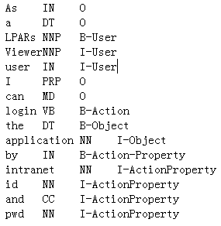
Example
As a LPARs Viewer user I can login the application by intranet id and pwd.
(LPARs Viewer user, login, the application, by intranet id and pwd, None)

Slide 10
Entity Extraction
Sequential labeling task
Conditional Random Fields (CRFs)
CRFs toolkit CRF++
Input features (Define in the template of CRF++)
Word sequences of a requirement item
Corresponding Part-Of-Speech (POS) tagging sequences of the word sequences
Performance depends on labeled data

Slide 11
Approach

Slide 12
Feature Extraction
Global Features
The number of requirement items
The number of unique nouns in all requirement items
The number of unique nouns in Object fields of all requirement items
The number of user categories in the User field of all requirement items
The number of unique section categories in the Action fields of all requirement items

Slide 13
Feature Extraction
Local Features
The number of unique nouns in the requirement item
The number of unique nouns in the Object field of the requirement item
Whether the ActionProperty in the five-tuple of the requirement item is null
Whether the Condition in the five-tuple of the requirement item is null
A Bag-Of-Word (BOW) vector of the Action field
Notes:
Tokenize all actions in all requirement documents
Do the stem operation for each word to get the root of it
Select high-frequency bigrams (appearing at least 8 times)
Remove stopwords and replace all low-frequency unigrams (appearing less than 3 times)

Slide 14
Approach

Slide 15
Size and Effort Estimation (by Regression)
Features and 5 drivers for Size Estimation
Precedentedness of Product
Development Flexibility
Architecture/Risk Resolution
Team Cohesion
Process Maturity
Size and 15 drivers for Effort Estimation
Dimensionality reduction techniques
Use fewer drivers to be more automatic
Drivers are obtained from the questionnaire filled by project manager.

Slide 16
Outline
Introduction
Approach
Improvement
Experiment
Future work

Slide 17
Improvement
Actions Enhancement
Sparse representation problem
No semantic relations between two actions
Inner-Project Size Estimation
Projects are developed by iterative method
Notes:
When doing the regression, because of the sparsity, the contribution of features extracted from Action fields will be decreased.

Slide 18
Actions Enhancement
Synonym Similarity Matrix, SSM
Obtain a symmetric matrix for synonyms from WordNet
Retain more meaning of original actions SSMw,w = |Sw|
”see, view, go” see: [1, 0, 0] -> [2, 1, 0] -> [0.66, 0.33, 0]
Part-of Similarity Matrix, PSM
Constructed manually
{add; delete; view; set} part – of {manage}
u is part-of v PSMu,v = alpha(0.4) PSMv,u = beta(0.2)

Slide 19
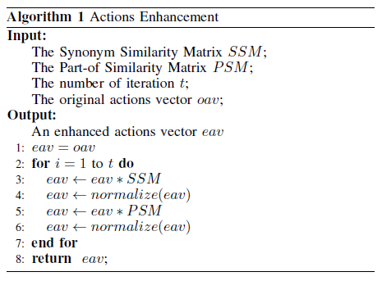
Actions Enhancement

Slide 20
Inner-Project Size Estimation
Nouns Vector Extraction
For nouns in User and Object field
Transfer Learning
Source domain (previous projects)
Target domain (previous iterations in the target project)
Regression to fs(Xt|Xs; ys) and ft(Xt|Xt; yt)

Slide 21
Outline
Introduction
Approach
Improvement
Experiment
Future work

Slide 22
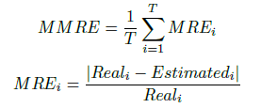
Experimental Settings
Mean Magnitude of the Relative Error
Variance of the Relative Error
Percentage of estimations within 25% of the actual values

Slide 23
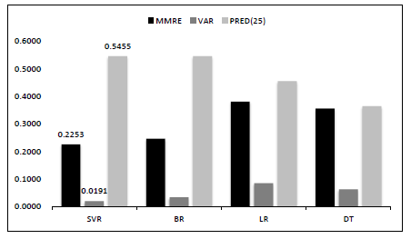
Performance of Baseline Method
Comparison of Regression Methods (SVR is the best)

Slide 24
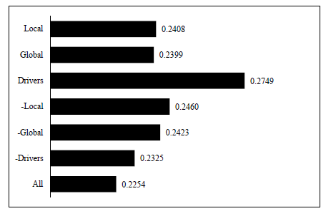
Performance of Baseline Method
Features Contribution (Local is the most important)

Slide 25
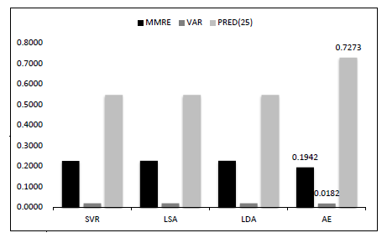
Performance of Action Enhancement
Action Enhancement is the best

Slide 26
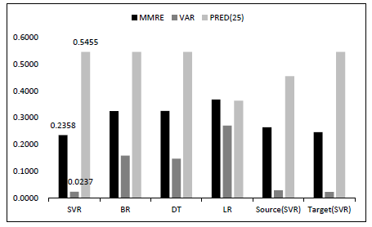
Performance of Inner-Project Estimation
Effective with transfer learning (SVR is the best)

Slide 27
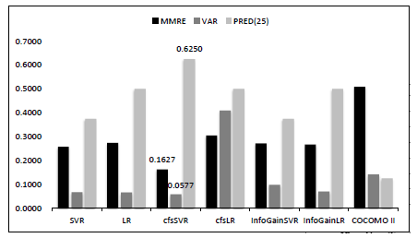
Performance of Effort Estimation
SVR algorithm with cfs is the best

Slide 28
Outline
Introduction
Approach
Improvement
Experiment
Future work

Slide 29
Future work
Collect more data from various projects to conduct experiments
Introduce deep learning to learn some deep features from documents
Improve the transfer learning algorithm
Introduce more relations during action enhancement process.

Slide 30
Thanks

