Slide 1
Matching Dependence-Related Queries in the System Dependence Graph
[Automated Software Engineering - 2010]
Xiaoyin Wang, David Lo, Jiefeng Cheng, Lu Zhang,
Hong Mei, Jeffrey Xu Yu
Key Laboratory of High Confidence Software Technologies (Peking University) School of Information Systems, Singapore Management University
The Chinese University of Hong Kong, China
Cai Xuyang
5/8/2016

Slide 2
Outline
Introduction
Background
Approach
Evaluation

Slide 3
Introduction
Developers often need to apply one change to a number of similar places in the code.
Make a programming style change
Change the environment of a software system
File
1
File
2
Only find in a few places~
File
n
File
n+1
File
n+2
Hard to find in other places!
Extract
common code patterns
It is challenging to locate all the places!

Slide 4
Introduction
Some possible ways to achieve the similar code detection:
Code-clone
Rely on a pre-defined uniform similarity metric to measure the similarity between two places.
Text search
Represent the common characteristics as a regular
expression and search in the code for matched code elements.

Slide 5
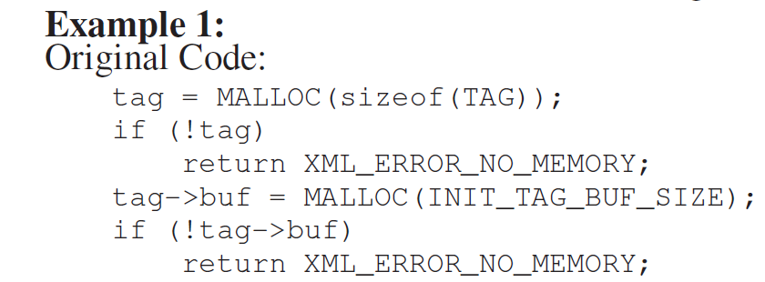
Introduction
Code-clone
Rely on a pre-defined uniform similarity metric to measure the similarity between two places.

Slide 6
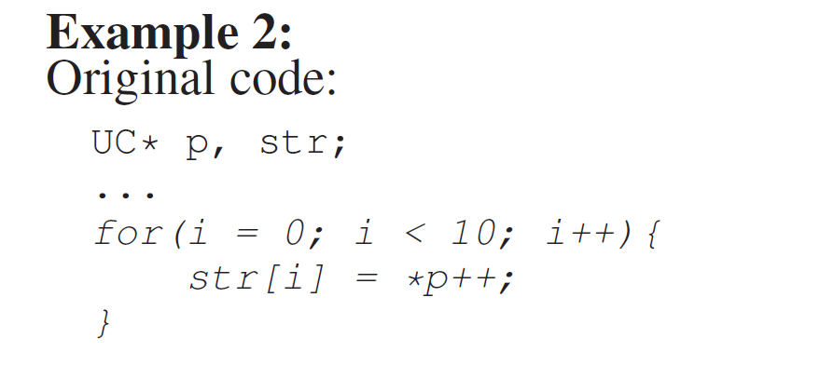
Introduction
Text search
Represent the common characteristics as a regular
expression and search in the code for matched code elements.
Some common characteristics based on control and data dependence relationships cannot be represented as a regular expression.

Slide 7
Introduction
A novel technique to locating code elements:
Write a query using a language named the Dependence Query Language (DQL)
Transform the query into a series of graph reachability patterns
Match patterns in the System Dependence Graph (SDG)
More effective than
code-clone detection and text search

Slide 8
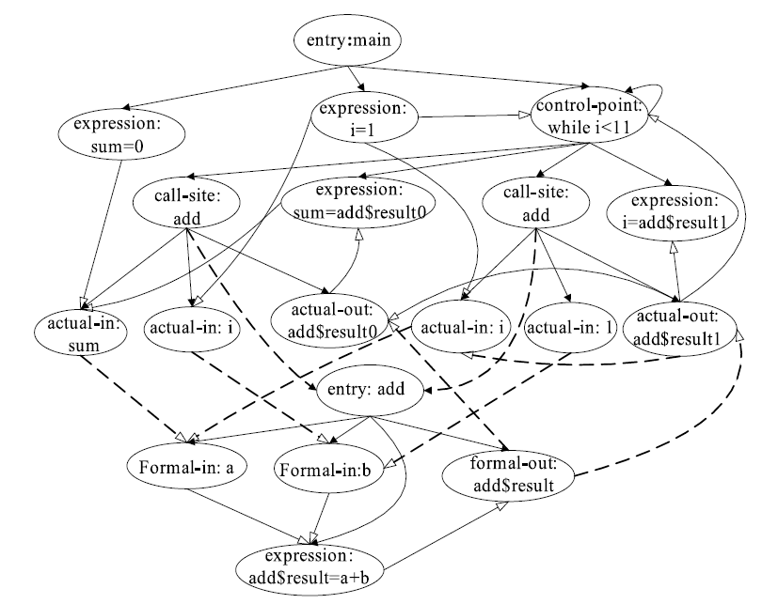
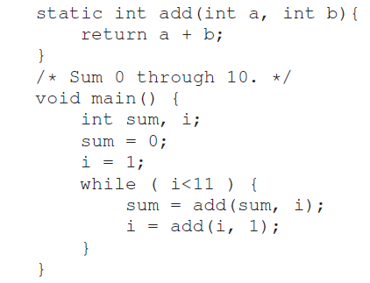
Background
System Dependence Graph (SDG)
SDG describes the dependence relationships between program points in the source code.
A fragment of code
CodeSurfer
An example system dependence graph

Slide 9
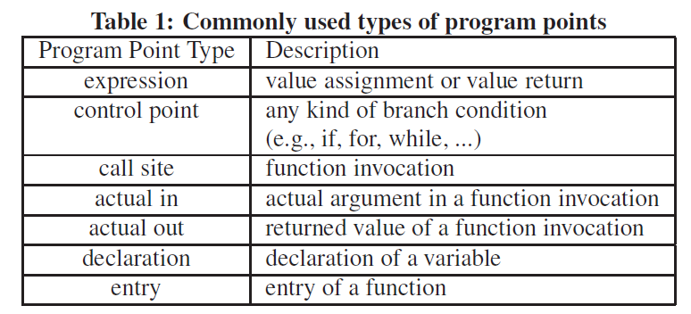
Background
System Dependence
Graph (SDG)

Slide 10
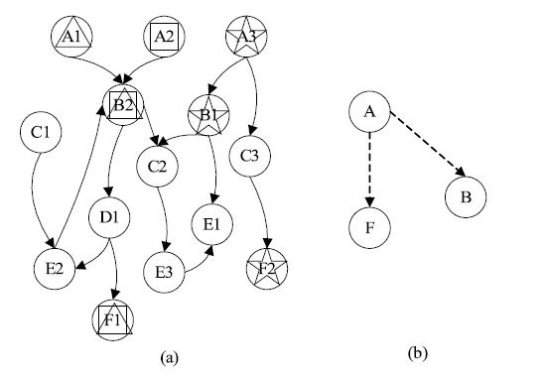
Background
Graph Reachability Indexing and Querying
Matching such a pattern in a large graph is computationally expensive.
Reachability calculation between all pairs
Matching a graph pattern
Graph reachability indexing algorithm

Slide 11
Approach
Dependence Query Language (DQL)
Query Declaration
This part allows a developer to declare a list of program points involved in the search.

Slide 12
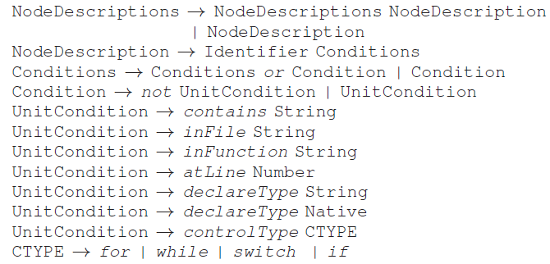
Approach
Dependence Query Language (DQL)
Node Descriptions
This part allows a developer to describe the properties related to a single program point.

Slide 13
Approach
Dependence Query Language (DQL)
Relation Descriptions
This part allows a developer to describe three kinds of dependence relationships between program points.
Target
This part allows a developer to indicate which program points in the query are the actual target.

Slide 14
Approach
Dependence Query Language (DQL) - Example
Node B
Node D
Node C
Node A

Slide 15
Approach
SDG Extraction
We obtain the system dependence graph (SDG) as follows:
Use CodeSurfer to generate an initial SDG from the code.
Check each node to see whether the node is a program point of one of the types
If so: extract its type, textual presentation, and location
Else: only label each node with its type
Extract all the edges between nodes and label them as control dependence or data dependence.

Slide 16
Approach
Query Transformation
To use graph reachability querying to search in the SDG, we need to transform a query described in DQL into one or more queries for graph reachability querying.
Transform queries in DQL into query graphs.
Split a query with disjunctions of conditions.

Slide 17
Approach
Query Transformation – Splitting Queries
We split the query into the disjunction of a series of sub-queries, each of which contains only conjunctions of conditions.
function / control-point A,
variable B;
A contains "abc" or contains "de";
A dataDepends B;
want A
control-point A,
variable B;
A contains "de";
A dataDepends B;
want A
function A,
variable B;
A contains "de";
A dataDepends B;
want A
function A,
variable B;
A contains "abc";
A dataDepends B;
want A
control-point A,
variable B;
A contains "abc";
A dataDepends B;
want A

Slide 18
Approach
Query Transformation – Transforming Conjunctive Queries
We transform the query into a query graph in the following way:
Transform each program point in the QueryDeclaration part into a node in the query graph.
Do not consider the conditions for in query transformation.
Transform the type of each program point into the label of the corresponding node.
Transform the relationships between program points into edges between nodes.

Slide 19
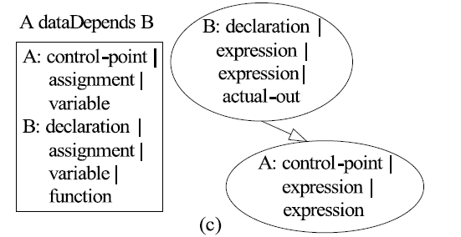
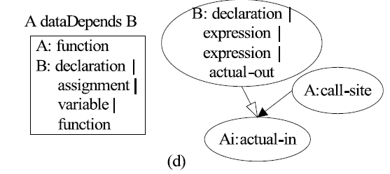
Approach
Query Transformation – Transforming Conjunctive Queries
Some rules for the transformation

Slide 20
Approach
Graph Querying
We divide either the query graph or the SDG to two partial graphs.
SDG with only data-dep edges
SDG
SDG with only ctrl-dep edges
Results in data-dep query
Final result
Query Graph with only data-dep edges
Results in ctrl-dep query
Query Graph
Query Graph with only ctrl-dep edges
Merge split nodes
Reachability indexing
algorithm

Slide 21
Approach
Result Filtering and Generation
We use the conditions that are in the original conjunctive query to filter the results.
Program Point Filter
Check each node with its corresponding program point in the query.
Relationship Filter
Verify the textual and structural conditions between program points.
OneStep Filter
Verify the oneStep conditions between program points.

Slide 22
Evaluation
Experimental Settings
To evaluate our technique, we applied our technique on four searching tasks in four versions of two different real-world open source C projects:
expat and gpsbabel
Two projects are of different sizes and from different domains.
V.S.
A code-clone detector: DECKARD
Text search

Slide 23
Evaluation
Task One - expat Project
Date: 2002-05-17
Comment: “Be more careful about failed MALLOC() and REALLOC() calls. This avoids a number of potential memory leaks”.
Places changed: 2
Method | Performance
Our Technique | Find 2 places and 36 other places
Code Clone | No results
Text Search | Find 33 places (528 pairs) by searching “malloc” or “realloc”
Location 1
Location 2

Slide 24
Evaluation
Task Two - expat Project
Date: 2002-05-22
Comment: “Use "NULL" instead of "0" for NULL pointers. Compare pointers == NULL or != NULL instead of using the implicit point-to-int conversion”.
Places changed: 8
Method | Performance
Our Technique | Find 8 / 8 places and 200 other places. 178 / 200 are also comparisons between pointer and 0.
Code Clone | No results
Text Search | Find 2 / 8 places and 70 other places by searching “==0” or “!=0” 10 / 70 are also comparisons between pointer and 0. Find 8 / 8 places and 829 other places by searching “$CTRL”
declaration A, control-point B;
A not declareType Native;
B oneStep dataDepends A;
want B
DQL

Slide 25
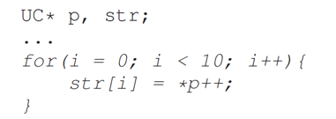
Evaluation
Task Three – gpsbael Project
Date: 2004-10-27
Comment: “Aggressively replace open-coded strncpy for space padded strings in various waypoint send functions”.
Places changed: 37
Method | Performance
Our Technique | Find 37 / 37 places and 25 other places.
Code Clone | Find 36 / 37 places and 23 other places.
Text Search | Find 39 / 37 places and 297 other places by searching “for” or “while”.
Location Example

Slide 26
Evaluation
Task Four – gpsbael Project
Date: 2005-03-21
Comment: “Call waypt_new instead of explicit calloc to prepare for external alt invalid indicator”.
Places changed: 19
Method | Performance
Our Technique | Find 19 / 19 places and 3 other places.
Code Clone | Find 17 / 19 places and 9 other places.
Text Search | Find 19 / 19 places and 86 other places by searching “xcalloc”.
Location Example

Slide 27
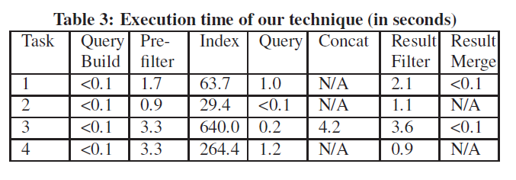
Evaluation
Execution Time
We also recorded the execution time of each step in our technique for performing each of the four tasks.

Slide 28
Thanks
Q&A

