Slide 1
Deriving a Large Scale Taxonomy from Wikipedia
AAAI 2007
Simone Paolo Ponzetto and Michael Strube
EML Research gGmbH
Schloss-Wolfsbrunnenweg 33 69118 Heidelberg, Germany
http://www.eml-research.de/nlp
Dong Xiang
2015.12.24

Slide 2
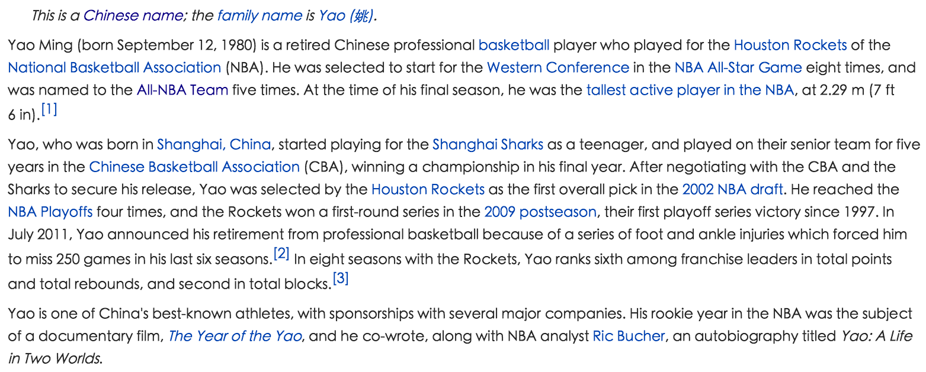
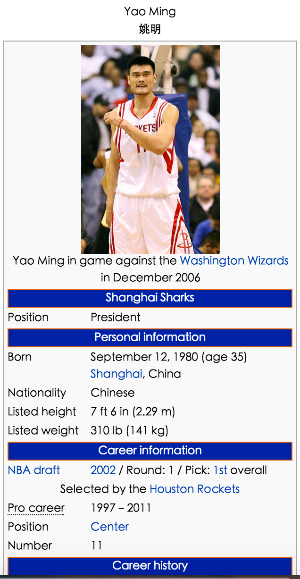
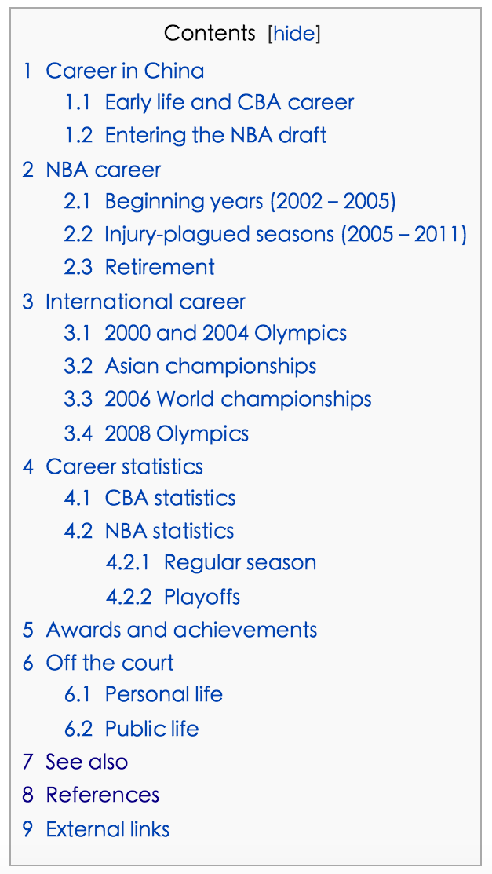
wiki Page
title
abstract
Page
text
content
infobox
category

Slide 3
Outline
Target
Approach
Experiments
Summary

Slide 4
Target
Deriving hypernym-hyponym relations from Wiki Category Network(isa & notisa)

Slide 5
category links
Yao Ming

Slide 6
Approach
1.Category network cleanup
2.Refinement link identification
3.Syntax-based methods
4.Connectivity-based methods
5.Lexico-syntactic based methods
6.Inference-based methods

Slide 7
1.Category network cleanup
Total:165,744 category nodes with 349,263 direct links
Remove WIKIPEDIA ADMINISTRATION
Remain:127,325 categories and 267,707 links
removed nodes:wikipedia, wikiprojects, lists, mediawiki, template, user, portal, categories, articles, pages.

Slide 8
2.Refinement link identification
is-a Relation expressing
Wikipedia users tend to organize many category pairs using patterns such as Y X and X BY Z
EXAMPLE: MILES DAVIS ALBUMS and ALBUMS BY ARTIST
Y
X
—>
X
BY
Z
isa
EXAMPLE: MILES DAVIS ALBUMS ——> ALBUMS BY ARTIST
isa
54,504 category links and leaves 213,203 relations to be analyzed.

Slide 9
3.Syntax-based methods (String)
(1)Head matching
label a category link as isa if the two categories share the same head lemma
e.g. BRITISH COMPUTER SCIENTISTS isa COMPUTER SCIENTISTS
Using: Stanford parser (Klein & Man- ning, 2003)
e.g. both BUILDINGS and INFRASTRUCTURES for BUILDINGS AND INFRASTRUCTURES IN JAPAN

Slide 10
3.Syntax-based methods (String)
(2) Modifier matching
assigning notisa relation to category links
e.g. CRIME COMICS vs CRIME or ISLAMIC MYSTICISM vs ISLAM
Using:Porter stemmer (词干提取算法)
e.g. CRIME COMICS notisa CRIME and ISLAMIC MYSTICISM notisa ISLAM
72,663 isa relations by head matching and 37,999 notisa relations by modifier matching

Slide 11
4.Connectivity-based methods(Structure)
(1)Instance categorization
1.find the page titled as the category or its lemma
2.we then collect all the page’s categories whose lexical head is a plural noun CP = {c1,c2,...cn}
3.for each c’s supercategory sc, we label the relation be- tween c and sc as isa, if the head lemma
of sc matches the head lemma of at least one category cp ∈ CP.
Example:
MICROSOFT
COMPANIES LISTED ON NASDAQ
COMPUTER AND VIDEO GAME COMPANIES
category
head matching
is a

Slide 12
4.Connectivity-based methods(Structure)
(2)Redundant categorization
A ——> B
&
A ——> C
==>
B isa C
or
C isa B
Example:
orange -> fruit and orange -> plant ==> fruit -> plant
finding 9,890 and 11,087 isa relations

Slide 13
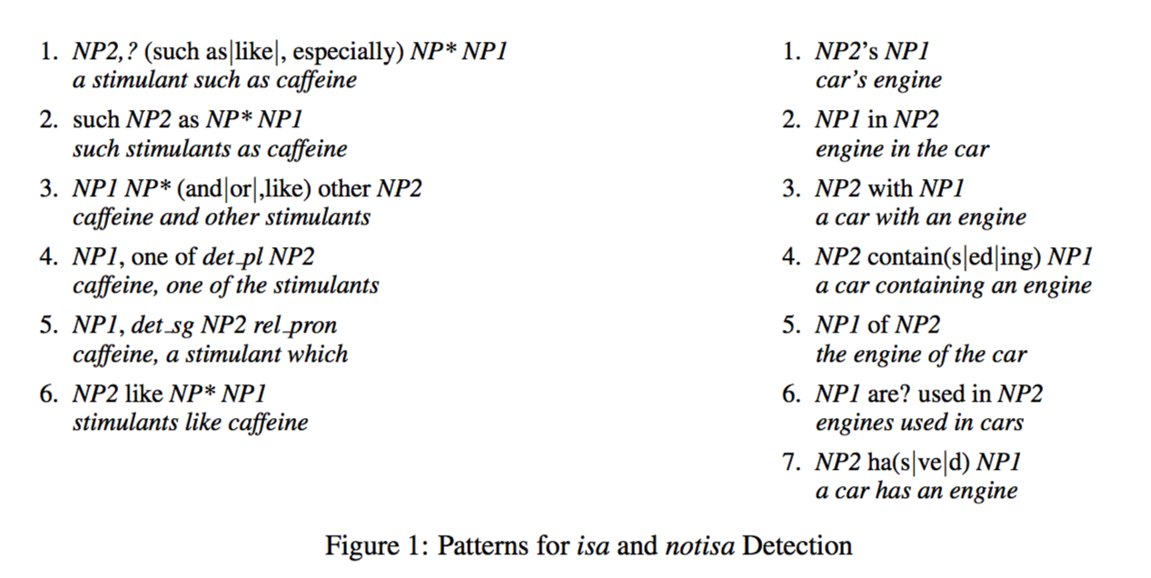
5.Lexico-syntactic based methods(Structure)
left with 81,564 unclassified relations
Text corpora : English Wikipedia (5 × 10⁸ words) , Tipster corpus (2.5 × 10⁸ words) and Harman & Liberman (1993)
only the lexical head of the categories
Create 15,055 isa relations and filter out 3,277 previously identified positive links.

Slide 14
6.Inference-based methods
propagate the previously found relations by means of multiple inheritance and transitivity
Example:
FRUIT isa CROPS and CROPS isa EDIBLE PLANTS
inference
FRUITS isa EDIBLE PLANTS

Slide 15
Experiments

Slide 16
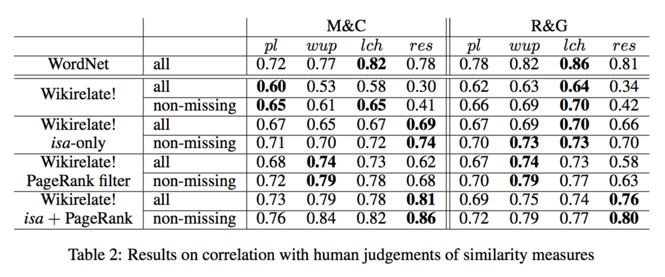
Source:
Two commonly used datasets, namely Miller & Charles’ (1991) list of 30 noun pairs (M&C) and
the 65 word synonymity list from Rubenstein & Goodenough (1965, R&G).
wikirelate!:
Strube & Ponzetto (2006)
PageRank:
(Brin & Page, 1998)
Value: Pearson product-moment correlation coefficient r
removing the top 200 highest ranked PageRank categories
This is because in both cases we are able to filter out categories and category relations which decrease the similarity scores
i.e. coarse-grained categories using PageRank, and notisa (e.g. metonymic, antonymic) semantic relations.

Slide 17
Analysis

Slide 18
Summary

