Slide 1
Finding Expert Users in Community Question Answering
Fatemeh Riahi, Dalhousie University
WWW 2012 – CQA'12 Workshop
Weizhi Huang
2016/11/15

Slide 2
Contents
Background and Motivation
Problem Statement
Methodology
Experiments
Conclusions

Slide 3
Community Question -Answering Websites
CQA services
Ask
Answer
Main problem in CQA services: low participation
Most users are not willing to answer questions or are not experts
Those users willing to answer questions are not aware of the new questions of interest to them
Solutions: finding experts for newly posted questions

Slide 4
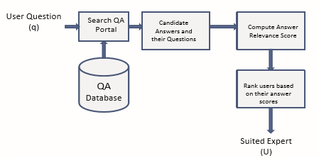
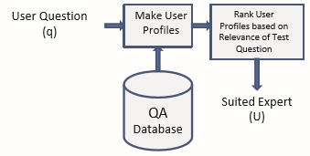
Methods for ﬁnding experts
Two categories
First category : search for relevant answers for a given question and
retrieve a ranked list of users based on their contribution to answers
Second category: build a proﬁle for each expert based on past answers
and use these proﬁles to ﬁnd experts.
Current work in second category
Model user proﬁles by using classical information retrieval approaches
Use lexical similarity measures and retrieve good results if suﬃcient word overlap exists
Our objective is to route new questions to the best suited experts

Slide 5
User profile modeling
Create user proﬁle by combining questions answered by the user for which he has been selected the best answerer
Based on user proﬁles, the relation between the answerer and a new question is measured by using diﬀerent methods.
language models with Dirichlet smoothing
TF-IDF
Latent Dirichlet Allocation (LDA)
Segmented Topic Model (STM)

Slide 6
Contents
Background and Motivation
Problem statement
Methodology
Experiments
Conclusions

Slide 7
Problem Statement
Given a new question q, return a ranked list of users u1, u2,...,un who are best suited to answer q
Probability of user u being the answerer for the question q :
Approximate by speciﬁc information such as user activity
Capture the expertise of user u on question q
Same for all the test questions

Slide 8
Contents
Background and Motivation
Problem statement
Methodology
Experiments
Conclusions

Slide 9
Modeling Expert Search
Diﬀerent methods for ranking users based on their interests
word-based methods | topic models
TF-IDF | LDA
Language model | Segmented Topic Model
Word-based methods ⇒ use a smoothed distribution to estimate the likelihood of a query in a given collection of documents
Topic models ⇒ Documents in these models are a mixture of topics and topics are mixtures of words

Slide 10
TF-IDF
Words that appear only in a small group of documents will have higher tf-idf scores than other words ⇒
Output: a term-by-document matrix , columns represent terms, rows represent documents and each value represents the tfidf weight
size of document collection
number of times w appears in d
number of documents that contain d

Slide 11
TF-IDF
Represent test question and each proﬁle as vectors of their tf-idf weights
Cosine Similarity
tf-idf weight of word w in q

Slide 12
Language Model
Candidate user: a multinomial probability distribution over words in the vocabulary
Question q: represented by a set of words q= {w₁,w₂,...,w_{N}} where w_{i} is a non-stop word
Output: the probability of a question being generated by a candidate user ⇒
number of times word w appears in question q
probability of generating word w from user proﬁle θ

Slide 13
Language Model
Problem : many words not in user profile ⇒ P(w|θu) will be zero
Solution : apply Dirichlet smoothing method for P(w|θu)
Maximum
likelihood
estimation
background language model
control coefficient
Frequency of w in profile
set to 1000
the frequency of words
Total number of words
Notes:
background language model built on the entire collection Q

Slide 14
Latent Dirichlet Allocation
LDA: (i) three-level hierarchical Bayesian model , (ii) each document in collection is modeled as a mixture over a set of topics, (iii) each topic is a distribution over words
Model user proﬁles as a mixture of topics ⇒
question: a vector of Nw words
collection of user profiles: D ={(w1, u1), ..., (wm, un)}
[m: number of words in vocabulary] [n: number of users]
Notes:
将LDA应用到专家发现问题中，需要先将用户的profile建模成一系列的主题。

Slide 15
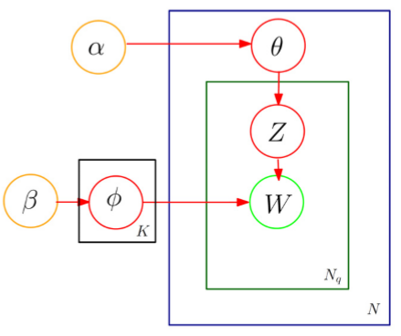
Generative Process of LDA
θ is a matrix of user-proﬁle probabilities for K topics drawn from Dirichlet α prior
Ф is a matrix of topic probabilities for all the words drawn from Dirichlet β prior
z is the topic assigned to word w from θ distribution
w is drawn from the topic distribution corresponding to z

Slide 16
Process of Profile Generating
Choose a topic k ∈{ 1,...,K} from the θ distribution
Pick a word w from the multinomial distribution Фk
⇒ Repeat the process for Nw times where Nw is the total number of words in user proﬁle.

Slide 17
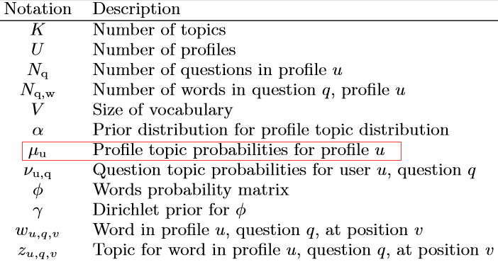
Segmented Topic Model
STM discovers the hierarchical structure of topics by
using the two-parameter Poisson Dirichlet process
allow each question to have a diﬀerent and separate distribution over the topics
Notations
question is considered as segment that contains Nq,w words
Notes:
LDA没有利用profile的结构

Slide 18
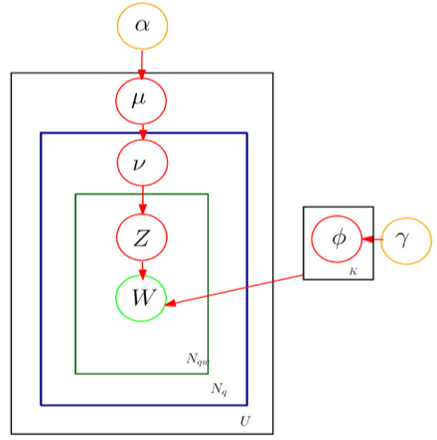
Generative model
User Profile u : a mixture of latent topics denoted
by probability vector μu
Question q :drawn from a probability vector νu,q
for question q of proﬁle u.
Generating user profile
1. Pick μu ∼ Dirichlet(α).
2. For each question q draw νu,q∼ PDP(a,b,μu).
3. For each word wu,q,v choose a topic from zu,q,v ∼ discrete (νu,q)
4. Select a word from wu,q,v∼ discrete(Фzu,q,v).

Slide 19
Contents
Background and Motivation
Problem Statement
Methodology
Experiments
Conclusions

Slide 20
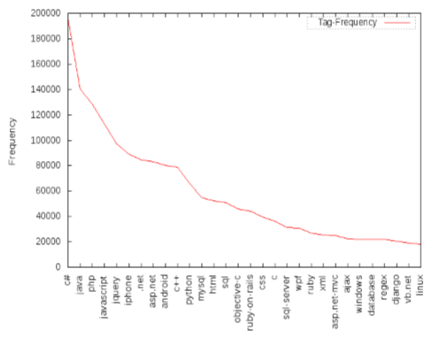
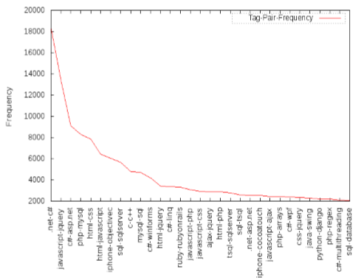
Data Set
Collected from Stackoverﬂow
http://stackoverﬂow.com/
Ranging from Jan 2008 to Jan 2009
Distribution of the most frequent tags
tags tag pairs

Slide 21
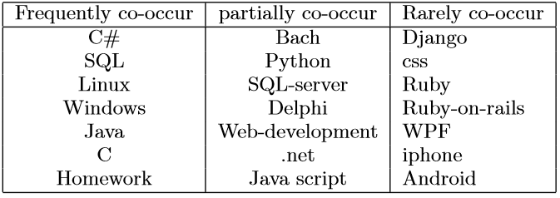
Data Set
Manually select 21 tags
Pick 118510 resolved questions and answers with tags of from the 21 selected tags
Statistics
Questions | Askers | Best Answerers
369440(123933) | 186027 | 22027(1845)

Slide 22
Test Dataset
Best answerers
users who have answered at least N best answers ( N=20)
1845 best answerers
All the questions answered by the best answerers are extracted to build the test dataset.
5128 test questions

Slide 23
Evaluation
Evaluation of ranked best users' quality
Only users who have answered a question are ranked and the
ranking position of the best answerer of the question is taken
Directing the question to all possible users.if the “real“ best answerer is among the top N predicted users, the prediction for that question is considered to be successful
S@N: a model could ﬁnd the actual best answerer of the questions among the top N predicted users
The value of S@N of all the test questions is the average S@N value of the whole test set.
Notes:
评估最终推荐用户的质量是一个比较困难的任务。

Slide 24
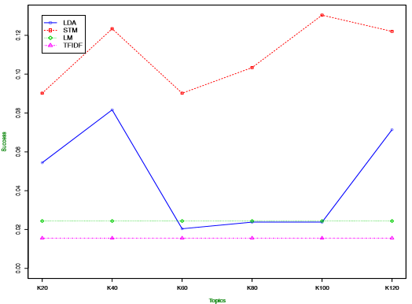
Evaluation Results
Results of S@1 for diﬀerent number of topics
Notes:
TF-IDF和语言模型与主题个数这个参数无关，因此当主题的数量变化时，模型的性能不变。

Slide 25
Evaluation Results
Examples of topics extracted from user proﬁles using the STM and LDA models
STM
LDA
Topics extracted using the STM model are superior compared to the ones extracted using the LDA model.

Slide 26
Evaluation Results
Results of predicting best answerers comparing four different methods
Topic models exhibit much better performance compared to the two traditional information retrieval approaches.

Slide 27
Contents
Background and Motivation
Problem Statement
Methodology
Experiments
Conclusions

Slide 28
Conclusions
Build user’s proﬁles based on their answering history and compare these proﬁles with a newly posted question.
Two statistical topic models are used along with two more traditional approaches.
Statistical topic models can be considered as replacements for more traditional methods in expert recommendation.

Slide 29
Thank You!

