Slide 1
Analysis software quality through user reviews
Qian Zhenzheng

Slide 2
Outline
Motivation
Related work
Methodology
Step
Conclusion

Slide 3
Motivation
Give the users of free software an useful advance
But most users don’t know much about professional vocabulary.

Slide 4
Target
The user can quickly understand without any professional background(analysis user reviews)
Find futures/aspects most user care about(using clustering Algorithm)
The method should be extensible,that means our method could handle any number of reviews.(analysis one kind of software instand of one software)

Slide 5
Related word
Professional software models
openBRR….
ISO9…
Too much manual intervention
hard understand
Big gap between the aspects evaluated and what users really care about

Slide 6
Review analysis/sentiment analysis
Only analysis the sentiment of a sentence

Slide 7
Methodology
Instert picture

Slide 8
Review Preprocessing
Classify informative reviews and non informative reviews
To lower case
Part of speech reduction
Remove punctuation and space
Remove stop words
Chunk

Slide 9
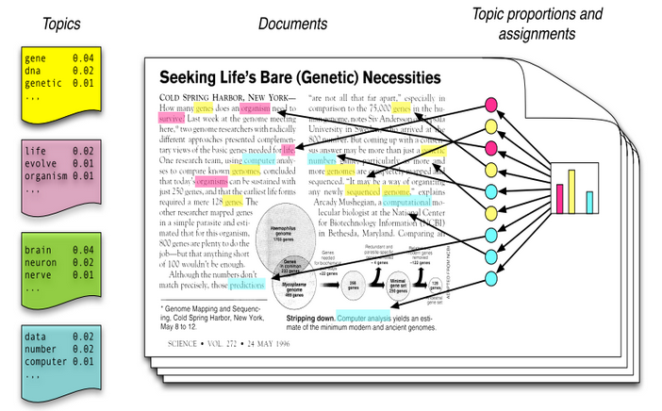
Topic Model

Slide 10
Topic Model

Slide 11
Find the number of topics
Empirical value is not suitable because all the reviews is from the same kind of software
logP(w|T)

Slide 12
SentiSthength
A short txt sentiment analysis tool
url:sentistrength.com
Example:I love dogs very much,but cats I really heat.
keyword: cats 1,-3
keyword: dogs 4,-1

Slide 13
Sentiment Score Of Every Topic
For(every NN or NNS in a review){
w = reduction(NN|NNS);
weigth = maxP(r|z)*P(w|z);
nounStntimentScore = +- max|SentiStrength(NN(S),review)|*weight;
}

Slide 14
Thanks

