Slide 1
PIDGIN: Ontology Alignment using Web Text as Interlingua
22nd ACM International Conference on Information and Knowledge Management, CIKM'13, San Francisco, CA, USA, October 27 - November 1, 2013. Derry Wijaya, Partha Pratim Talukdar, Tom Mitchell
Carnegie Mellon University 5000 Forbes Avenue Pittsburgh, PA
{dwijaya@cs.cmu.edu, ppt@cs.cmu.edu, tom.mitchell@cs.cmu.edu. }
Dong Xiang
2016.04.18

Slide 2
Outline
Ontology Alignment
PIDGIN
Experiments
Summary

Slide 3
ontology Alignment
What is Ontology Alignment ?

Slide 4
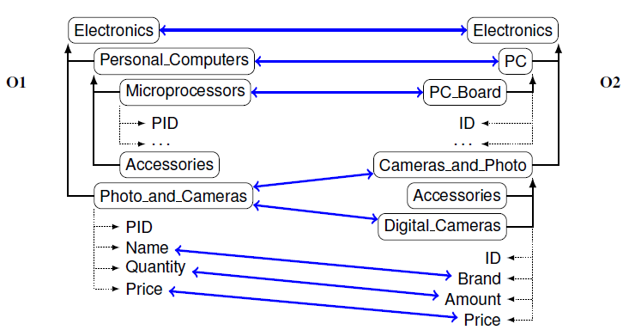
ontology Alignment
An ontology defines the basic terms and relations comprising the vocabulary of a topic area, as well as the rules for combining terms and relations to define extensions to the vocabulary

Slide 5
ontology Alignment
Significance and Challenges ?

Slide 6
ontology Alignment
Significance: Ontology Alignment is used for Ontology Combination and Mechanical Translation
Challenges: The problem of aligning ontologies and database schemas across different knowledge bases and databases is fundamental to knowledge management problems, including the problem of integrating the disparate knowledge sources that form the semantic web’s Linked Data

Slide 7
ontology Alignment
Related works

Slide 8
ontology Alignment
1.Prateek Jain等在[1]中使用了维基百科作为外部知识库，扩充了本体中概念的语义表示
2.Ningsheng Jian等在[2]介绍了本体对齐系统Falcon-AO。基于语言学相似度计算方法，采用基于结构的相似度实现对齐
3.Juanzi Li等人开发了RiMOM框架[3]，通过整合了多种相似度策略，通过对不同的任务设置不同的参数，以此达到较好的对齐结果
…
[1] Jain P, Hitzler P, Sheth A P, et al. Ontology alignment for linked open data[M]//The Semantic Web–ISWC 2010. Springer Berlin Heidelberg, 2010: 402-417.
[2] Jian N, Hu W, Cheng G, et al. Falcon-ao: Aligning ontologies with falcon[C]//Proceedings of K-CAP Workshop on Integrating Ontologies. 2005: 85-91.
[3] Li J, Tang J, Li Y, et al. Rimom: A dynamic multistrategy ontology alignment framework[J]. Knowledge and Data Engineering, IEEE Transactions on, 2009, 21(8): 1218-1232.

Slide 9
Outline
Ontology Alignment
PIDGIN
Experiments
Summary

Slide 10
PIDGIN
Background: PARIS
PARIS is a ontology alignment tools which uses the overlap of instances between two relations (or categories) from a pair of KBs as one of the primary cues to determine whether an equivalence or subsumption relationship exists between those two relations (or categories).
What about the aligned relations with low overlap ?

Slide 11
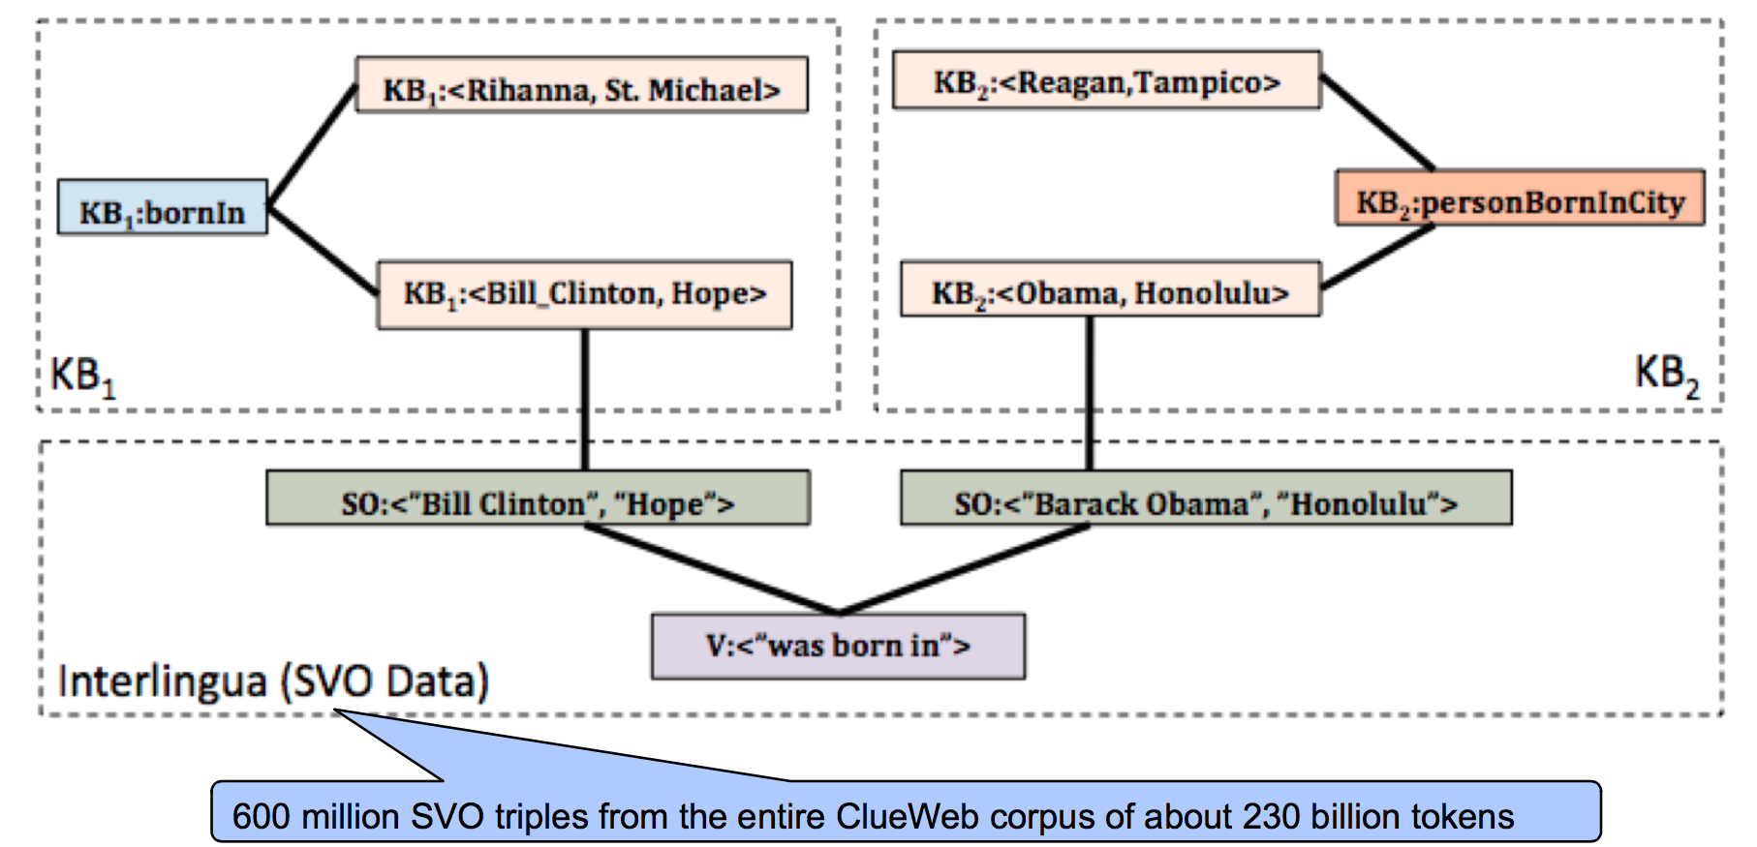
PIDGIN
PIDGIN: Employs a very large natural language text corpus as an interlingua to relate different knowledge bases.It based on Graph.

Slide 12
PIDGIN
Stage 1: Graph Construction
1)Relation-Entity Pair edge:
For each (e1 , r, e2 ) 2 IRk 8k 2 {1,2}, add vertices a = KBk:r and b = KBk:<e1,e2> to V, add the edge (a,b) to E, and set Wa,b = Wb,a = 1.0.
For example:
KB1:bornIn, KB1:<Bill Clinton, Hope>
KB2:personBornInCity, KB2:<Barack Obama, Honolulu>

Slide 13
PIDGIN
Stage 1: Graph Construction
2)Entity Pair-NP Pair edge:
For example:
KB1:<Bill Clinton, Hope>, SO:<”Bill Clinton”, ”Hope”>
KB2:<Barack Obama, Honolulu>, KB2:<“Barack Obama”, “Honolulu”>

Slide 14
PIDGIN
Stage 1: Graph Construction
3)NP Pair-Verb edge
Example: (SO:<”Bill Clinton”, ”Hope”>, ”was born in”)
(SO:<“Barack Obama”, “Honolulu”>, “was born in”)

Slide 15
PIDGIN
Output of Stage 1: Graph(V,E,W)

Slide 16
PIDGIN
Stage 2: Alignment as Classification over Graph
PIDGIN generates two labels and injects them as seed labels into nodes of the graph G, get the confidence of operation from Modified Adsorption (MAD)
1)Equivalence Alignment
2)Subsumption Alignment
Finally, we get the result Graph(V,E,W)

Slide 17
Outline
Ontology Alignment
PIDGIN
Experiments
Summary

Slide 18
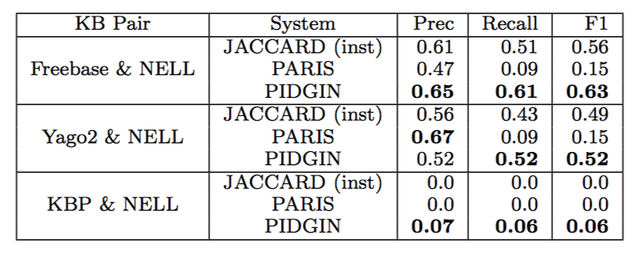
Experiment1: whether PIDGIN improves precision, recall and F1- score of relation and category alignments.(vs. PARIS)

Slide 19
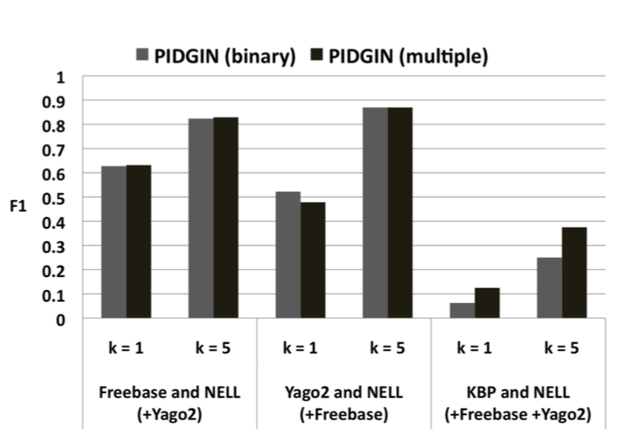
Experiment2: alignment for Two source vs. Multiple source

Slide 20
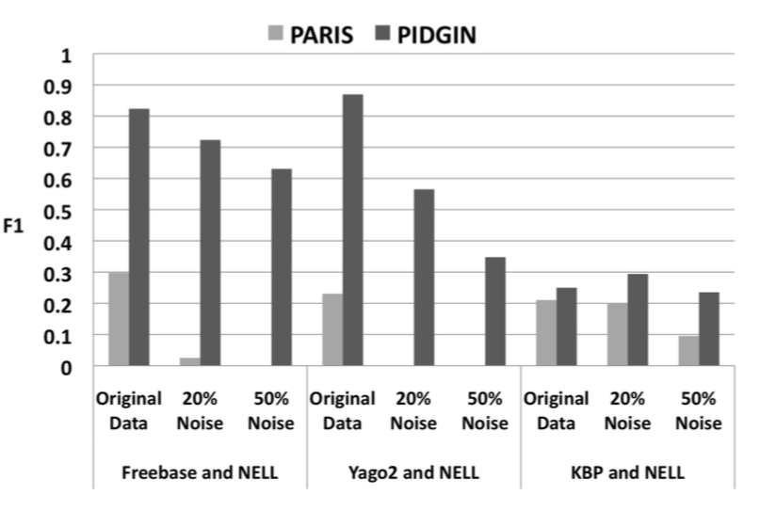
Experiment3: The Noise tolerant of PIDGIN

Slide 21
Outline
Ontology Alignment
PIDGIN
Experiments
Summary

Slide 22
PIDGIN
Summary

Slide 23
Thanks

