Slide 1
Extract Reliable Relations from Wikipedia Texts for Practical Ontology Construction
Computación y Sistemas, Journal, 2016
Jin-Xia Huang^{1,2}, Kyung Soon Lee², Key-Sun Choi³, Young-Kil Kim¹
Carnegie Mellon University 5000 Forbes Avenue Pittsburgh, PA
{dwijaya@cs.cmu.edu, ppt@cs.cmu.edu, tom.mitchell@cs.cmu.edu. }
Dong Xiang
2016.11.8

Slide 2
Outline
Relations Extraction
Methods of this paper
Method Description
Feature Selection
Experiments
Summary

Slide 3
Relations Extraction
The Kinds of Relations：
Intra-sentence relationship：The two related entities are in the same sentence
Inter-sentence relationship: occur in different sentences but in same section or document
Explicit relation: If there are constituents in a common syntactic structure with two entities explicitly convey a relation type, like “consist of” for part- whole relation, “be a kind of” for isa relation
Implicit relation: like entities car and window in expression of “car window”

Slide 4
Relations Extraction
The Process of Relations Extraction:
Three steps – Entity detection, Relation detection & Relation classification.
Entity detection: recognizes entities from contexts.
Relation detection: extracts two related entities from texts and detects if they have relationship with each other.
Relation classification: classifies detected relations to certain relation types.

Slide 5
Relations Extraction
Two Methods:
Supervised approach: have been broadly employed for relation extraction and relation classification
Kernel-based approach: compute similarities between parse trees or strings using different kernel functions

Slide 6
Feature-based approache
Feature-based approach: investigate various features including lexicon, part-of-speech (POS) information, syntactic information and semantic information to represent relation candidates, and classify the relations
Classifiers: support vector machines (SVM), maximum entropy model (MEM) based classifiers, and deep neural networks (DNN)

Slide 7
Extract Reliable Relations from Wikipedia Texts for Practical Ontology Construction
Computación y Sistemas, Journal, 2016
Jin-Xia Huang^{1,2}, Kyung Soon Lee², Key-Sun Choi³, Young-Kil Kim¹
Carnegie Mellon University 5000 Forbes Avenue Pittsburgh, PA
{dwijaya@cs.cmu.edu, ppt@cs.cmu.edu, tom.mitchell@cs.cmu.edu. }
Dong Xiang
2016.11.8

Slide 8
Outline
Relations Extraction
Methods of this paper
Method Description
Feature Selection
Experiments
Summary

Slide 9
Method Description
Aiming at building IT domain ontology from texts, we focus on the problem of relation classification on intra-sentence relation candidates.
– isa: can be a subclass relationship between two classes, or an instanceOf relationship between an instance and a class (it means, this paper does not distinct either a term is a class or an instance). be, be a from of, such as
– usedFor: in a relation of “A usedFor B”, domain A can be used for, or used in B.
be used for, be used as, be available for
– produces: “A produces B” indicates B is generated, created, or manufactured from empty, by A. produce, invent, establish
– provides: “A provides B”, means B is an existing one, but offered, provided, or supported by A. provide, offer, invest

Slide 10
Outline
Relations Extraction
Methods of this paper
Method Description
Feature Selection
Experiments
Summary

Slide 11
Features for Wikipedia concepts I.
1. Frequency - the occurrence frequency of the candidate concept and its synonyms in the tag’s wiki page.
2. First Occurrence - the distance between the start of the tag’s wiki page and the first occurrence of the candidate concept.
3. Last Occurrence - the distance between the end of the tag’s wiki page and the last occurrence of the candidate concept.
4. Spread – the distance between the first and last occurrences of the candidate concept.

Slide 12
Features for Wikipedia concepts II.
5. Max Link Probability - the ratio of the number of times it occurs in Wikipedia articles as a hyperlink.
6. Average Disambiguation Confidence - each term in the wiki page can only correspond to a single concept that has the highest probabilistic confidence.
7. Max Disambiguation Confidence - the maximum disambiguation confidence value of a candidate concept that appear in the tag’s wiki page.
8. Link-based Relatedness to Other Concepts - according to the number of Wikipedia concepts that discuss/mention and have hyperlinks to both the two concepts being compared.(Wikipedia Link-based Measure)
9. Link-based Relatedness to Context - the relatedness of the candidate concept is only measured against those of other candidate concepts in the tag’s wiki page that are unambiguous.

Slide 13
Building a training and testing dataset
Adopt a semi-supervised labelling method to build our required dataset. This method consists of two main stages :
1> The tag’s wiki page should contain one or more hyperlinks to Wikipedia articles.
2> One of those hyperlinks should be to the Wikipedia article corresponding to the first Wikipedia concept detected in the tag’s wiki page.

Slide 14
Using Connexor parser
“Application streaming is a relatively new form of software distribute method using
application virtualization”

Slide 15
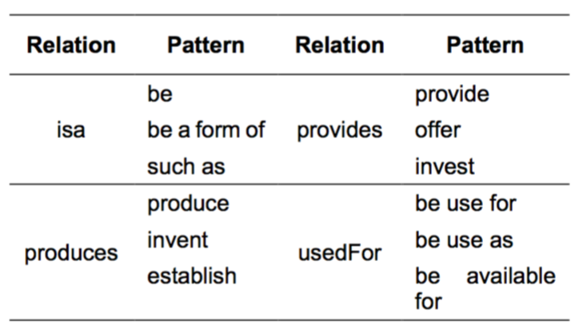
The Whole Process
1. Building training dataset: patterns & Connexor parser
result: get IT domain training dataset

Slide 16
The Whole Process
2. Extracting Concepts from Wikipedia & filtering
Using WordNet to gain IT domain
result: get IT domain Entities

Slide 17
The Whole Process
3. Feature & Classifiers building
Using Maximum Entropy Model (MEM)
result: get 4 Classifiers: isa, provides, produce, usefor

Slide 18
Outline
Relations Extraction
Methods of this paper
Method Description
Feature Selection
Experiments
Summary

Slide 19
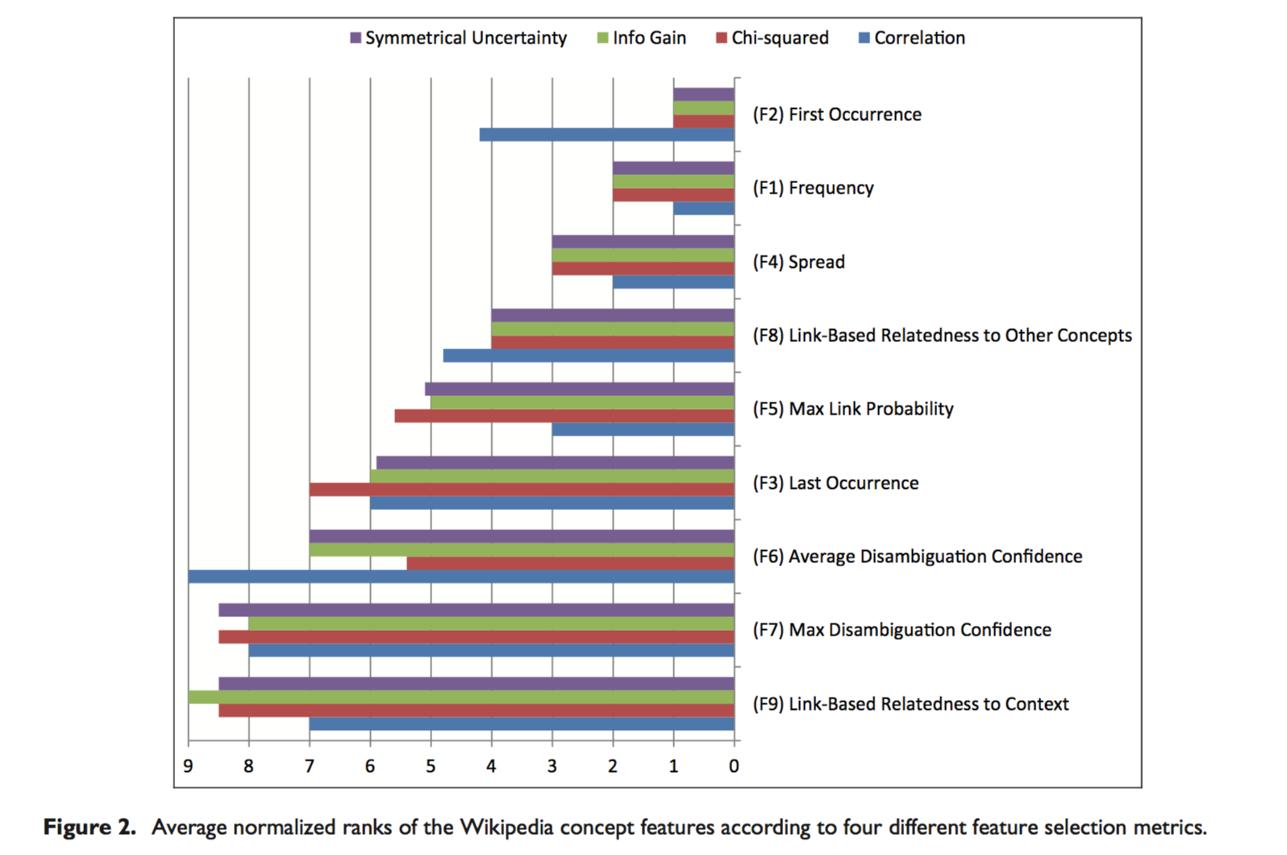
Experiment1:
Ranks of Wikipedia concept features

Slide 20
Experiment2:

Slide 21
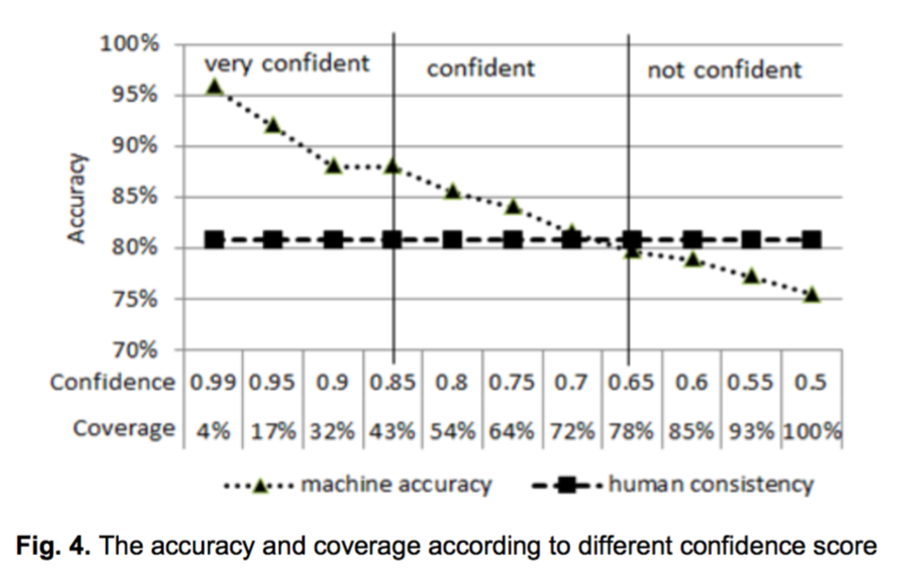
Experiment3:

Slide 22
Outline
Relations Extraction
Methods of this paper
Method Description
Feature Selection
Experiments
Summary

Slide 23
PIDGIN
Summary

Slide 24
Thanks

