Slide 1
Seventh IEEE International Conference on Data Mining
Language-Independent Set Expansion of Named Entities using the Web
Richard C. Wang and William W. Cohen
Language Technologies Institute
Carnegie Mellon University
Pittsburgh, PA 15213 USA
Kai Chen
2015.10.15

Slide 2
Outline
Introduction
Approach
Algorithm
Experiment
Summary
Our related work

Slide 3
Introduction
Question:
How can we get all concepts in some domain?
NBA team
Country
Software Programming

Slide 4
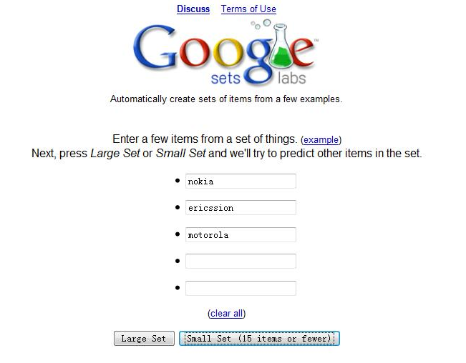
Introduction

Slide 5
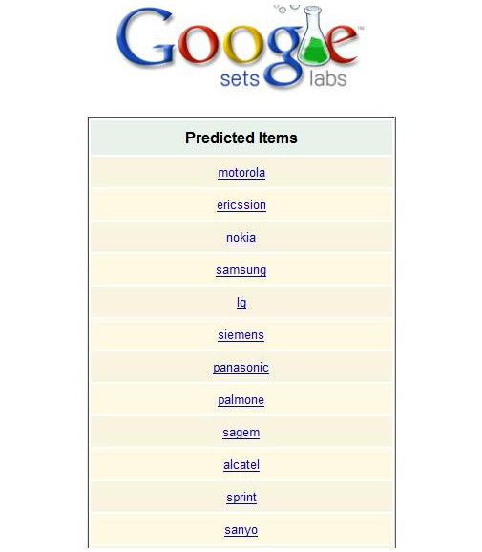
Introduction

Slide 6
Introduction
Relevancy
Nokia 275,000,000 pages
Motorola 137,000,000 pages
nokia AND motorola 76,400,000 pages
76,400,000/(275,000,000 + 137,000,000 - 76,400,000) = 0.22765196662693682=22.8%

Slide 7
Introduction
SEAL
Set Expander for Any Language
superior to Google Sets
Notes:
Google Set only for English.

Slide 8
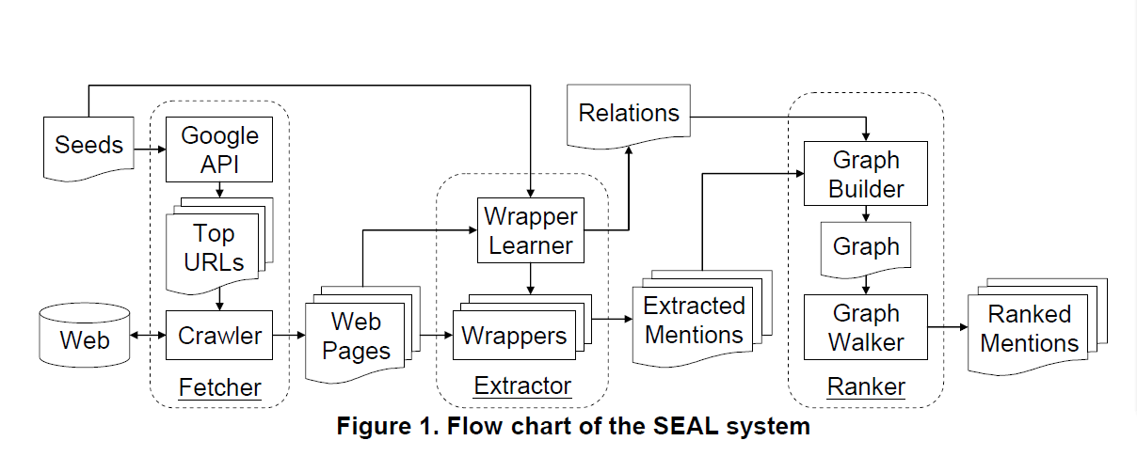
Approach

Slide 9
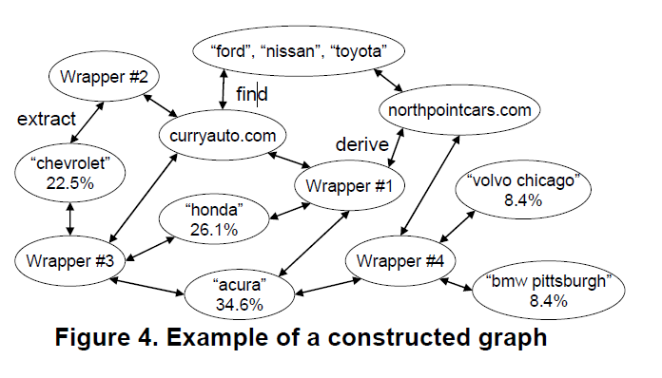
Approach

Slide 10
Algorithm
Wrapper Extract
extract
extract

Slide 11
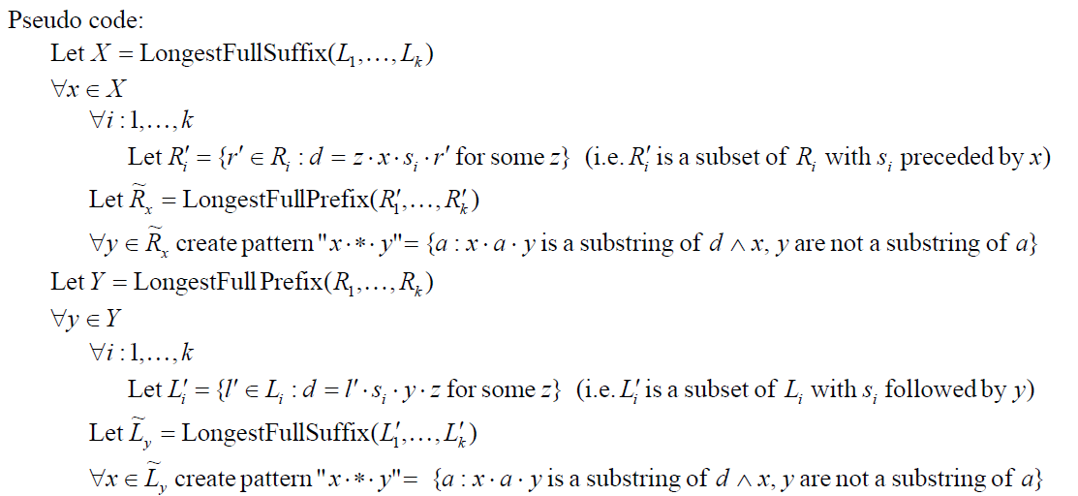
Algorithm
Wrapper Extract

Slide 12
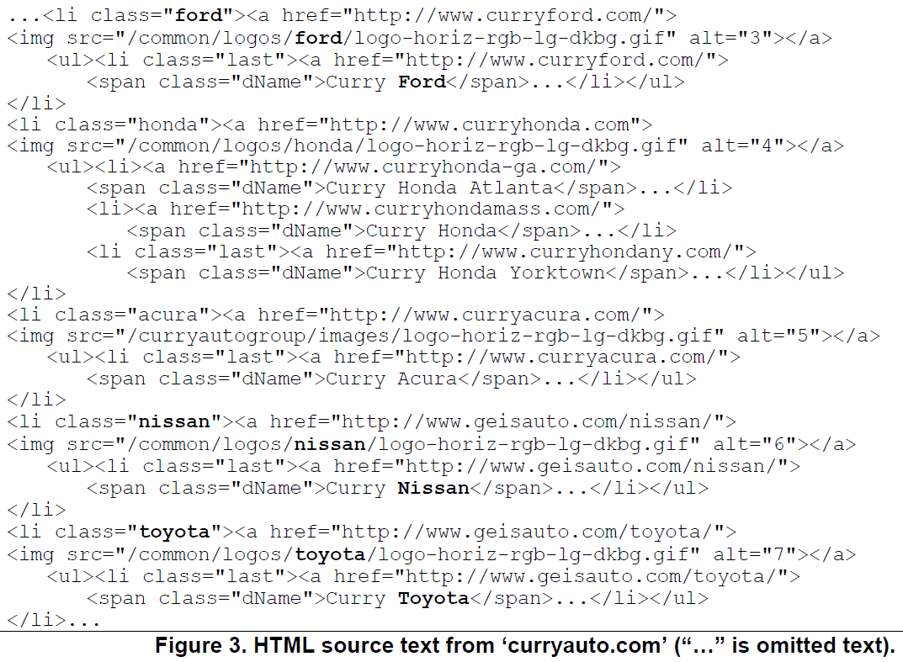
Algorithm

Slide 13
Algorithm

Slide 14
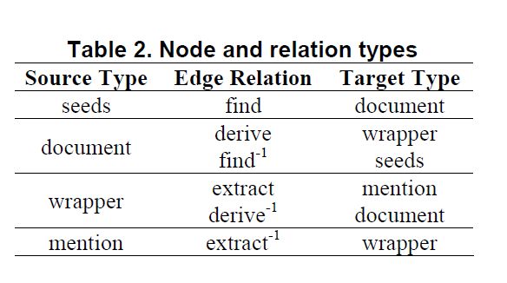
Algorithm
Graph Walker

Slide 15
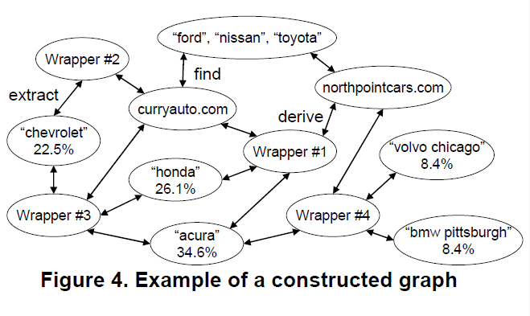
Algorithm

Slide 16
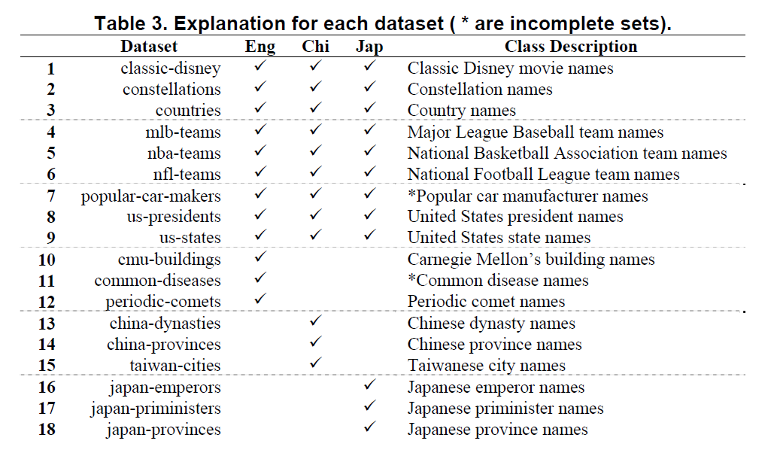
Experiment

Slide 17
Experiment
MAP
mean average precision

Slide 18
Experiment
Steps:

Slide 19
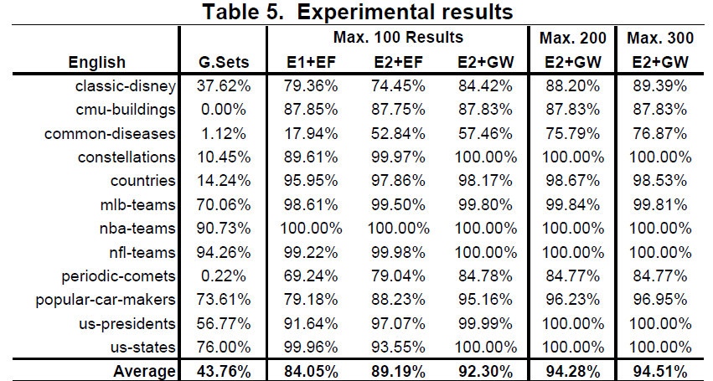
Experiment
E1,E2: - Wrapper Extract Algorithm
EF,GW: - Ranker Algorithm

Slide 20
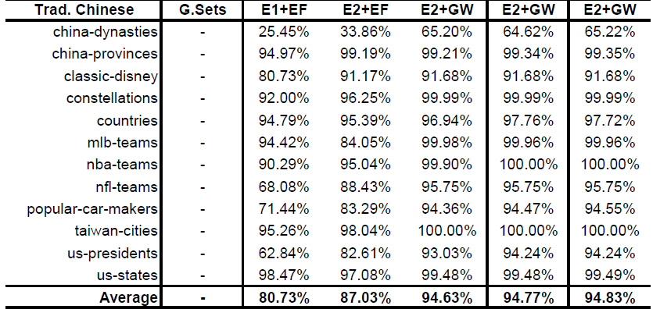
Experiment

Slide 21
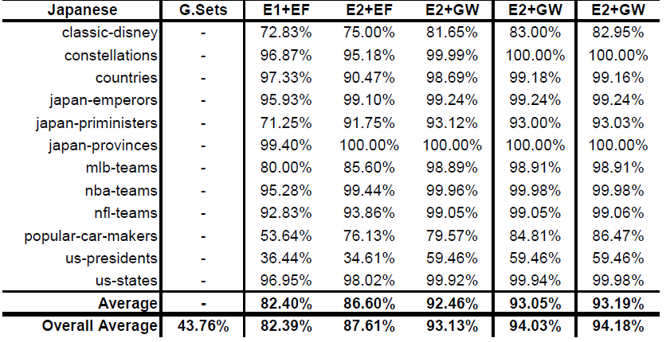
Experiment

Slide 22
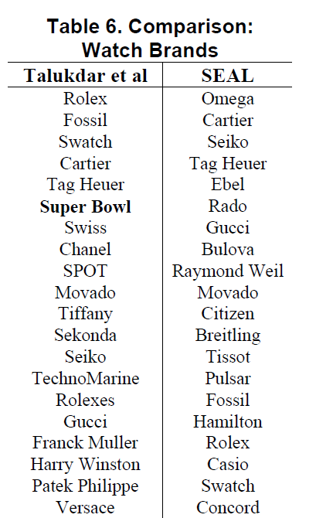
Experiment
17 Seeds
3 Seeds

Slide 23
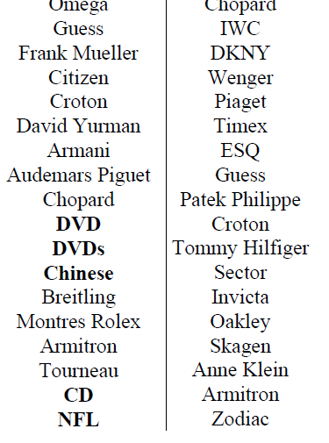
Experiment

Slide 24
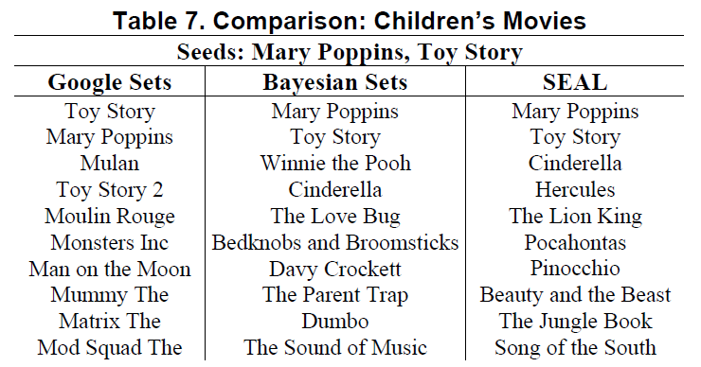
Experiment
Google Sets VS Bayesian Sets VS SEAL

Slide 25
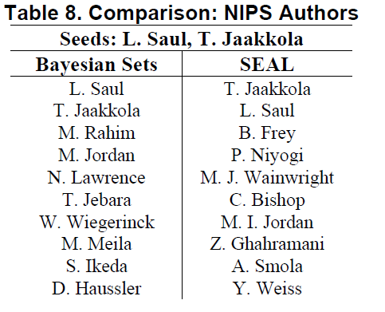
Experiment

Slide 26
Summary
1. superior to Google Sets Why?
2. superior to Bayesian Sets Why?

Slide 27
Faultiness
1. Specific VS Fuzzy
2. Seeds Select
3. Algorithm

Slide 28
Our Related Work
Link Open Data
Wikipedia concepts
SWBOK concepts
Software Programming

Slide 29
How Can We Do
1.Stack Overflow Tags -> Semantic correlation
2.Wikipedia Links Mining
3.Set Expansion Web->Wiki Context

Slide 30
Some Advices for US
Thanks
Q&A

